Slide 1
BeadLoom Game
by Dustin Culler
daculler@uncc.edu
Acey Boyce
akboyce@uncc.edu
Antoine Campbell
acampbel@uncc.edu
Shaun Pickford
sgpickfo@uncc.edu
Dr. Tiffany Barnes
tiffany.barnes@uncc.edu

Slide 2
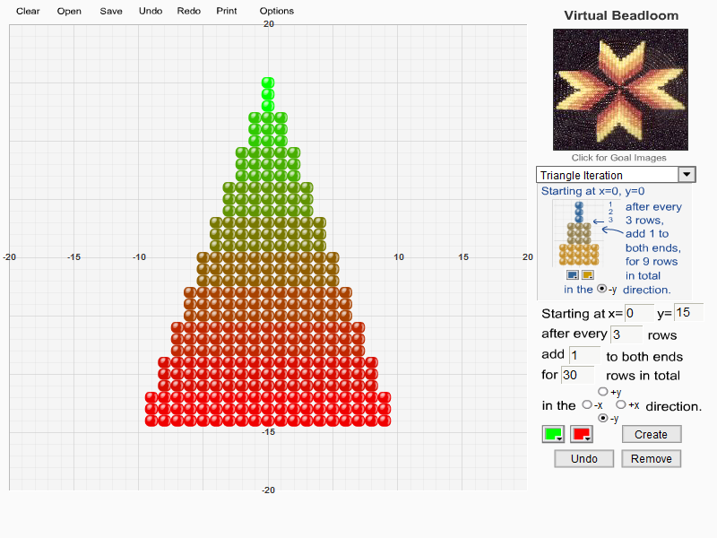
Motivation
Virtual Bead Loom
Create Puzzles
Mimic actual Bead Loom art
Use iteration and Cartesian coordinates
Dustin Culler – BeadLoom Game
2
Notes:
Motivation is Virtual Bead Loom.
Ron Eglash CSDT
Teach math and computing through culture
Create custom art
Mimic goal image
The motivation for BeadLoom Game is Virtual Bead Loom. Virtual Bead Loom is a tool that was created by Ron Eglash as a Culturally Situated Design Tool or CSDT. The purpose for the CSDT’s he has created are to teach math and computing through culture. In this tool students can create custom bead loom art or try to mimic art that is displayed in the goal image window near the top right corner of the program.

Slide 3
Virtual Bead Loom
Designed to teach
Cartesian Coordinates
Iteration
Pros
Allows for creativity
Students avoid advanced functions
Lack of replayability
Cons
Dustin Culler – BeadLoom Game
3
Notes:
VBL teaches cartesian coords, iteration, and layering
Itroduces concepts in new ways
Drawbacks
no creative solutions
Virtual Bead Loom has been used to teach Cartesian coordinates, iteration and the painters algorithm. Virtual Bead Loom is a useful tool for introducing these concepts to students in a new and interesting way. However it does have a few drawbacks. Students who use Virtual Bead Loom rarely use the more complex functions such as iteration and feel little need to complete bead loom art efficiently and rarely think of new creative solutions to the art they try and mimic. Students also seem to have little motivation to continue using the tool.

Slide 4
3 Step Process
BeadLoom Game
CSDT Social Website
Dance Tool
Dustin Culler – BeadLoom Game
4

Slide 5
Implementation
Based on Java port of Virtual Bead Loom
Built as a Java Applet to be played online
Added game mode
Created a containing website
Dustin Culler – BeadLoom Game
5
Notes:
To implement BeadLoom Game we used a Java port of the original Virtual Bead Loom. It was created as an applet so that students could access it from a web browser make it more accessible for teachers as well as students wanting to play from home. We took the tool and added a game mode with all the features and functionality we needed as well was features we wanted to test. We also created a website in which students could log in and play BeadLoom Game as well as view their achievements, leaderboards, and custom puzzle ratings. We also implemented many of the features so that they can be easily turned off and on without affecting other portions of gameplay.

Slide 6
Implemented Features
Original Java Port
BeadLoom Game
Displayable Grid
Bead Functions
Undo
Resolution Independent
Scalable Bead Size
Puzzle Thumbnails
Custom Puzzles
Menu System
Game Mode
XML Puzzles
Bead Images Options
Avatars
Ghost Bead Previews
Server Side Login
Server Side Scores
Achievements
Dustin Culler – BeadLoom Game
6

Slide 7
Hypotheses
BeadLoom Game will provide stronger internal motivation to explore advanced functions.
BeadLoom Game will have higher learning gains than Virtual Bead Loom.
Dustin Culler – BeadLoom Game
7
Notes:
Our Hypotheses for Bead Loom Game is that
BeadLoom Game will provide stronger internal motivation to explore advanced functions.
and, BeadLoom Game will have higher learning gains than Virtual Bead Loom.

Slide 8
Video
Dustin Culler – BeadLoom Game
8

Slide 9
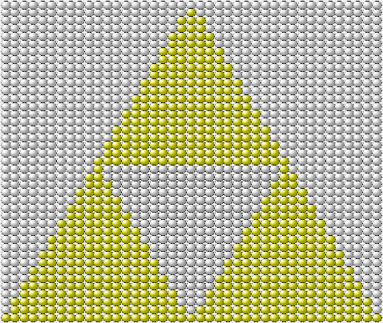
Can you solve this puzzle?
Dustin Culler – BeadLoom Game
9
Notes:
This is one of the puzzles in BeadLoom Game. Can you complete this puzzle in the least number of moves? Hint: The background is a big white rectangle.

Slide 10
Step 1
Dustin Culler – BeadLoom Game
10
Notes:
This is one of the puzzles in BeadLoom Game. Can you complete this puzzle in the least number of moves? Hint: The background is a big white rectangle.

Slide 11
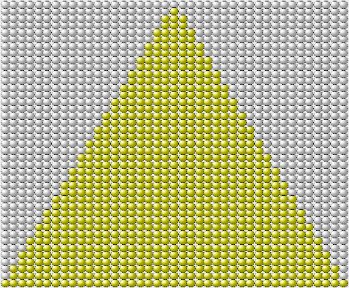
Step 2
Dustin Culler – BeadLoom Game
11
Notes:
This is one of the puzzles in BeadLoom Game. Can you complete this puzzle in the least number of moves? Hint: The background is a big white rectangle.

Slide 12
Step 3
Dustin Culler – BeadLoom Game
12
Notes:
This is one of the puzzles in BeadLoom Game. Can you complete this puzzle in the least number of moves? Hint: The background is a big white rectangle.

Slide 13
Research Studies
Two UNCC summer camps
Middle School
High School
Data Collection
Pretest
Mid-Session test
Post test
Logs
High Scores
Custom Puzzles
Dustin Culler – BeadLoom Game
13
Notes:
This summer we were able to test BeadLoom Game with two different UNCC summer camp groups. Each group spent 5 days using Virtual Bead Loom, BeadLoom Game and other CSDTs from Ron Eglash’s CSDT site.
Students where given a pretest before using any software, a Mid-Session Test after they used their first tool, of which half used BeadLoom Game and half used Virtual Bead Loom and finally the post test at the end of the week. During the week the students had set times to use specific software and other times they were allowed to pick what they worked on. During these times the software that students choose to work on was documented.

Slide 14
Studies
Middle School Summer Camp
Pretest to Post test
Layering
Out of 21 students
16 preferred BeadLoom Game
5 preferred Virtual Bead Loom
Two-sample t-test for unequal variances
Iteration and Layering
Two-sample t-test for unequal variances
t(21) = -3.58, p <= 0.05
t(21) = -2.99, p <= 0.05
 | M | SD | N
Pre | 0.24 | 0.19 | 21
Post | 1.38 | 1.95 | 21
 | M | SD | N
Pre | 2.32 | 1.01 | 21
Post | 3.83 | 4.33 | 21
Dustin Culler – BeadLoom Game
14
Notes:
The results from the middle school summer camp showed statistically significant learning gains with from pre to post test for layering and iteration and layering. Students also seemed to enjoy BeadLoom Game and where more engaged. For Cartesian coordinates, learning gains were not statistically significant. However, the types of errors they were making did show some learning was occurring because most of them went from leaving it blank and negative positive reversals to off by one errors. On the post survey, 16 out of 21 students reported that they preferred BeadLoom Game over Virtual Bead Loom. The high school summer camp tests and surveys have yet to be graded or analyzed. The high schoolers did choose BeadLoom Game to Virtual Bead Loom 14 to 5.

Slide 15
Pre to post test score comparison
Dustin Culler – BeadLoom Game
15

Slide 16
High School post survey response
“The game forces me to use more complicated iterations to improve my score, which makes it a fun activity and a good learning tool.”
Dustin Culler – BeadLoom Game
16
Notes:
On the post survey one student explained why he preferred BeadLoom Game to Virtual Bead Loom. Quote “The game forces me to use more complicated iterations to improve my score, which makes it a fun activity and a good learning tool”

Slide 17
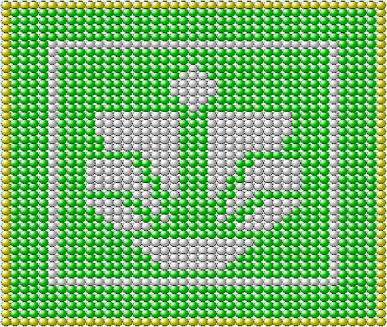
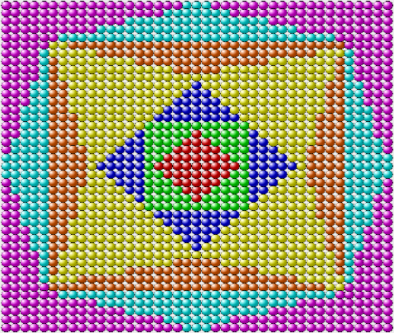
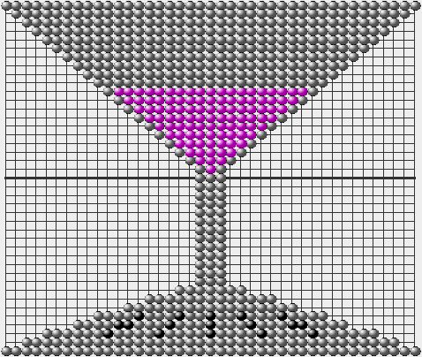
Custom Puzzles
Dustin Culler – BeadLoom Game
17
Notes:
13 of 21 enjoyed creating and solving customs
These are some of the custom puzzles that where created by the middle and high school summer camps in the custom puzzle mode of the game. Players can view and play each others custom puzzles to try and get the least amount of moves and the fastest time.

Slide 18
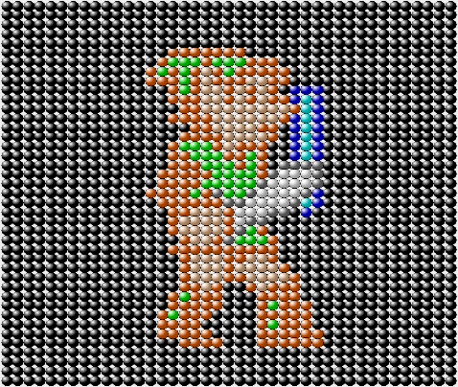
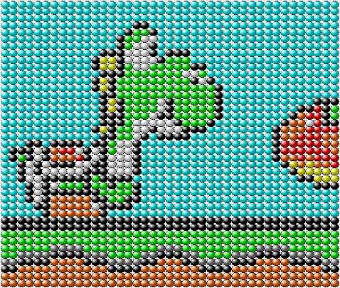
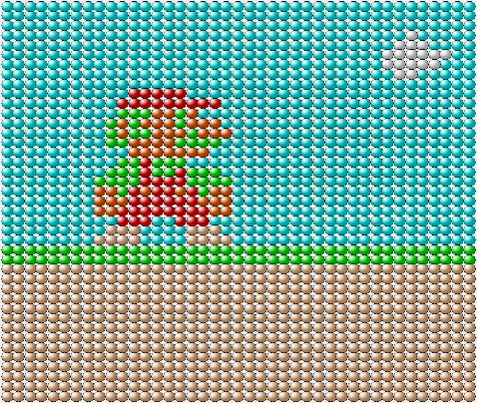
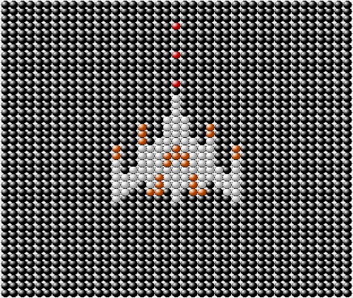
Custom Puzzles
Dustin Culler – BeadLoom Game
18
Notes:
This is some more 8-bit art that was created during the two summer camp sessions. Some of the students even spent time at home outside of the camp creating custom art, as well as competing on the leaderboards with standard puzzles.

Slide 19
Custom Puzzles
Mid Survey 57% preferred BeadLoom Game
Post Survey showed a 75% increase in the number of students that preferred BeadLoom Game
62% stated custom puzzle creation and solving was their favorite feature
Dustin Culler – BeadLoom Game
19
Notes:
Direct increase in student motivation to play/replay due to custom

Slide 20
Future work
Full integration into CSDT Social site.
Test BeadLoom Game with different features enabled to determine which features provide learning gains.
Dustin Culler – BeadLoom Game
20
Notes:
Future work with BeadLoom Game will lead to a full integration into the CSDT Social site so that users can view achievements and leaderboards across several different CSDT based games and tools.
Future research and studies for BeadLoom Game will determine which features of BeadLoom Game facilitate learning and engagement to provide data with what contributes to the learning gains of educational games.

Slide 21
Take Away
Java Applet
Java/PHP interaction
XML
Unity Game Engine
Drupal
Dustin Culler – BeadLoom Game
21
Notes:
This summer has proved to be a valuable experience for me in many aspects. I have worked with one of the most talented teams I have ever worked with on any computer science based project. I have also vastly expanded my knowledge of Java Applets and Java Archives. I also learned more about integrating a Java Applet into a PHP based website and how to communicate data between the client and server sides. To facilitate this communication of data I had to extend my knowledge of XML. I was also introduced to the Unity Game Engine for the development of Dance Tool. Finally, I have learned a lot about Drupal for the creation of the CSDT Social site.

Slide 22
Questions?
Dustin Culler – BeadLoom Game
22

