Slide 1
A Museum Monitoring Application Using PAQ Middleware
Cory Shields

Slide 2
Problem
PAQ Middleware
Showcase benefits
Socially relevant
Done in two months
Proposed situations
Museum object preservation
Triage

Slide 3
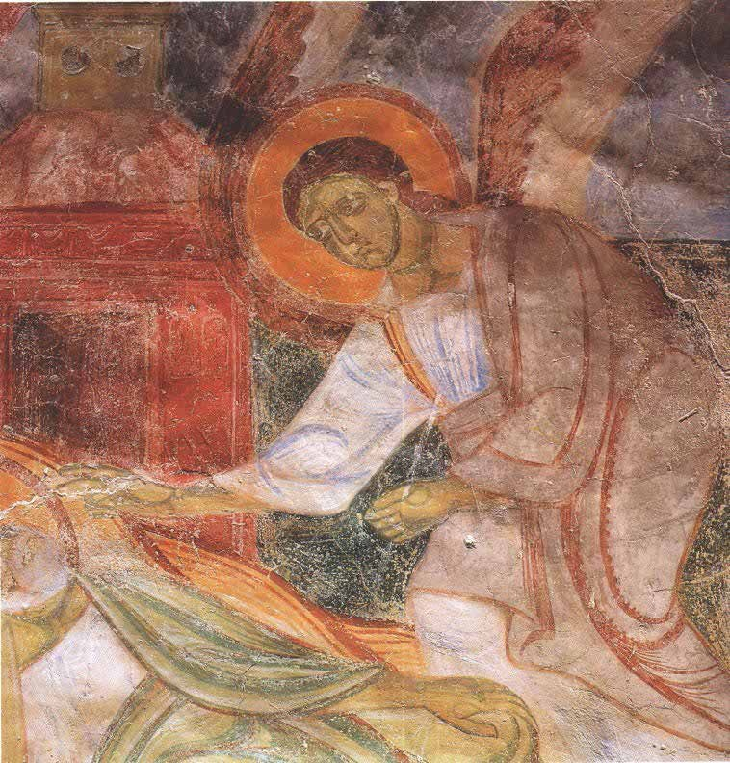
Museum Object Preservation
Motivation:
Socially relevant
Demonstrates many PAQ benefits
Possibility of real world tests
Many of the current systems are inadequate

Slide 4
Current System
Later…
Notes:
Has to plug it in!

Slide 5
Museum Object Preservation
Environmental impact
Temperature
Summer: 70-75 degrees Fahrenheit
Winter: 65-70 degrees Fahrenheit
Humidity
Summer: 45%-55%
Winter: 40%-45%
Light
As low as possible
Notes:
Kept these in mind when developing our introspection strategies. Gained from talking with preservation experts. Environmental

Slide 6
Museum Application Requirements
Original requirements
Monitor environmental factors and report to a database
Allow for quick and easy analysis
Flexibility
Economic, and environmental factors must be taken into account

Slide 7
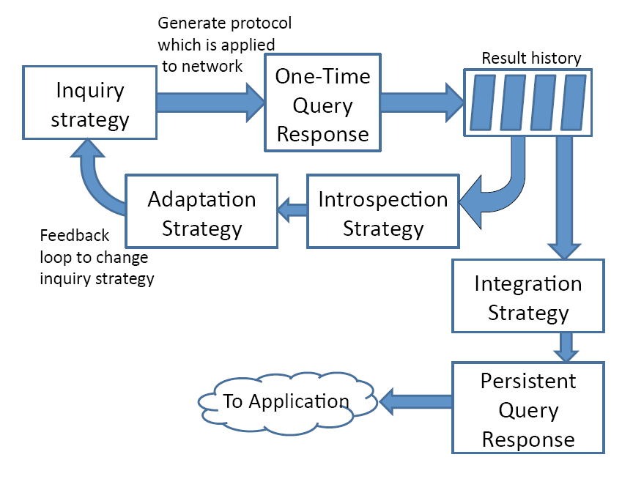
PAQ Middleware
Provides API that simplifies development of applications with persistent adaptive queries
Notes:
PAQ solves all of the issues listed before

Slide 8
Adaptation Example
Inquiry Mode:
Random Sampling
Flooding
Notes:
WHAT IS FLOODING. PAQ will adapt to conserve battery life. Uses introspection strategies to gain a clear picture of the network. Explain why we would want to adapt.

Slide 9
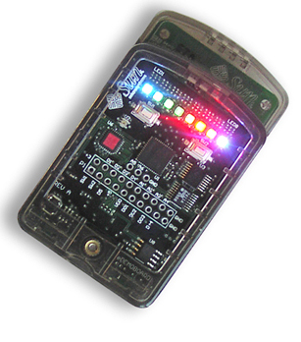
SunSPOT Hardware
Quick deployment supporting Java
Used 802.11.X communication
Loaded the client application onto these
Onboard light and temperature sensors
Could simulate actuators by using onboard LED’s
Notes:
Explain what an actuator is and how they could be used

Slide 10
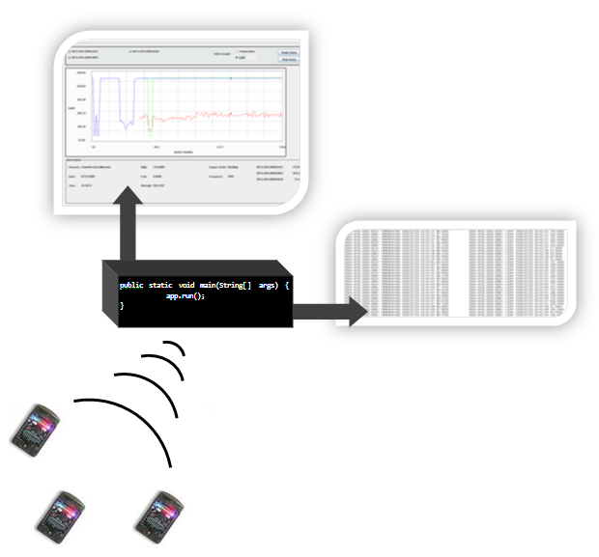
Application Implementation

Slide 11
Introspections and PAQ
Examines the persistent query’s history and compares it to an idealized result
public interface IntrospectionStrategy{
double introspect(Vector<QueryResult>history);
}
Notes:
Because of this, the programming time was quick and easy.

Slide 12
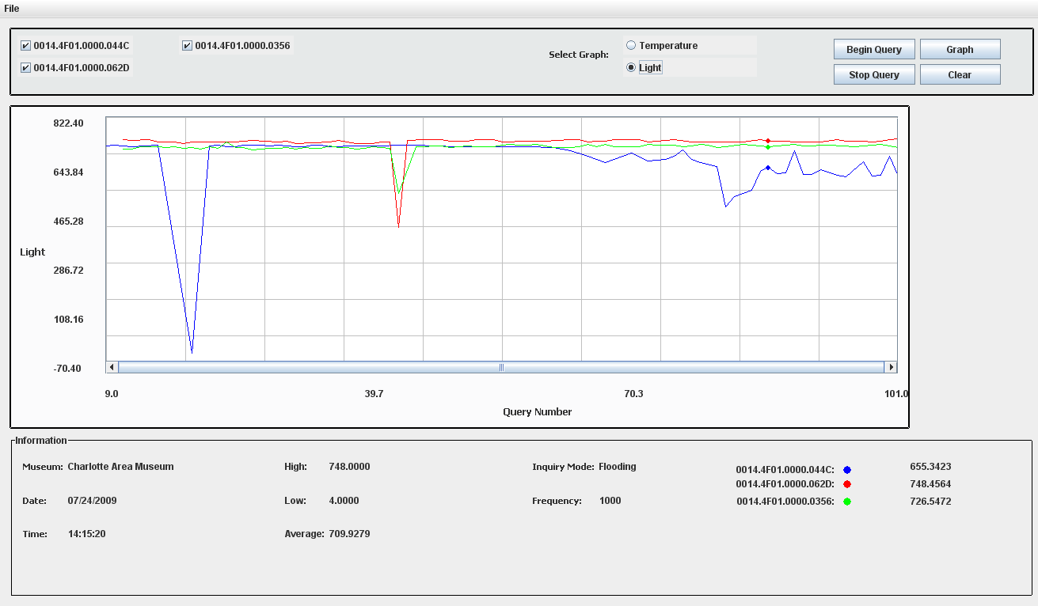
GUI
Notes:
1. Sensor ID; 2. Output Values; 3. Sensor Values and Color Keys

Slide 13
Impact and Conclusion
PAQ Middleware could be suitable for development of a persistent query system
From conception to finished project took only three weeks
Powerful applications could be built to cover a wide variety of situations
Provided groundwork for future tests
Notes:
Even with our limited knowledge

Slide 14
Future Work
Real deployment of our system into a museum
Compensate for inaccurate readings
Temperature sensor was reading temperature of the SunSPOT board, not outside temperature
Integrating actuators into our system
Control HVAC system
Close blinds/dim lights

Slide 15
References
J. Payton, C. Julien, G.-C. Roman, V. Rajamani. Semantic Self-Assessment of Query Results in Dynamic Environments. ACM Transactions on Software Engineering and Methodology, 2009
Reilly, James. "Managing Collection Environments: What Should We Know and How Can We Know it? IPI's 15 years of research on environmental assessment and management." The Library of Congress. West Dining Room, 6th floor, Madison Bldg, Washington DC. 28 May 2009.
V. Rajamani and C. Julien and J. Payton and G.-C. Roman. PAQ: Persistent Query Middleware for Dynamic Environments. Technical Report, 2008
V. Rajamani, C. Julien, J. Payton, G.-C. Roman. Inquiry and Introspection for Non-Deterministic Queries in Mobile Networks. Proceedings of the International Conference on Fundamental Approaches to Software Engineering 2009

