Slide 1
Social Activity Recognition Using a Wrist-Worn Accelerometer
Ashton Maltie
UNCC WiNS Lab

Slide 2
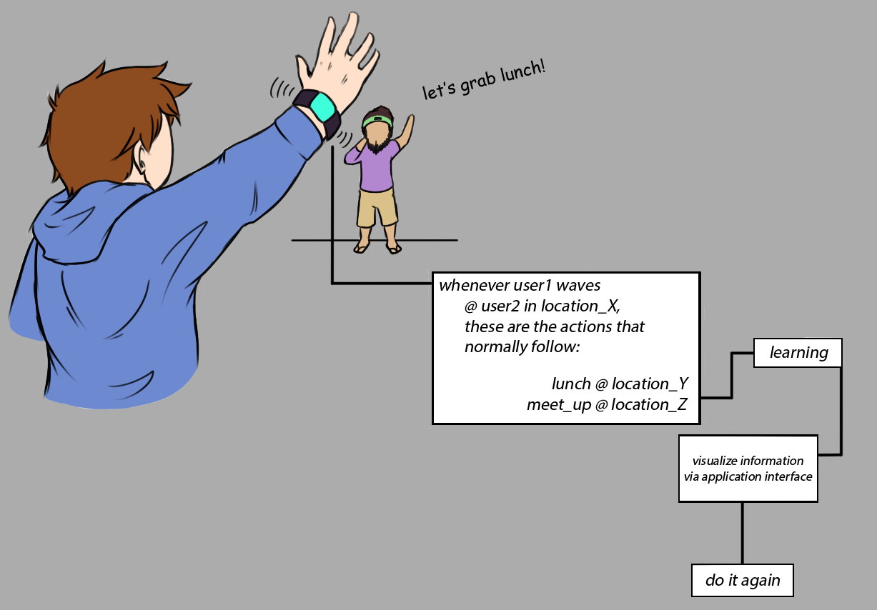
Creating a novel social application
Activity recognition
Application will:
Detect gestures performed via accelerometer
Deliver feedback to user in terms of social interaction
How will the application recognize the gestures?

Slide 3
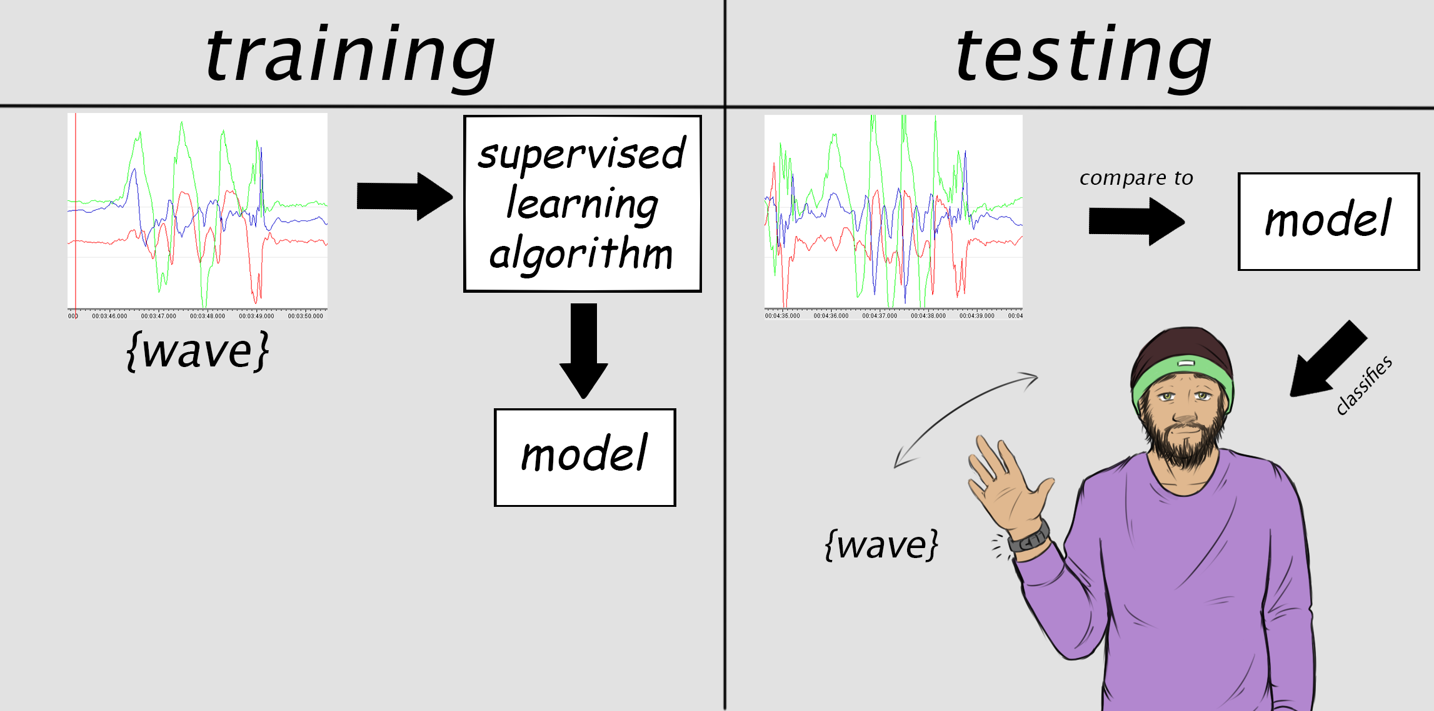
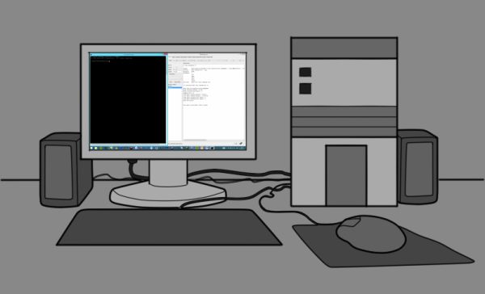
Machine Learning (ML) and Classification

Slide 4
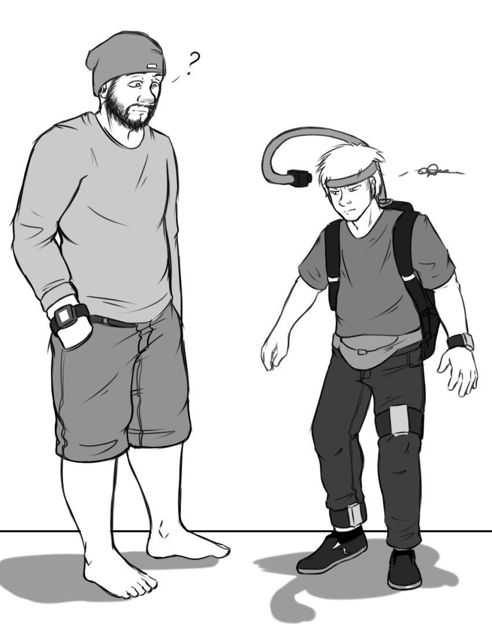
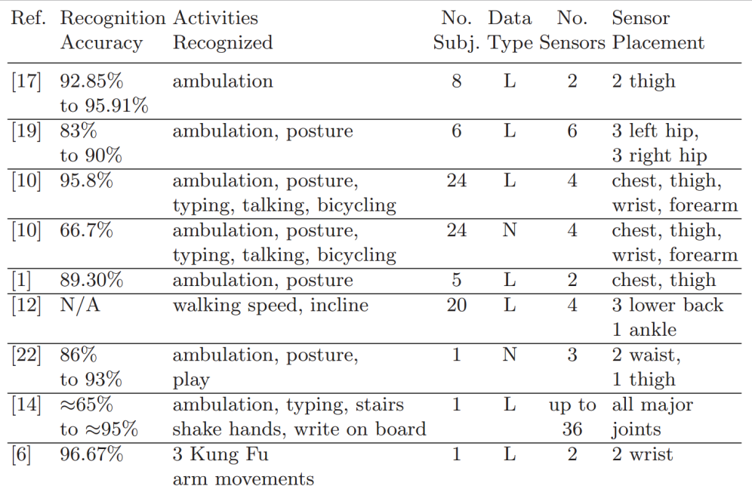
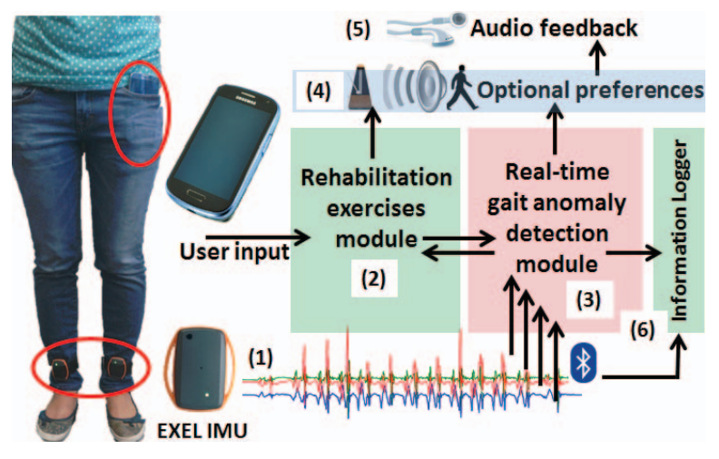
Previous Work
Bao and Intille
What we propose:
One wrist-worn accelerometer
More focus on social activity rather than physical diagnostics
Mazilu et. al.

Slide 5
Process
Notes:
Actinos are a sequence of points over time
Window data to learn what a gesture
Users wear an accelerometer on their dominant wrist
Users perform a sequence of gestures
We record video to help us label gestures for ML classification

Slide 6
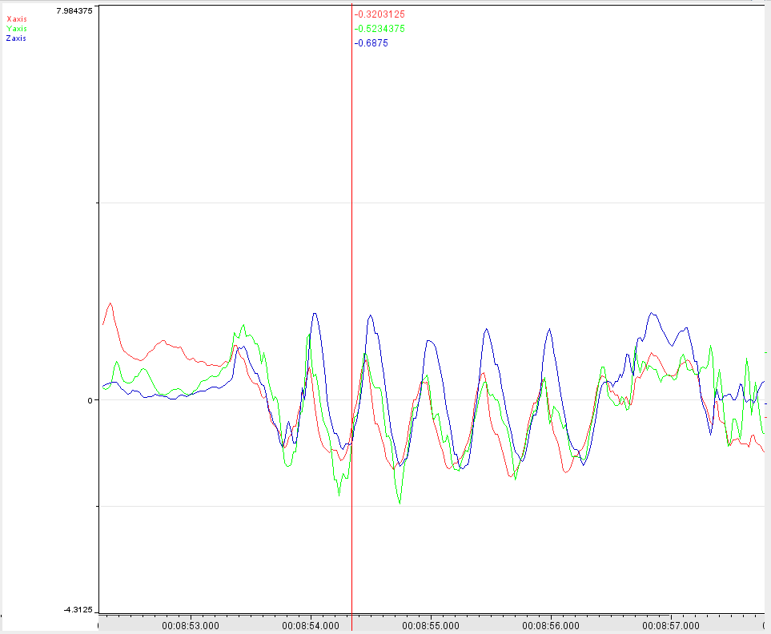
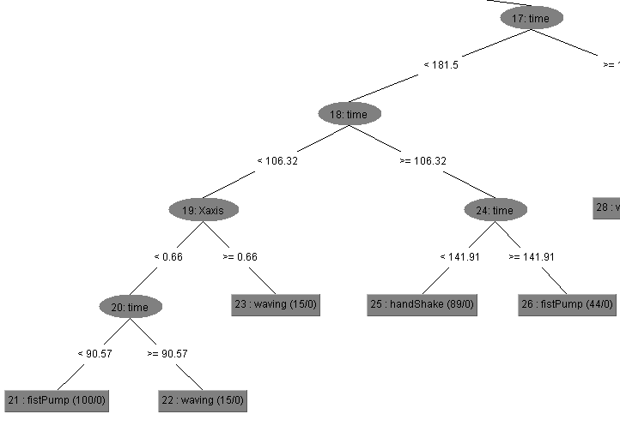
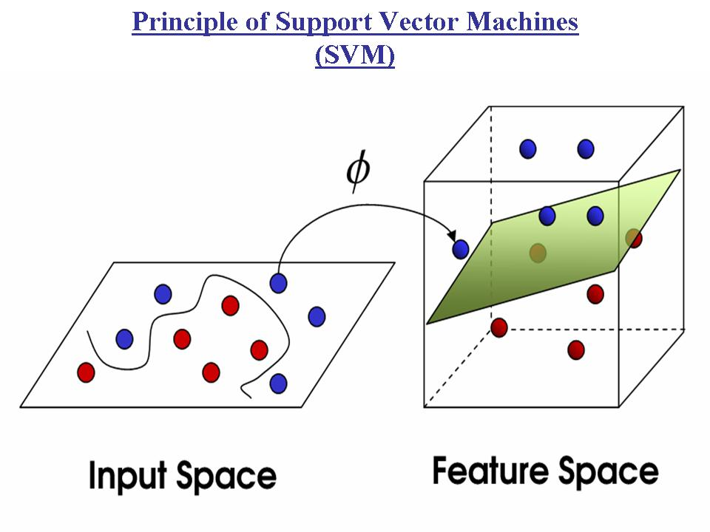
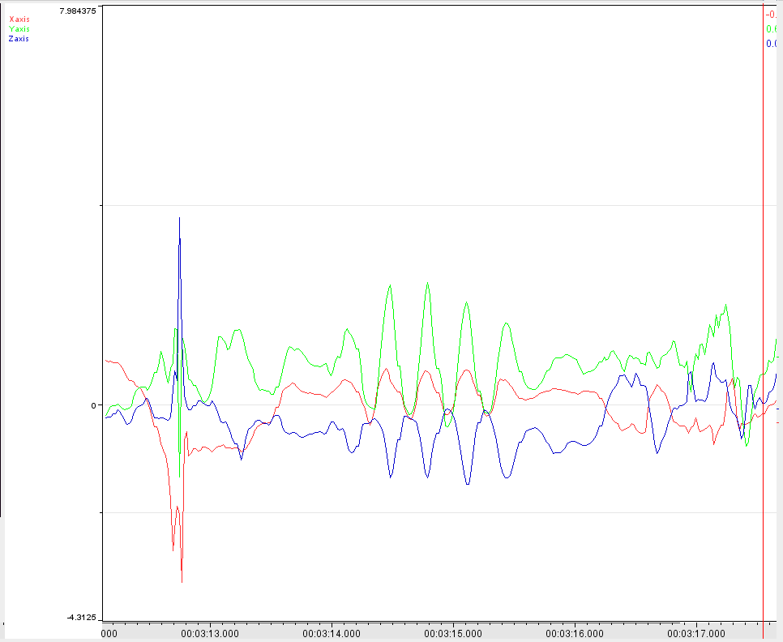
ML algorithms
RandomForest
Support Vector Machines
←
Shaking Hands?
Or
Fist-Pumping? →
Baban, 2013
How well do these algorithms handle the activity recognition data?

Slide 7
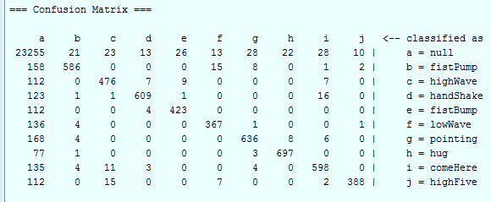
Preliminary Results
LibSVM with windows=200

Slide 8
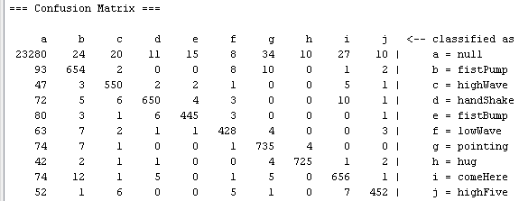
Preliminary Results
RandomForest with windows=200

Slide 9
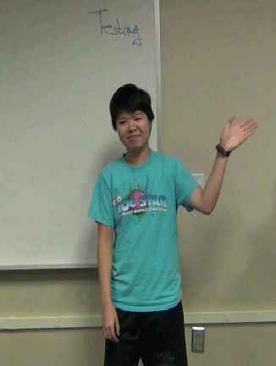
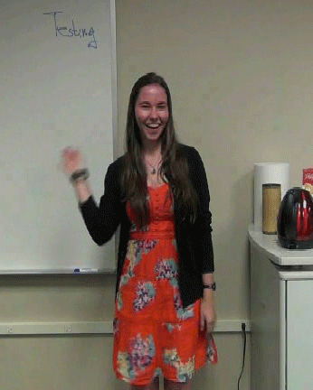
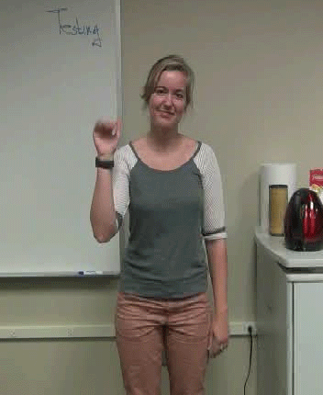
Conclusions and Future Work
RandomForest and Support Vector Machines provide high accuracy from one accelerometer
Hidden Markov Models
Conditional Random Fields
A need for a robust and diverse dataset
Can we achieve the same amount of high accuracy with more actions and more recorded data?

Slide 10
Acknowledgements
Thank you!

