Slide 1
Assessment & Evaluation
NSF CISE REU Site PI Meeting
February, 2012

Slide 2
Project Supporters
2009 Working Group Members
Guy Alain Amousou Chris Aberson Wendy Cooper Teresa Dahlberg Andy Fagg Stephen Gilbert Manfred Huber Niels Lobo
Sanjay Madrias Joan Peckham Eric Wong Yu-Dong Yoa
Kevin Zeng
2010 Implementation Members
Brooklyn College, CUNY Iowa State University University of Alabama University of Massachusetts Amherst
Colorado Springs Jackson State University University of Central Florida UNC Charlotte
Dakota State University Louisiana State University University of Texas Austin University of South Carolina
Depaul University Montclaire State University University of Houston University of Wisconsin Oshkosh
Depauw University Marshall University University of Illinois Urbana-Champaign
Hope College Oklahoma University
2010 Participants: 13 Common Application
20 CISE REU Pre-Post Survey
Notes:
I’d like to especially thank the Working Group members who contributed to this project. The group began several years ago and was led by
Recognize the WG members from 2009:
Teresa Dahlberg, Guy Alain Amousou, Chris Aberson, Andy Fagg, Wendy Cooper, Eric Wong, Kevin Zeng, Stephen Gilbert, Manfred Huber, Sanjay Madrias, Yu-Dong Yao, Niels Lobo, Joan Peckham and those PIs who agreed to use our tools.
Iowa State University, Dakota State University, Montclair State University, Texas Tech, Marshall, UNC Charlotte, University of Central Florida, University of Houston, University of Massachusetts Amherst, University of Missouri - Columbia, University of South Carolina, UIUC Passionate on Parallel, Louisiana State University

Slide 3
Project Supporters
2011 Implementation Members
Auburn University University of Alabama University of South Florida
Dakota State University of California- Berkley University of Texas Austin
Iowa State University University of Central Arkansas University of Wisconsin Oshkosh
Louisiana State University of Central Florida Virginia Tech
Marquette University of Houston Washington State University
Marshall University University of Illinois at Urbana-Champaign Rutgers University
Montclaire University University of Massachusetts Amherst University of Texas San Antonio
North Dakota State University University of Missouri University of Maryland
Texas State San Marcos UNC Charlotte
2011 Participants: 20 Common Application
18 CISE REU Pre-Post Survey
Notes:
I’d like to especially thank the Working Group members who contributed to this project. The group began several years ago and was led by
Recognize the WG members from 2009:
Teresa Dahlberg, Guy Alain Amousou, Chris Aberson, Andy Fagg, Wendy Cooper, Eric Wong, Kevin Zeng, Stephen Gilbert, Manfred Huber, Sanjay Madrias, Yu-Dong Yao, Niels Lobo, Joan Peckham and those PIs who agreed to use our tools.
Iowa State University, Dakota State University, Montclair State University, Texas Tech, Marshall, UNC Charlotte, University of Central Florida, University of Houston, University of Massachusetts Amherst, University of Missouri - Columbia, University of South Carolina, UIUC Passionate on Parallel, Louisiana State University

Slide 4
Assessment Project
Common Application
a la carte Survey
Evaluation Toolkit
Coitweb.uncc.edu/reu/toolkit
Future Directions
Toolkit and Survey Refinements
Continued Longitudinal Follow up
Explore Common Application tools
Notes:
Just to refresh everyone’s memory, the project included building a …..
What we’ll discuss today are the findings from the first use of these tools, and talk about our next steps/future directions

Slide 5
Common Application
2010 (13 sites)
Most applied to 1 site
Application Range: 29-152
Average Number of Applications per Site: 77
~ 130 accepted = 18% approximate acceptance rate
2011 (19 sites) (only 14 with apps)
Most applied to 1 site
Application Range: 4-176
Average Number of Applications per Site: 79
Notes:
Audrey describes what the common application is, why PIs should use it, and how to use it
Show the student view and the PI view
Link embedded in title; also as screen shots just in case

Slide 6
Unique Applicant Gender

Slide 7
Unique Applicant Ethnicity
2011

Slide 8
Applicant Level in School

Slide 9
Degrees Considering

Slide 10
Post-Graduation Plans - Industry

Slide 11
Post-Graduation Plans - Academia

Slide 12
First Person in Family to Attend College

Slide 13
Immediate Family Involved in Research

Slide 14
CISE REU Pre-Post Survey
Pre survey: May-June and Post survey: July-August
Total N: 339 REU Students; 20 Sites in 2010 + 18 in 2011
What is measured:
Self Efficacy
I can formulate a research problem
Intent to attend graduate school
I plan to apply to graduate school in a computing discipline
Attitudes towards computing
I like to use computer science to solve problems
Help seeking/coping skills
When I do poorly on an exam, typically I….skip class
Positive Impact has been demonstrated

Slide 15
Methodology
Items
4 point Likert type scale, 4 being positive
Some items were reverse scored
Collapsed into construct means representing 4 variables
Ethnicity collapsed into URM status
Reliability
Coefficient alphas above .547
MANOVA
To test hypothesis that there would be differences between means based on time, gender, URM status

Slide 16
Survey Participant Profiles
Pre Demographics (N=219)
14% (28) reported having had 1 prior REU

Slide 17
Survey Participant Profiles
Post Demographics (N=160)

Slide 18
Combined Outcomes 2010+2011
2010
Increases at Post Assessment were not significant
No main effects, no interactions
2011
Significant increase at Post for Self-Efficacy

Slide 19
Outcomes
2010
No significant increases
2011
*Significant increase (p=.00)
Construct | Time | Mean | SD
Self- Efficacy | pre | 3.05 | 0.47
 | post | 3.43 | 0.40
Intent | pre | 3.10 | 0.46
 | post | 3.19 | 0.47
Attitude | pre | 3.59 | 0.32
 | post | 3.65 | 0.29
Help Seeking- Coping | pre | 2.94 | 0.33
 | post | 2.98 | 0.37
Construct | Time | Mean | SD
Self- Efficacy | pre | 3.11 | 0.47
 | post | 3.48* | 0.39
Intent | pre | 3.22 | 0.59
 | post | 3.23 | 0.66
Attitude | pre | 3.67 | 0.36
 | post | 3.70 | 0.38
Help Seeking- Coping | pre | 2.98 | 0.39
 | post | 2.98 | 0.36

Slide 20
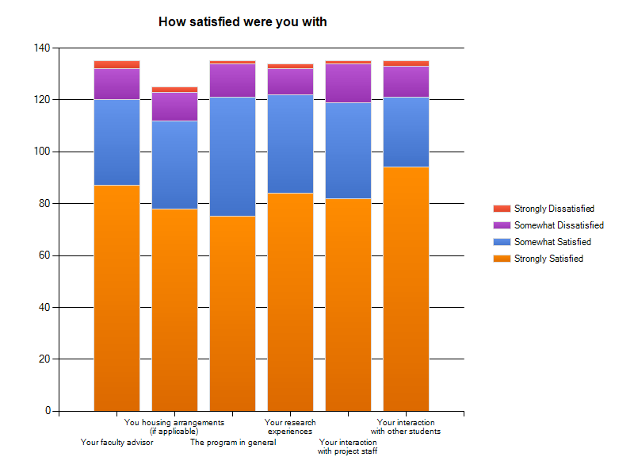
Post Program Evaluation
Majority of REU Students were satisfied with their program
Faculty advisor 89%
Housing 90%
Program in general 90%
Research experience 91%
Interaction with staff 88%
Interaction with students 90%

Slide 21
What does this mean?
We know there is positive impact from the REU experience
Increases between pre and post surveys
Slightly higher interest in graduate school among applicants that did participate to those who didn’t
Individual sites and students have powerful stories
The ‘surprise’ factor can negatively impact attitudes in the short term
Look at individual stories
Consider the learning outcomes

Slide 22
Implications & Limitations
Effects are small given the time frame
Effects may be delayed
Self-report
Possible ceiling effect
Consider time series design
What else should we measure?
Mentoring
Ethics
Knowledge gains

Slide 23
Next Steps
Common Application
Track offers
Follow up with applicants
Compare accepted/declined on key indicators
Survey
Deeper analysis
Larger sample
More variables, or different variables
Control groups?
Learning outcomes?
Notes:
For example- do minority applicants receive more offers than other applicants
Do those who accept have a better graduate school completion rate
For example- aggregate by level in school, by discipline to see if technical majors predict better outcomes

Slide 24
Discussion
Collaborations for Research & Writing Circles
Case Studies
Develop and pilot new survey modules (i.e. ethics)
CISE REU Evaluation Toolkit
http://www.coitweb.uncc.edu/reu/toolkit/

