Slide 1
CISE REU Evaluation Toolkit 3 Year Overview
Audrey Rorrer
audrey.rorrer@uncc.edu

Slide 2
History of Evaluation Project
2009 Working Group Members
Guy Alain Amousou Chris Aberson Wendy Cooper Teresa Dahlberg Andy Fagg Stephen Gilbert Manfred Huber Niels Lobo
Sanjay Madrias Joan Peckham Eric Wong Yu-Dong Yoa
Kevin Zeng
Common Application
A la Carte Student Survey
Faculty/PI Survey
New in 2013:
Shared Applicant Pool
Faculty PI Survey
New Student Survey Items
Research
OCI
Evaluation Toolkit: reu.uncc.edu/cise-reu-toolkit

Slide 3
The Common Application

Slide 4
3 Year Trends in Common Applications
Site Descriptors | 2010 (N=13) | 2011 (N=20) | 2012 (N=22)
Range of Applicants | 29-152 | 4-176 | 18-212
Avg Applications per Site | 77 | 79 | 93
Largest # of Sites Applied to by Individual | 30 (n=1) | 6 (n=1) | 7 (n=2)
84%
Site with most applicants:
Iowa State University (2010-2012)
University of Pennsylvania has 291 for 2013!

Slide 5
Common Applications: Gender, Ethnicity, Level
72% in women
from 2011
*
*
*
*Some applicants indicated dual level status; not included
2012
African American applicants more than doubled
from 2011
2011
2010

Slide 6
Percentage of Applicants by Gender & Ethnicity
% Underrepresented Minority Group Applicants
% of Female Applicants
Across 3 years
36% URM
10%
Multi-Ethnic/Other
24%
27%
34% URM
35% URM
52%
8%
Caucasian
3%
26%
52%
9%
Hispanic
61%
7%
10%
17%
African American
18%
16%
10%
14%
11%
Asian
Native American, Pacific Islander, Unspecified <1%
Notes:
Yes we’ve seen increases in gender and underrepresented minority group applicants, but still fewer than 1/3 of applicants are women
And African American applicants have more than doubled since 2011; their overall percentage is between 16 and 18%
Applicants have been between 50 and 60% caucasian and 10-15% Asian meaning that we have over a third of applicants from underrepresented minority groups

Slide 7
Common Applications: Graduate School Plans
Majority indicated plans to pursue graduate degrees
Over 95% across the 3 years
Few are first generation college students
Less than 20% across the 3 years
Notes:
Maybe they think indicating plans to pursue graduate school help their chances for selection……

Slide 8
Shared Applicant Pool
Now
Site
Decides
Applicant
Decides
1. Sites agree to participate
2. Item included in Common Application for Applicant choice to participate
3. Sites confirm applicant availability for Shared Pool
4. Available applicants who’ve agreed to participate are moved into Shared Applicant Pool: Drop Box
5. All Site PIs invited to view folder following creation
6. Reminder emails announce new candidates throughout April
Sites Communicate with Applicants of Interest
Communication with Audrey
Communication with Audrey
Communication from Audrey

Slide 9
The A la Carte Student Survey

Slide 10
A la Carte Student Survey
Modular, pre/post assessment of student outcomes
Self Efficacy
I can formulate a research problem
Intent to attend graduate school
I plan to apply to graduate school in a computing discipline
Attitudes towards computing
I like to use computer science to solve problems
Help seeking/coping skills
When I do poorly on an exam, typically I….skip class
New in 2013:
Research Skills
Piloted in 2012
Incorporate into Pre-Survey 2013
OCI items
Collaborations underway
New items for Pre-survey 2013
Notes:
Contacted the OCI sites (there were 3 in Dec): LSU, Oregon State, Marshall to collaborate on item development
This is underway, and I invite OCI Pis to participate. I’ll send the items out for your review to “vet” these new items, and will deploy in the May pre survey:
Suggested changes are
Change the phrase in our Attitudes items from ‘computer science’ to computational sciences
change the item “discuss research in computer science’ to ‘..in my discipline’
ecology, computer science, math and engineering, so perhaps a possible solution to the nomenclature issue is to remove "computing" altogether in favor of simply "research", and use the survey introduction to explain collectively what is being referred to is their summer research discipline.

Slide 11
A la Carte 3 Year Outcomes
2011
*Significant increase (p=.00) in Self Efficacy
2012
*Significant increase (p=.00) in Self Efficacy and Computing Attitudes
Construct | Pre (SD) | Post (SD)
Self-Efficacy | 3.11 (.47) | 3.48 (.39)*
Intent to Grad School | 3.22 (.59) | 3.23 (.66)
Attitudes | 3.67 (.36) | 3.70 (.38)
Help-Seeking/ Coping | 2.98 (.39) | 2.98 (.36)
Construct | Pre (SD) | Post (SD)
Self-Efficacy | 3.75 (.69) | 4.06 (.79)*
Intent to Grad School | 3.93 (.75) | 3.93 (.79)
Attitudes | 3.58 (.24) | 4.55 (.49)*
Help-Seeking/ Coping | 3.52 (.48) | 3.48 (.51)
Note: 4 pt Likert scale
Note: 5 pt Likert scale
2010: Gains in all 4 areas; none significant
Notes:
Pre to Post gains in all 4 areas all 3 years, none were statistically significant in 2010, Self Efficacy was significant in 2011, and Self Efficacy and Computing Attitudes were significant in 2012
Not surprising that we are note seeing significant increase in plans to attend graduate school- these are high to begin with, (ceiling effect) since our programs attract students interested already
So the question becomes how prepared for graduate school are they? And we can begin to cultivate and answer for this with the new research skills module this summer

Slide 12
A la Carte Gender & Ethnicity at Post
2011
Overall Significant increase from pre to post (p=.00) in Self Efficacy
Significant differences at Post (p<.05) between Groups:
Women had higher means on Coping Skills
Mean of 3.06 for women vs 2.9 for men
Underrepresented Minority Groups* had higher intentions to attend graduate school
Mean of 3.47 for URM group vs 3.16 for non-URM
2012
Significant increase from pre to post (p=.00) in Self Efficacy and Computing Attitudes
Significant differences at Post (p<.05) between Groups:
Women had higher means on Coping Skills
Mean of 3.63 for women vs 3.39 for men
Underrepresented Minority Groups* had lower intentions to attend graduate school
Mean of 1.82 for URM group vs 2.15 for non-URM
Note: 4 pt Likert scale
Note: 5 pt Likert scale
*URM= all ethnicity groups except Asian, Caucasian, Unspecified

Slide 13
Post Program Evaluation
Majority are satisfied with program
2012:
Faculty advisor 94%
Housing 90%
Program in general 96%
Research experience 93%
Interaction with staff 99%
Interaction with students 96%
Consistently >90%
Across all 3 years

Slide 14
Faculty/PI Survey

Slide 15
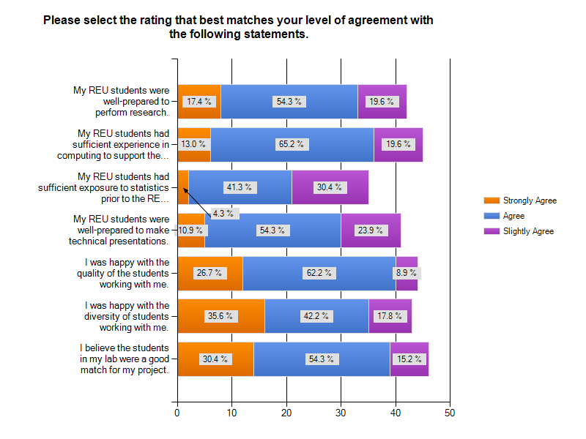
Faculty Survey
Snowball sample
Dec 2012 – Jan 2013
NSF PI Lists (2010– 2012)
Likert scale survey to measure
Motivation to participate
Faculty roles & site management
Satisfaction with students
Perceived student outcomes
Respondent Characteristics
REU faculty 1-4 yrs
70% Male
70% Caucasian
Half Associate rank

Slide 16
Recruiting & Managing Students
Recruiting
Managing
68% indicate being “very selective”
80% have selection committee
7% conduct phone interviews
Not important: Having research experience
Highly important:
Student motivation and interests
Gender/ethnicity mix
56% meet with students twice a week
21% daily
21% weekly
Majority reported student social events at least once a week
Nearly half (40%) have Graduate student mentors

Slide 17
Why Faculty Participate in REU Site Management
Altruistic factors
Asst & Assoc faculty are concerned about research and professional development
Note: Not all respondents answered all questions

Slide 18
Why Faculty Participate in REU Site Management
Notes:
None of these were found to be significant differences, but is interesting

Slide 19
Other Important Factors: Open Ended Response Themes
Why Faculty Participate: Pay It Forward
“Many professors encouraged me and provided me with opportunities. I want to pay that forward. Working with the REU students makes me feel like I am contributing to the world. I look forward to going to work because the REU students make my job more fun. I love seeing them make progress and setting higher goals for themselves.”
Effective Components: Team Projects
“Undergraduate students, graduate students, and faculty members working together on research projects”
“An opportunity to give back. When I was an undergraduate, I participated in a summer research program, and I wrote a senior thesis. These experiences promoted my interest in a research career.”
“Doing research as part of team. Gaining confidence”

Slide 20
What does it all mean?
Candidate supply is strong
Student impact is positive
Faculty are motivated by altruism
Need to increase gender diversity
Graduate school training wheels
Value ‘giving back’ and contributing to pipeline

Slide 21
Next Steps
Rolling out Shared Applicant Pool
Vetting OCI items
A la Carte Survey Call out in April
Toolkit components on New CISE REU Website

Slide 22
Results from Poll During Meeting
11 faculty responded to the poll during the meeting
Still open: www.surveymonkey.com/s/cisereutoolkit
Are these tools helpful to you?
If not, why not?
What survey modules are of interest?

Slide 23
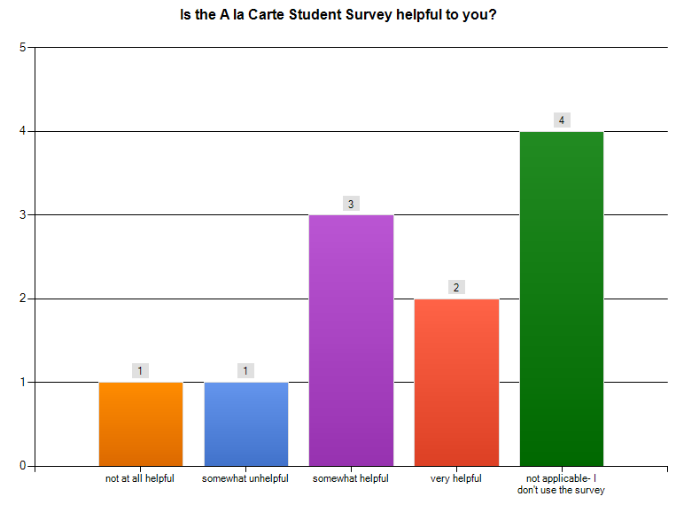
A la Carte Survey Modules
4 faculty desire:
Mentoring
Research assessment
Ethics
modules to be
added

Slide 24
Why don’t you use the A la Carte?
Of the 3 total responses to this item
All have internal measures

Slide 25
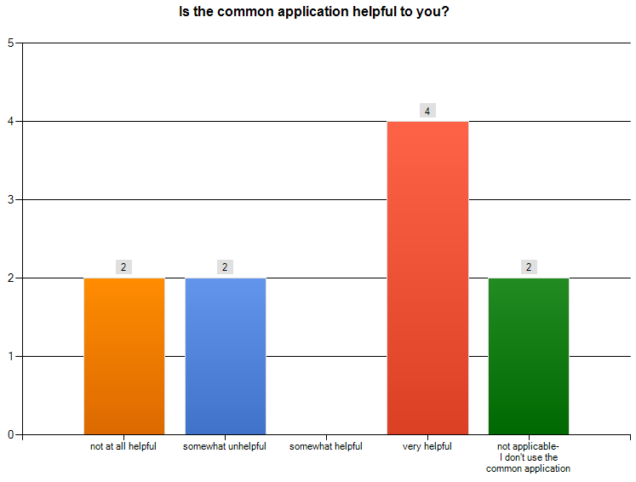
Common Application
3 comments:
New site
Have internal application
Wish results available at site annual report time

Slide 26
Thank you audrey.rorrer@uncc.edu

Slide 27
Appendices

Slide 28
Participating Sites
2012
Auburn University
Brooklyn College
Dakota State University
Drexel University
DuPaul University
Georgia State University
Iowa State University
Louisiana State University
Marquette University
Marshall University
Montclair State University
Oregon State University
Rutgers University
Salisbury University
Suffolk University
Texas A&M Corpus Christie
Texas State University
Texas Tech University
University of Alabama
University of Connecticut
University of California Berkley
University of California Santa Cruz
University of Central Arkansas
University of Central Florida
University of Maryland
University of Massachusetts
University of Michigan
University of Missouri
UNC Charlotte
University of Pennsylvania
University of South Florida
University of Texas Arlington
University of Texas Austin
University Tennessee Chattanooga
University Texas San Antonio
[22] Common Application
[23] CISE REU Pre-Post Survey
2010
Brooklyn College
Colorado Springs
Dakota State University
Depaul University
Depauw University
Hope College
Iowa State University
Jackson State University
Louisiana State University
Marshall University
Montclair State University
Oklahoma University
UNC Charlotte
University of Alabama
University of Central Florida
University of Houston
University of Illinois Urbana-Champaign
University of Massachusetts Amherst
University of South Carolina
University of Texas Austin
University of Wisconsin Oshkosh
[13] Common Application
[20] CISE REU Pre-Post Survey
2011
Auburn University
Brooklyn College
Dakota State
Iowa State University
Louisiana State
Marquette
Marshall University
Montclair State University
North Dakota State University
Rutgers University
Texas State San Marcos
University of Alabama
University of California- Berkley
University of Central Arkansas
University of Central Florida
University of Houston
University of Illinois at Urbana-Champaign
University of Maryland
University of Massachusetts Amherst
University of Missouri
UNC Charlotte
University of South Florida
University of Texas San Antonio
University of Texas Austin
University of Wisconsin Oshkosh
Virginia Tech
Washington State University
[20] Common Application
[18] CISE REU Pre-Post Survey

Slide 29
A la Carte Methodology
Items
4 point Likert type scale, 4 being positive in 2010/2011
Converted to 5 point scale in 2012
Some items were reverse scored
Collapsed into construct means representing 4 variables
Ethnicity collapsed into URM status
Reliability
Coefficient alphas above .547
MANOVA
To test hypothesis that there would be differences between means based on time, gender, URM status;
none found in 2010

Slide 30
A la Carte Student Survey Participants

Slide 31
A la Carte Student Survey Participants
Responses
 | Number of Sites | Pre Survey N | Post Survey N | Response Rate*
2010 | 20 | 196 | 144 | 72%
2011 | 18 | 199 | 137 | 76%
2012 | 23 | 167 | 151 | 66%
*Calculated from Post Survey responses; estimates based upon 10 students per site (e.g., 2010: 200 students; 2011: 180 students; 2012: 230 students)

Slide 32
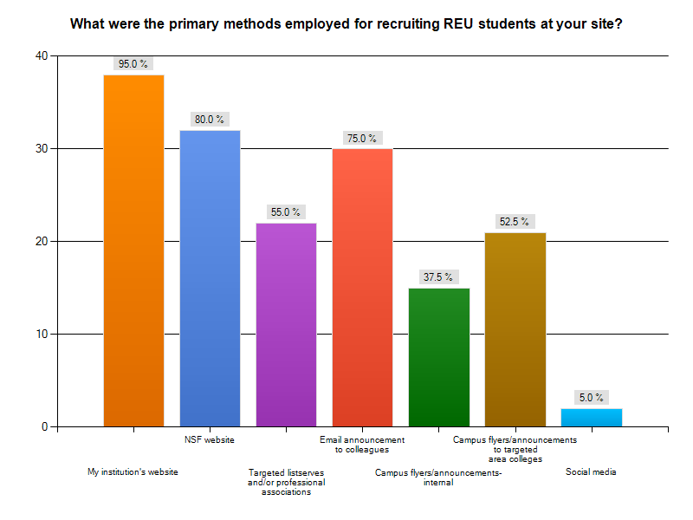
Recruiting Students

Slide 33
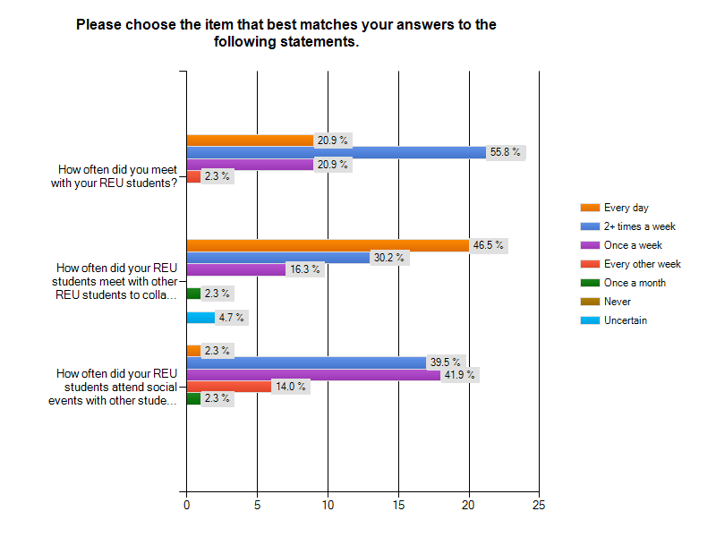
Managing Students

Slide 34
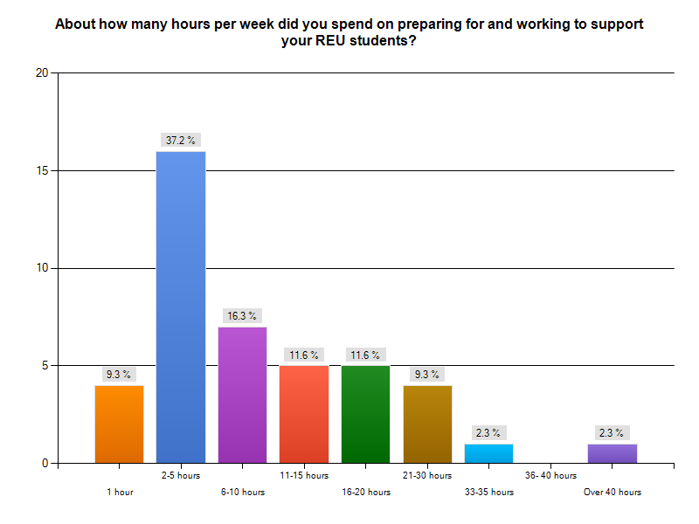
Weekly Time Spent

