Slide 1
Finding Cells via Adaptive Detectors for Breast Cancer Image Analysis
Annika Fredrikson
Notes:
Hello, my name is Annika Fredrikson and for my REU this summer I have been working on Finding Cells via adaptive detectors for breast cancer image analysis. The objective of my project was to improve the computer’s ability to identify cells in breast tissue images.

Slide 2
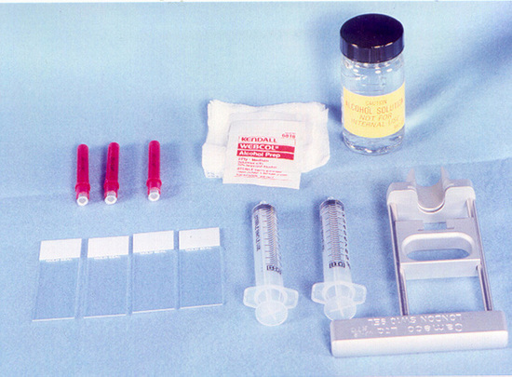
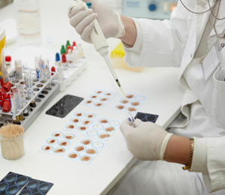
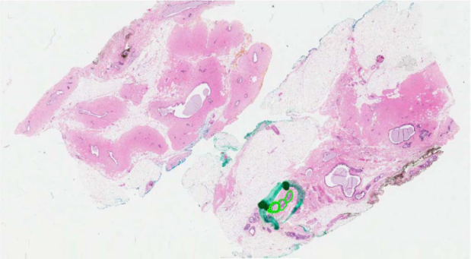
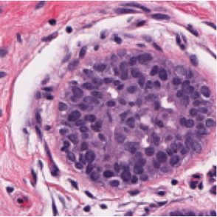
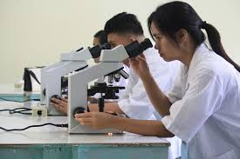
Breast Cancer Images
Biopsy
-Time consuming
-Inconsistent
Images: www.thyroidmanager.org www.oncologyupdate.com.au
Notes:
Breast cancer is the second most common cancer in the US, affecting 1 in every 8 women in the course of her life. Fortunately, early diagnosis and treatment can significantly increase the survival rate among patients. Biopsy which is illustrated here is the most common examination method. During biopsy a very thin needle is used to remove a small sample of tissue which is then examined under a microscope by a pathologist. The biopsy process, however, poses some challenges. Pathologists have to manually examine each tissue sample which is incredibly time consuming. In order to be completely accurate, the pathologist would need to examine each cell individually, but through a microscope this is quite difficult. Instead pathologists look at clumps of cells like the one pictured in the image here. This leads to inconsistency in analysis because there exists a lot of observer bias.

Slide 3
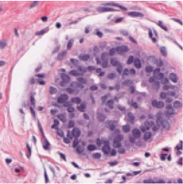
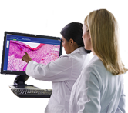
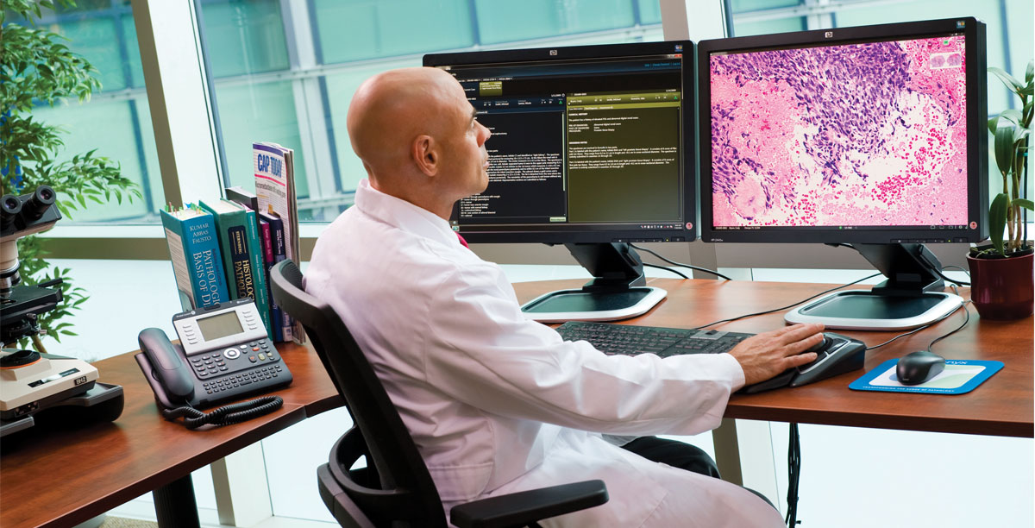
Computer-Aided Diagnosis
-Save time for doctors
-More consistent
analysis
Images: getheathcare.com
Notes:
All these challenges have led to the development of computer aided diagnosis, which has become increasingly important in the medical world today and more specifically in breast cancer analysis. With the aid of the computer, pathologists can more easily and clearly examine and analyze tissue samples on a cell by cell basis. By automating the image analysis portion of the process, we can save time for the pathologists and reduce the overall workload of the pathology lab. Computer aided diagnosis has also improved the accuracy of analysis and the overall quality of the interpretation because doctors can use image processing techniques to classify the cells.

Slide 4
Cell Detection
Notes:
However, Computer-aided diagnosis is useless if the computer is unable to identify the cells. Before the pathologists can classify the cells they see in an image as cancerous or benign, machine learning techniques must be employed to ensure that the computer will output accurate results. That’s where I come in. In order to analyze these breast tissue images, we need to be able to identify the cells in the image. Using machine learning techniques, we can train the computer to differentiate cells from surrounding tissue and fat. So as you can see, cell detection is a crucial step in the analysis process. The computer needs to be able to detect the cells in an image before it can complete the real task of classifying the cells as cancerous or benign. Without the detection step, the computer won’t know what to analyze. Cell detection is especially important in the analysis of breast cancer images, because cancerous cells will have enlarged nuclei.

Slide 5
Previous Method
C. Arteta, V. Lempitsky, J. A. Noble, A. Zisserman “Learning to Detect Cells Using Non-overlapping Extremal Regions” MICCAI 2012

Slide 6
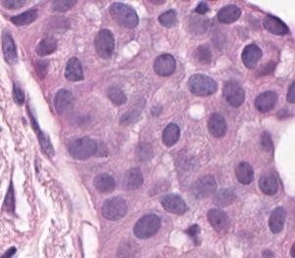
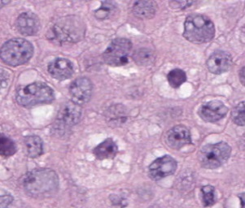
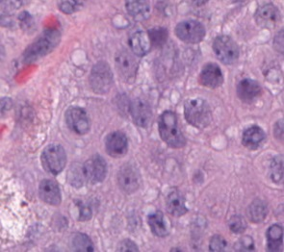
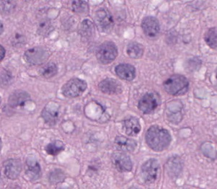
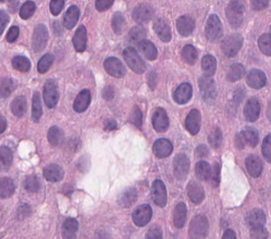
Our Method
Notes:
So how were our clusters composed? These images represent the 6 clusters for which I trained adaptive detectors. As you can see the adaptive detectors vary by color intensity, ranging from pale to dark purple. Training multiple adaptive detectors allows us to capture the optimal results for each ROI, meaning we will detect more cells overall. This will allow for better classification results and ultimately a more accurate, usable system for doctors and nurses in clinical practice.

Slide 7
Dataset

Slide 8
Results
Oxford detector
[C.Arteta MICCAI 2012]
Our adaptive detector

Slide 9
Results
Oxford detector
[C.Arteta MICCAI 2012]
Our adaptive detector

Slide 10
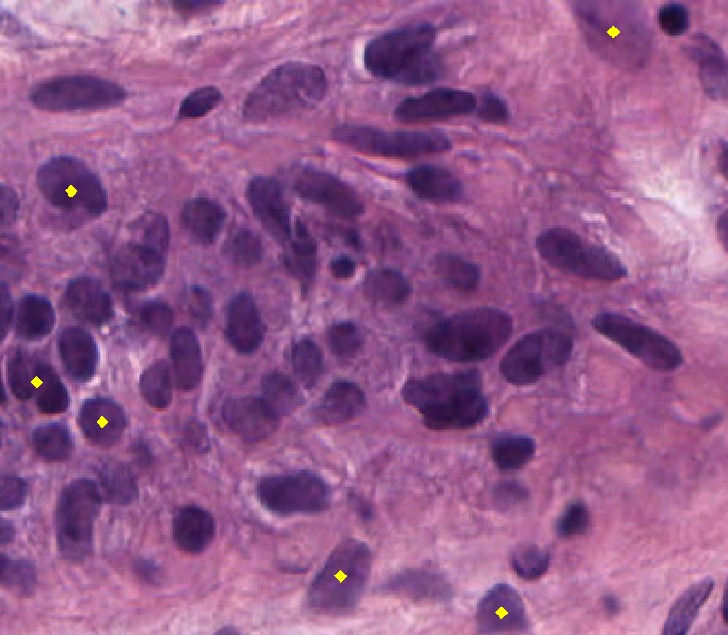
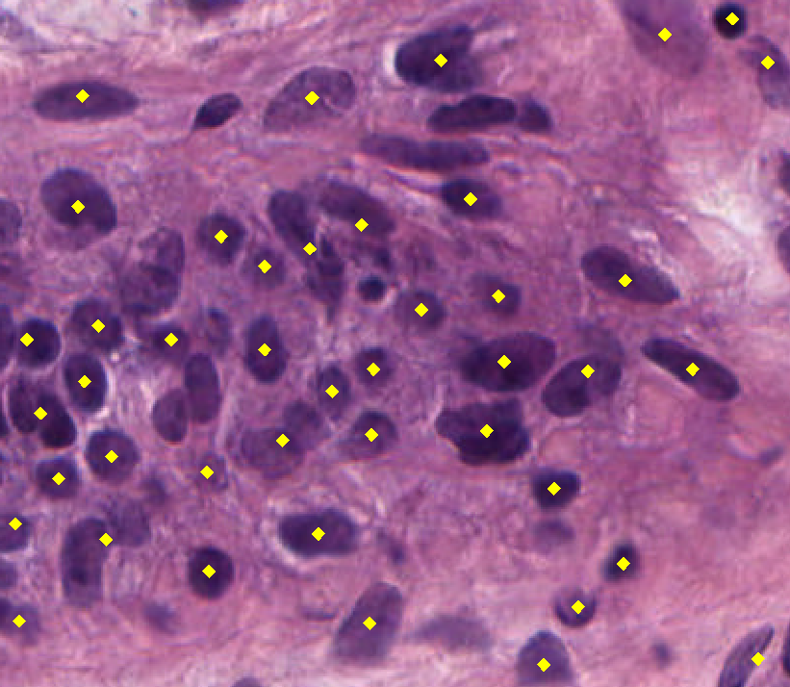
Results
Oxford detector
[C.Arteta MICCAI 2012]
Our adaptive detector

Slide 11
Results
Standard deviation 6.65%
Standard deviation 4.49%
[C.Arteta MICCAI 2012]
Notes:
These results are based on the average of 20 images. Precision is the percentage of cells that were correctly identified. Recall is the percentage of total cells in the image that were correctly identified.

Slide 12
Precision & Recall
High Precision
High Recall

Slide 13
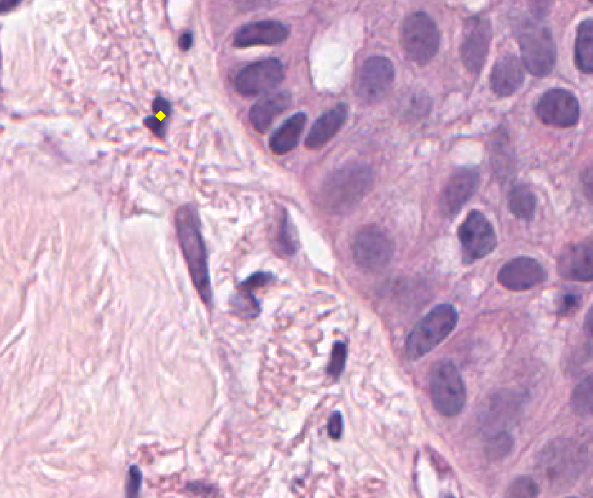
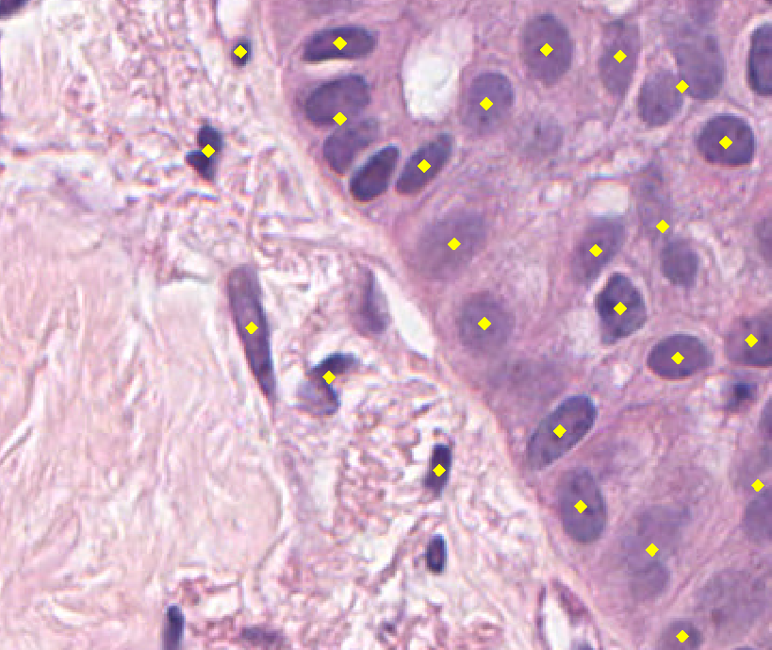
Conclusions
Oxford detector
[C.Arteta MICCAI 2012]
Our detector
Oxford detector
[C.Arteta MICCAI 2012]
Our detector

Slide 14
Future Work
Create additional clusters
Improve training process
Submit paper for SPIE conference

Slide 15
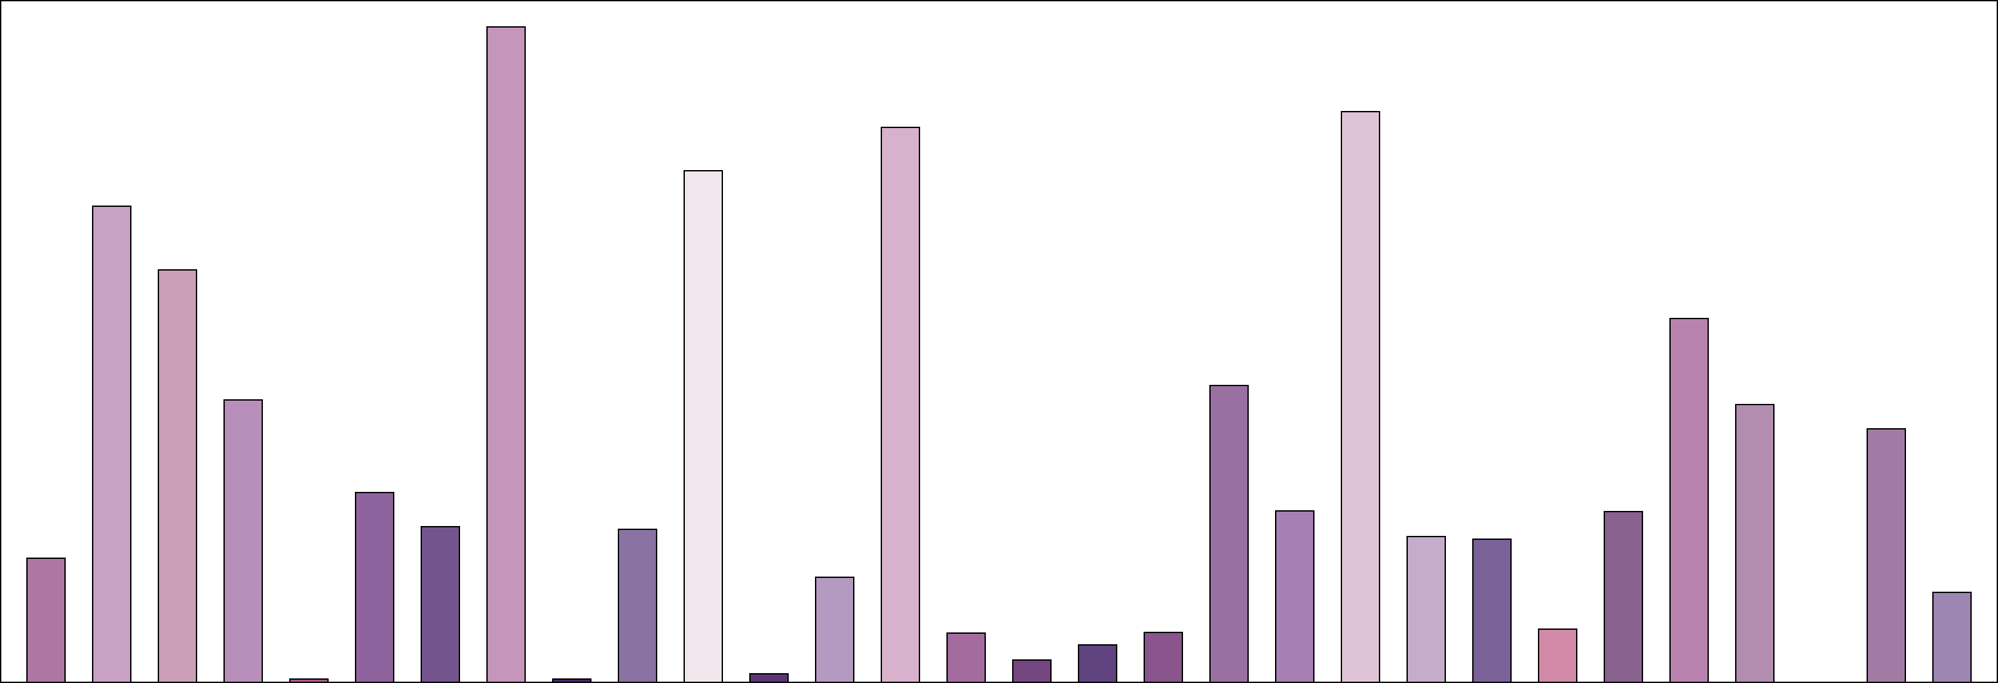
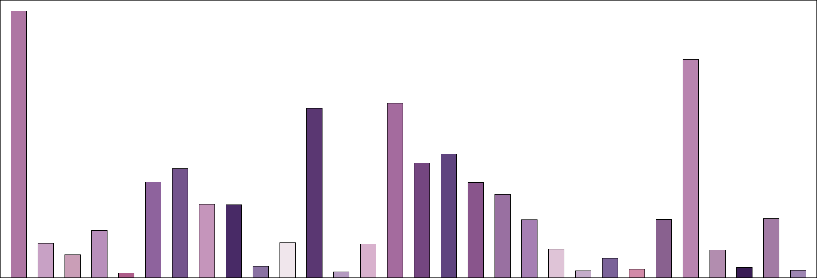
K-Means Clustering

