Slide 1
Image Geolocation
from Faces
Connor Greenwell
Notes:
Image Geolocation

Slide 2
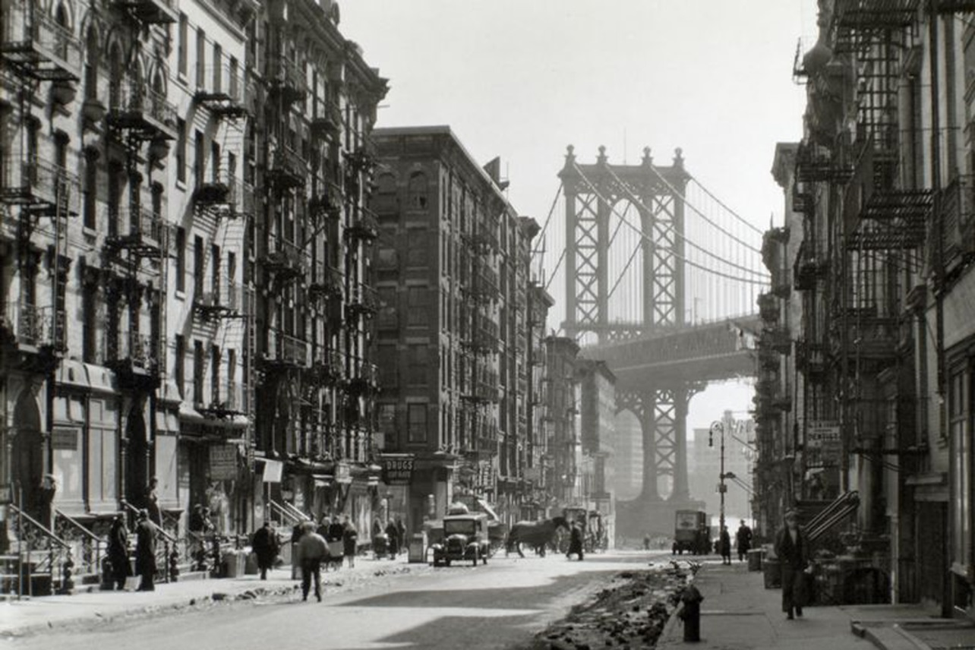
?
Notes:
Motivation
Image forensics
Bad/Intentionally obfuscated metadata
Old scanned photos
We don’t know where most photos have been taken
Interesting to have information we don’t already have

Slide 3
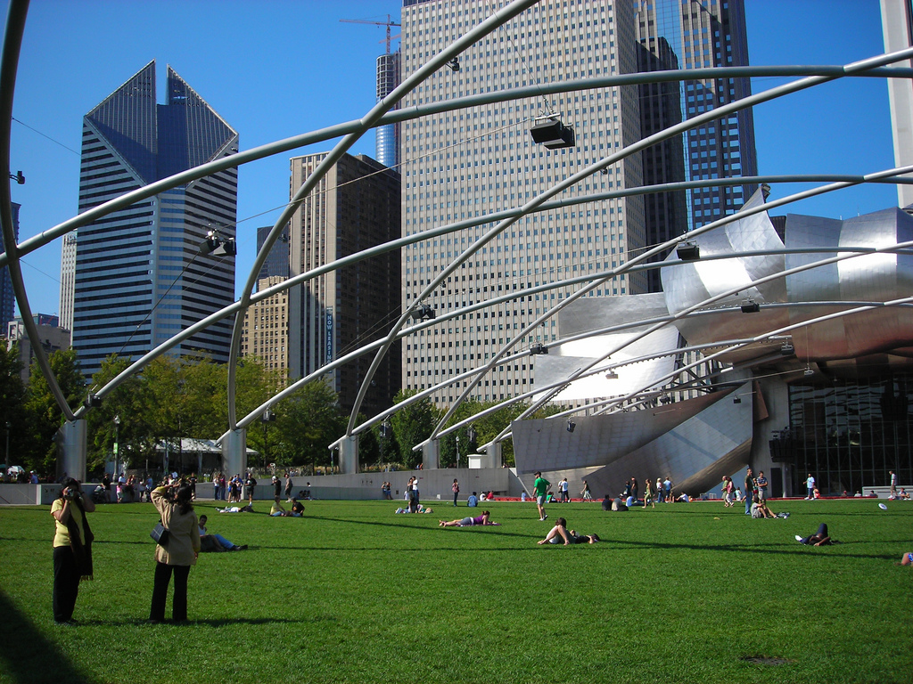
Architectural
analysis
Scene
analysis
Locator
Notes:
Scene Analysis

Slide 4
Architectural
analysis
Scene
analysis
Locator
Carl Doersch, Saurabh Singh, Abhinav Gupta, Josef Sivic, and Alexei A. Efros. What Makes Paris Look like Paris? ACM Transactions on Graphics (SIGGRAPH 2012), August 2012, vol. 31, No. 3.
Notes:
Scene Analysis

Slide 5
Architectural
analysis
Scene
analysis
Locator
James Hays, Alexei A. Efros. IM2GPS: estimating geographic information from a single image. Proceedings of the IEEE Conf. on Computer Vision and Pattern Recognition (CVPR), 2008.
Notes:
Scene Analysis

Slide 6
Architectural
analysis
Scene
analysis
Locator
Face
analysis
Notes:
Scene Analysis

Slide 7
Architectural
analysis
Scene
analysis
Locator
Face
analysis
Notes:
Scene Analysis

Slide 8
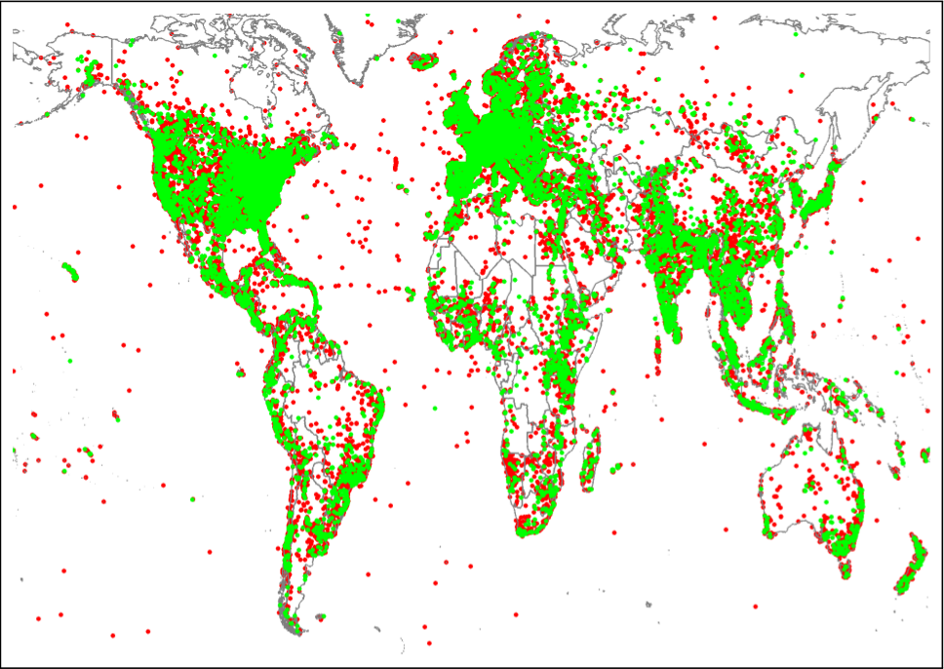
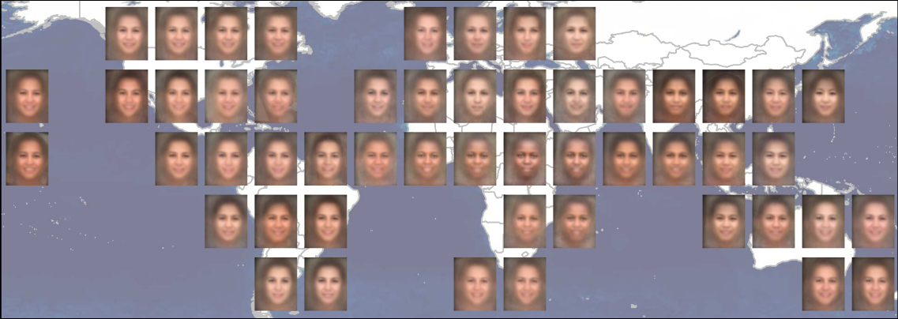
Dataset: GeoFaces
1.2M faces and corresponding locations scraped from Flickr images
Exploring the Geo-Dependence of Human Face Appearance
(Mohammad T. Islam, Scott Workman, Hui Wu, Richard Souvenir, Nathan Jacobs),
In IEEE Winter Conference on Applications of Computer Vision (WACV), 2014.
Notes:
Geofaces dataset

Slide 9
CMU IntraFace
Attribute
Detector
(…, female, no beard, glasses, white, …)
(…, female, no beard, no glasses, black, …)
(…, male, beard, no glasses, black, …)
(…, male, no beard, no glasses, white, …)
(…, male, no beard, no glasses, asian, …)
(…, male, beard, no glasses, asian, …)
(…, female, no beard, glasses, white, …)
(…, male, no beard, no glasses, black, …)
(…, male, beard, no glasses, asian, …)
(…, female, no beard, glasses, white, …)
(…, female, no beard, no glasses, black, …)
(…, male, beard, glasses, asian, …)
(…, male, no beard, glasses, black, …)
(…, female, no beard, glasses, black, …)
(…, male, beard, no glasses, asian, …)
(…, female, no beard, glasses, white, …)
(…, female, no beard, no glasses, white, …)
(…, male, beard, no glasses, asian, …)
2.5
CPU-months
Supervised Descent Method and its Application to Face Alignment X. Xiong and F. De la Torre IEEE Conference on Computer Vision and Pattern Recognition (CVPR), 2013.
Notes:
Face attributes

Slide 10
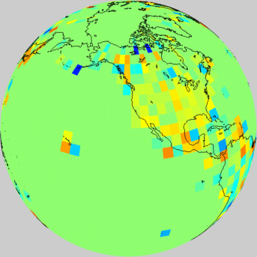
Attribute Relative Frequency
Female(red)
or Male(blue)
Notes:
Face attribute relative frequency

Slide 11
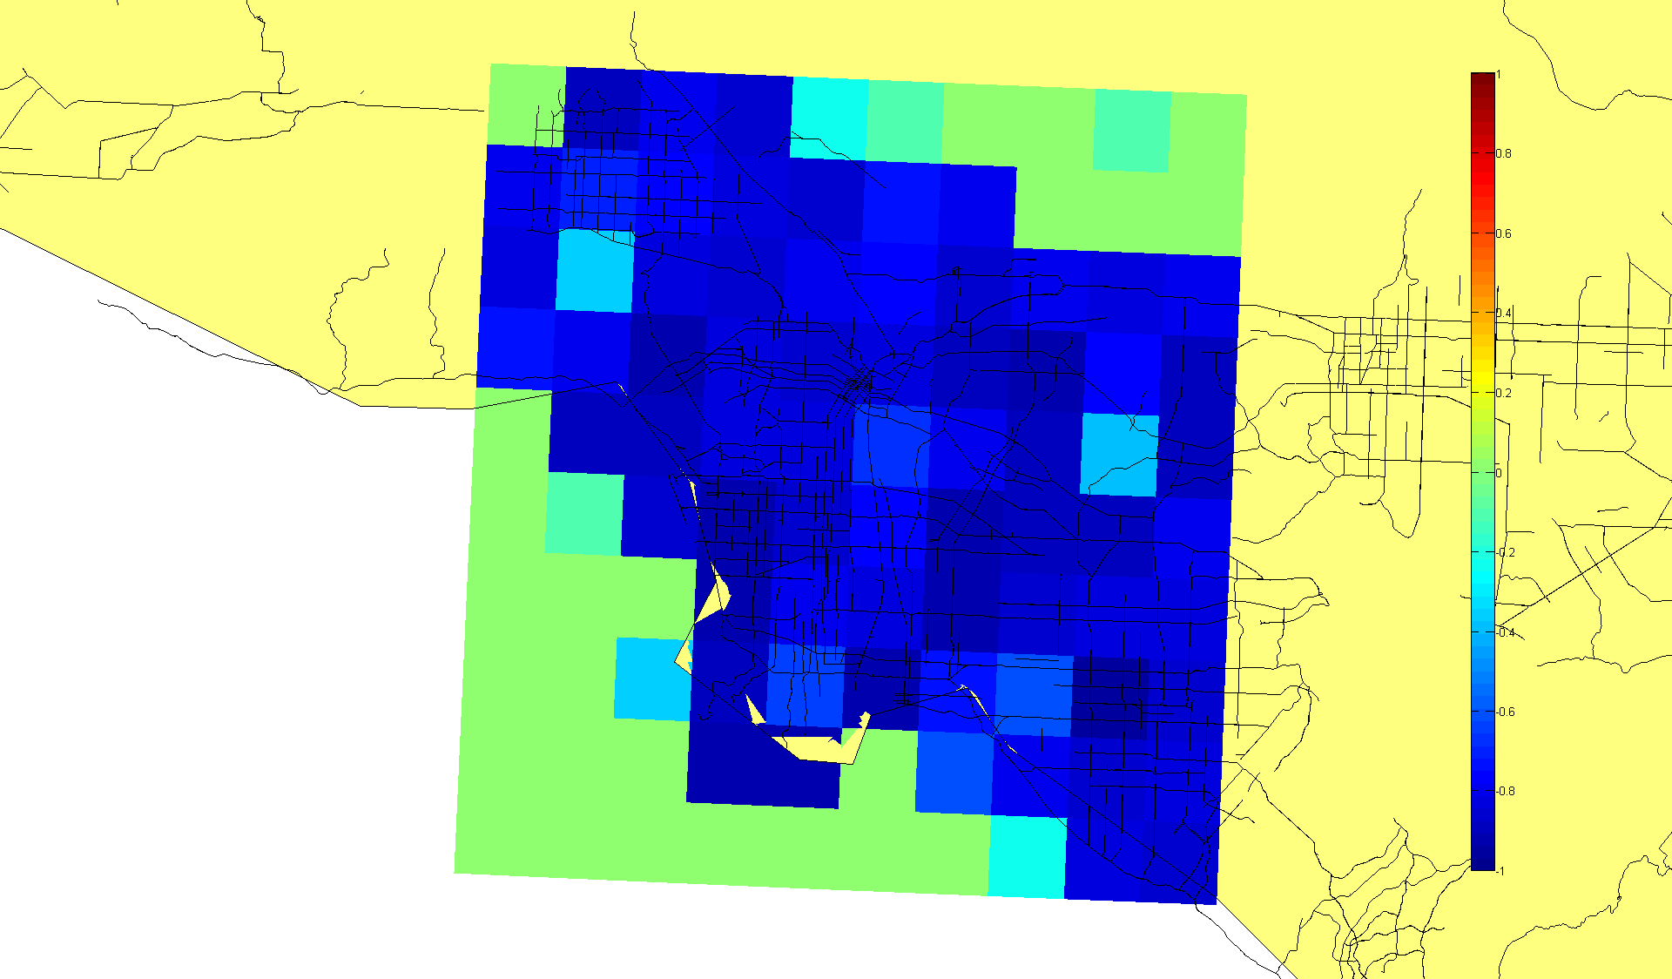
Attribute Relative Frequency
No Beard
Beard
Notes:
Face attribute relative frequency

Slide 12
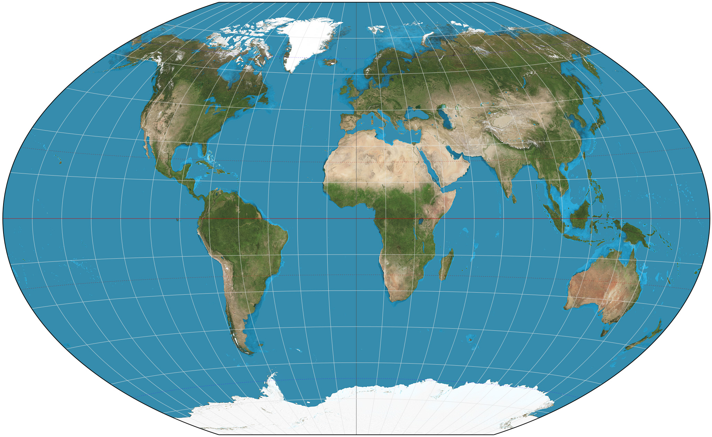
Continent
Classification
Notes:
Continent Classification

Slide 13
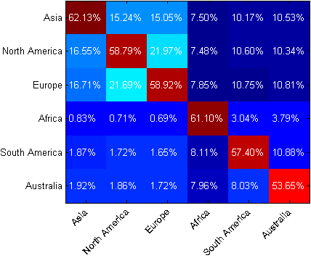
Labeled As
True Location
Notes:
Continent Classification

Slide 14
Clustering By Similarity and Location
Notes:
clustering

Slide 15
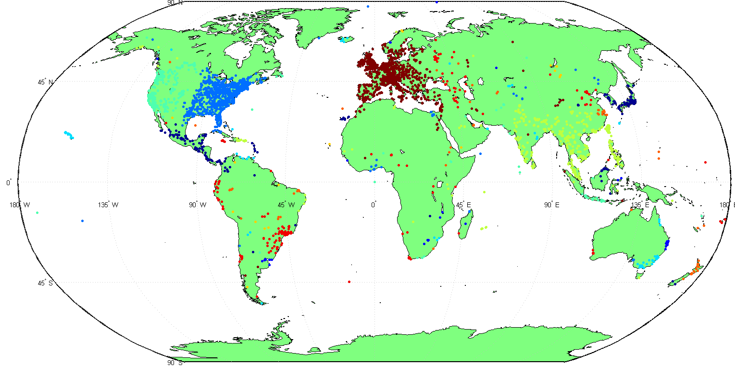
Notes:
Unsupervised clustering

Slide 16
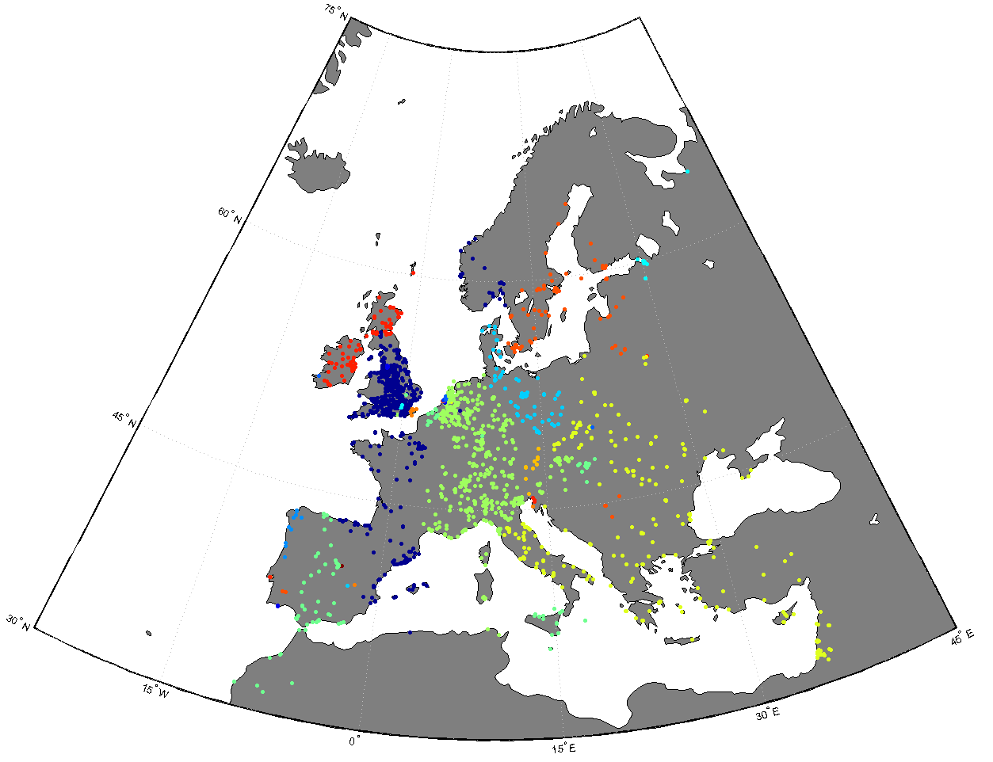
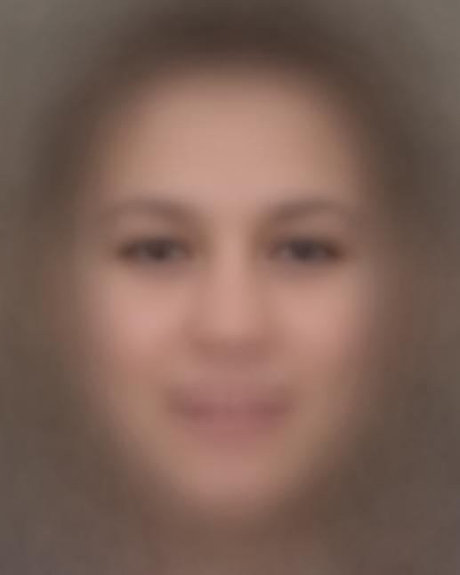
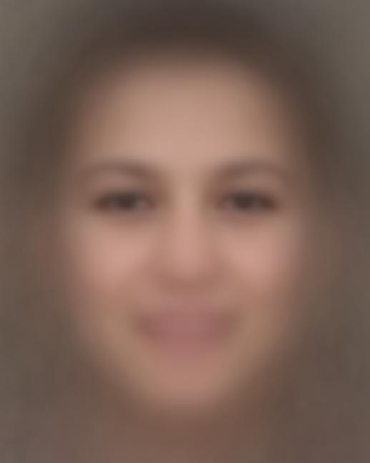

Slide 17
Arch.
analysis
Conclusion
Scene
analysis
Face analysis
Locator

Slide 18
Questions?

