Slide 1
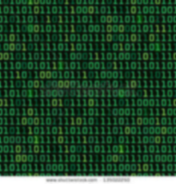
Presentation By Darren Stevens II
VisLab Mentors
Dr. Wenwen Dou /// Dr. Isaac Cho
Notes:
Intro: I’m Darren S II working @ UNC Charlotte’s Visualization lab
Background: One of the problems we have identified is that the size and complexity of data is increasing. Organizations need to upgrade their systems that handle and analyze data
Purpose: One of our core objectives here is to find and create tools and methods that improve the way people view data
Transition: One of the tools that the VisLab has developed is a browser based program code-named: VARome

Slide 2
Visualization Lab
Problem:
How to discover the latent structure in unstructured data (e.g. Wikipedia articles).
Objective:
Improve the ways people explore and analyze hundreds of thousands Wikipedia articles.
Methods (cont.) :
Extract topics that summarize 189,000 Wikipedia articles
Extract time and location from the articles
Visually present the results in a meaningful way.
Notes:
Intro: I’m Darren S II working @ UNC Charlotte’s Visualization lab
Background: The amount and complexity of data is increasing. Data sets such as Wikipedia articles are hard to analyze because they are mostly text. Organizations need stronger structures that can efficiently handle and analyze such data.
Purpose: One of our core objectives here is to find and create tools and methods that improve the way people view data.
---Specific Objective: Specifically, we want to improve the way people can explore and analyze the numerous Wikipedia articles without reading every single one of them.
Transition: One of the tools that the VisLab has developed is a browser based program code-named: VARome.
Topics are summaries of a bunch of articles. Topics can include war, architecture, culture, etc…

Slide 3
Methods
Extract Topic Summaries
Collect Data
Visualize Results
Extract Location and Date
Notes:
Processing the data from Wikipedia articles

Slide 4
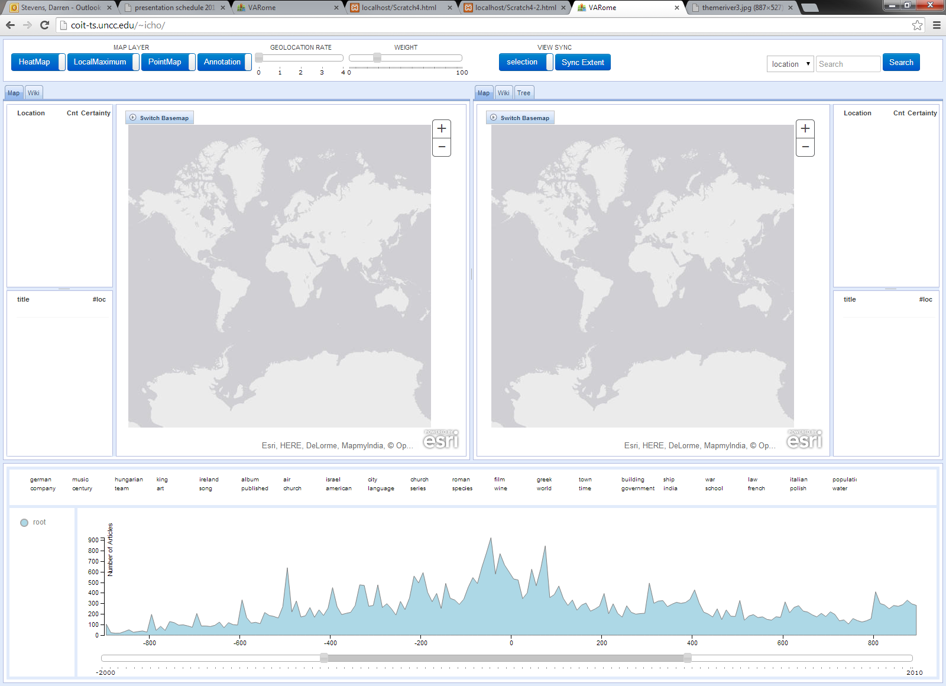
Notes:
Background: VARome is a web program designed to efficiently find Wikipedia articles based on algorithmic magic that determines what the article’s location, time, and topic of its contents are. It was originally commissioned for use in quickly finding information on the Roman empire (thus the temporary name).
(Visual Analytics Rome)
Features:
Main View: Shows an example of one of the many types of base maps
Support View: Shows a snippet of the various topics to search through from the articles that have been scanned so far
TimeLine: The navigator specifies the range the user wants to search in from 2000 BC to 2010. The actual graph shows the number of articles about the current topic in the time period (in this case all topics). Peaks represent more articles on the subject in that decade.
How to use:
Select a topic
Select the decade you want. Wait for results to appear.
Zoom in and select a red dot. Click on an article.
Emril: BAM. Found an article on the Battle of Alesia. What that is? I don’t know. But if I wanted to know the location, time, and what it was, I know where I could find out.
But what if for whatever reason I wanted to compare how multiple topics related to each other over time? Well we have an app for that too.

Slide 5
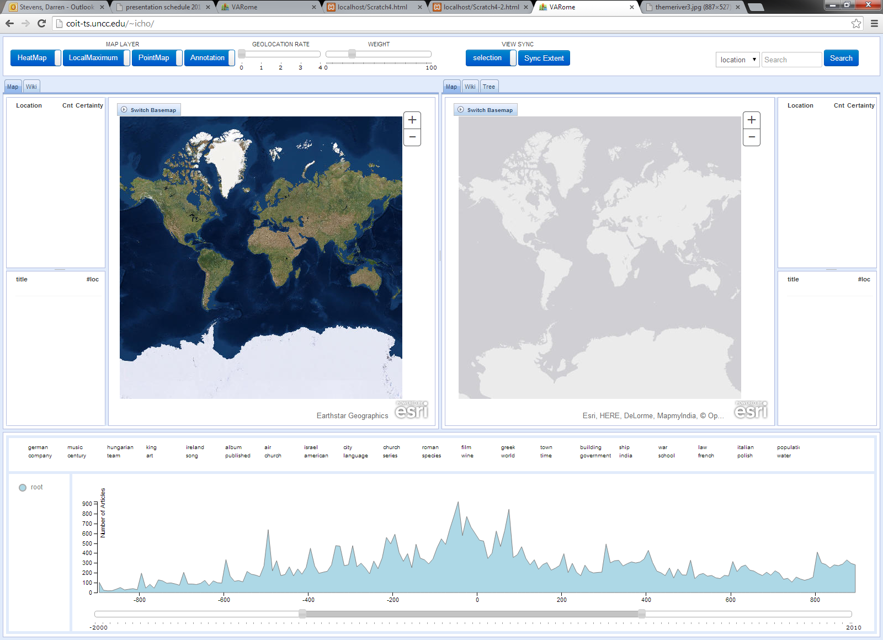
Map View
Views can include:
Imagery
Topographic
Street layer
Oceanic
Notes:
Features:
Map View: Shows an example of one of the many types of base maps
Support View: Shows a snippet of the various topics to search through from the articles that have been scanned so far
TimeLine: The navigator specifies the range the user wants to search in from 2000 BC to 2010. The actual graph shows the number of articles about the current topic in the time period (in this case all topics). Peaks represent more articles on the subject in that decade.

Slide 6
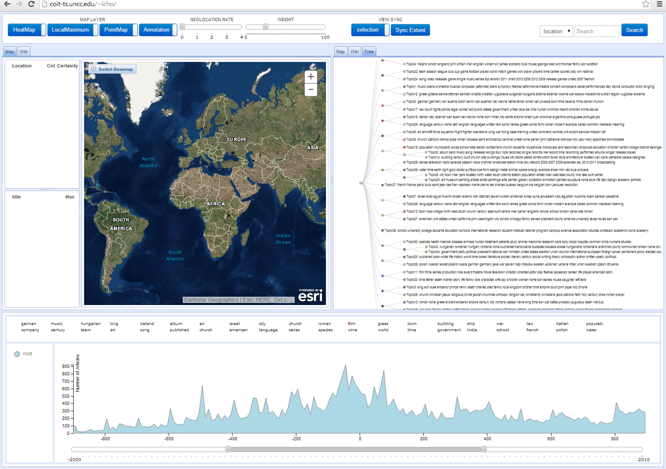
Support View
Tabs can show:
Separate map
Link to Wikipedia article
List of searchable topics
Notes:
Features:
Main View: Shows an example of one of the many types of base maps
Support View: Shows a snippet of the various topics to search through from the articles that have been scanned so far
TimeLine: The navigator specifies the range the user wants to search in from 2000 BC to 2010. The actual graph shows the number of articles about the current topic in the time period (in this case all topics). Peaks represent more articles on the subject in that decade.

Slide 7
Timeline
Navigation slider shows user’s range
Graph shows number of articles on topic at the time
Notes:
Features:
Main View: Shows an example of one of the many types of base maps
Support View: Shows a snippet of the various topics to search through from the articles that have been scanned so far
TimeLine: The navigator specifies the range the user wants to search in from 2000 BC to 2010. The actual graph shows the number of articles about the current topic in the time period (in this case all topics). Peaks represent more articles on the subject in that decade = important events.
How to use:
Select a topic
Select the decade you want. Wait for results to appear.
Zoom in and select a red dot. Click on an article.
Emril: BAM. Found an article on the Battle of Alesia. What that is? I don’t know. But I know where I could find out.
But what if for whatever reason I wanted to compare how multiple topics related to each other over time? Well we have an app for that too.

Slide 8
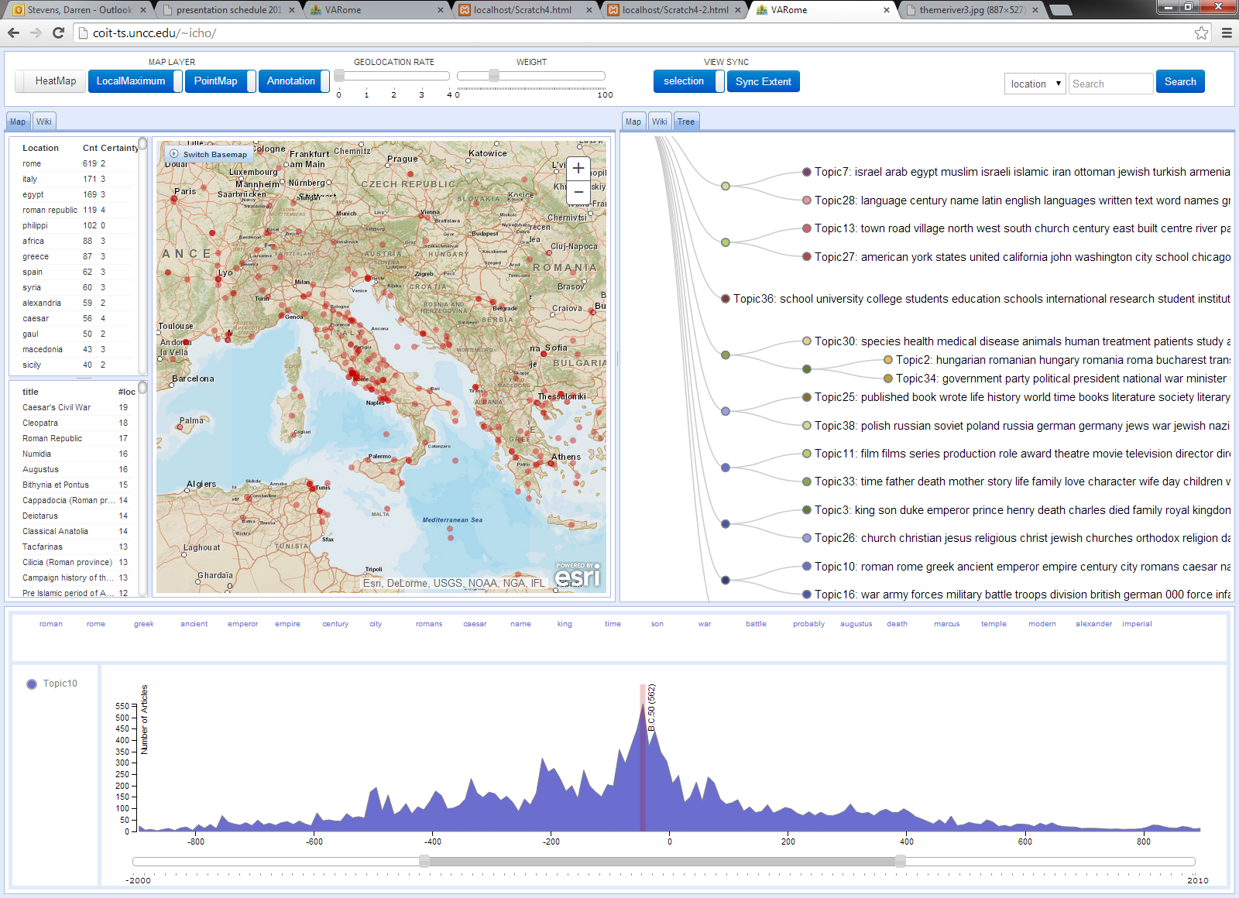
3
1
2
Notes:
How to use:
Select a topic
Select the decade you want. Wait for results to appear.
Zoom in and select a red dot. Click on an article.
Emril: BAM. Found an article on the Battle of Alesia. What that is? I don’t know. But I know where I could find out.
But what if for whatever reason I wanted to compare how multiple topics related to each other over time? Right now our timeline only shows one topic at a time Well we have an app for that too.

Slide 9
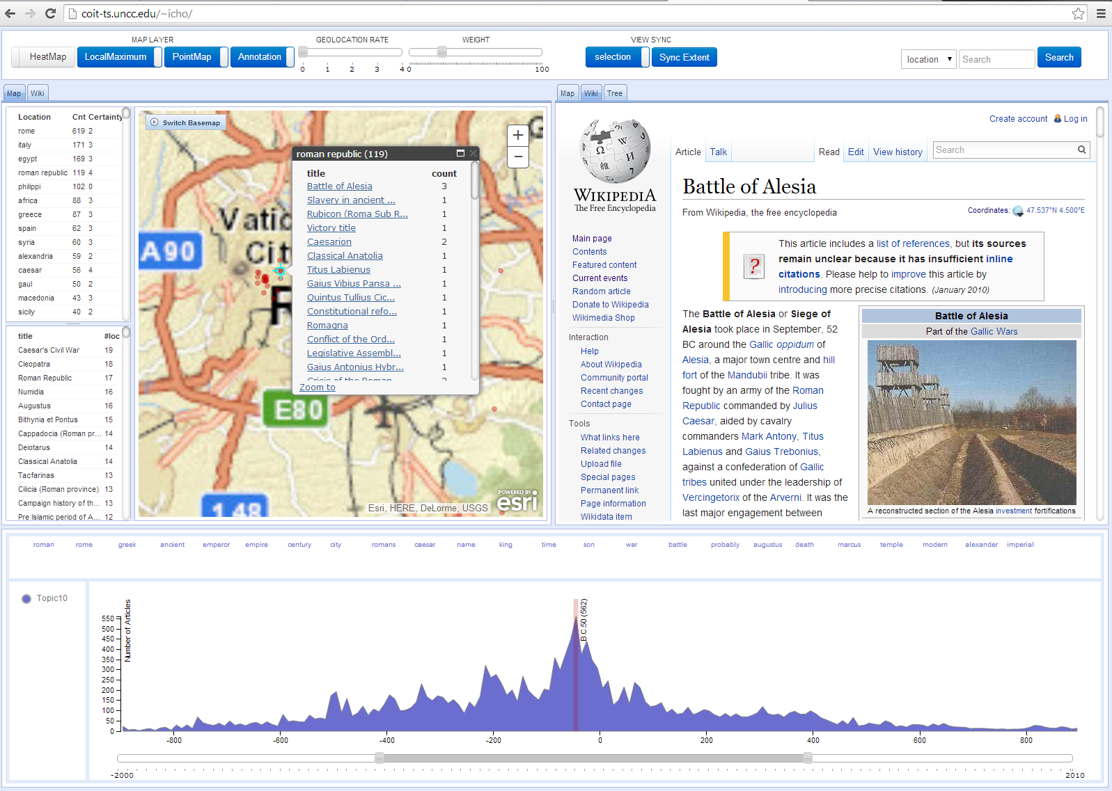
Notes:
Emril: BAM. Found an article on the Battle of Alesia. What that is? I don’t know. But I know where I could find out.
But what if for whatever reason I wanted to compare how multiple topics related to each other over time? Well we have an app for that too.

Slide 10
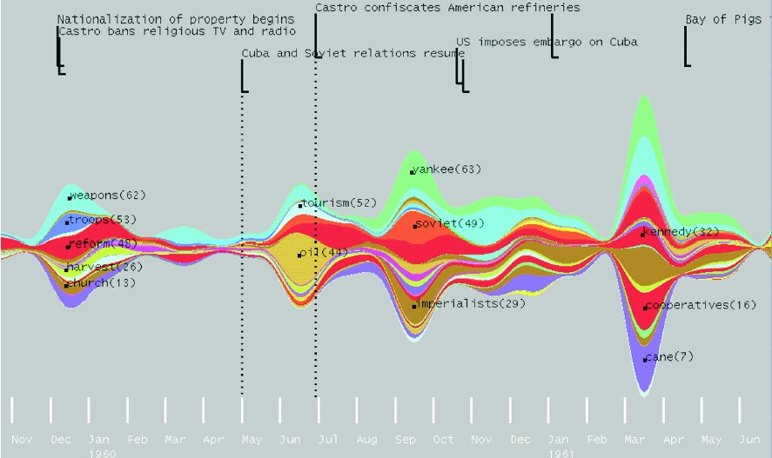
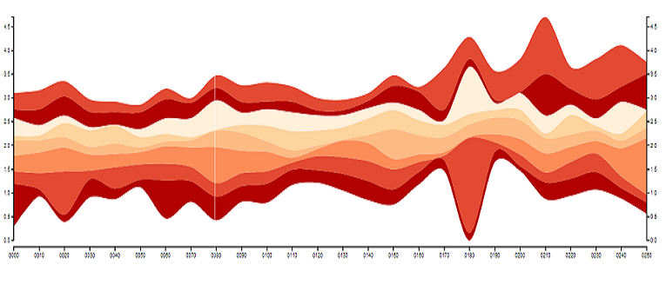
ThemeRiver
Havre et al. “ThemeRiver Visualizing Thematic Changes in large Document Collections”
Specialty: Large amounts of data over time.
Notes:
ThemeRiver: In our quest to find meaningful ways to present data, we came across a type of graph called a ThemeRiver.
This type of graph is called a ThemeRiver. These graphs are especially useful for displaying the relationship between large amounts of related data over time. I like to think of them as super bar charts.
In our case, each ribbon would represents a different topic or set of topics. The ‘peaks’ of the ribbons would be representative of the peaks found in the TimeLine on VARome. Larger peaks = larger events in that topic set = more articles confirming events at that time period.
Thanks to some test users, we have recorded annotation data (topic, date, weight) from several of the articles. By taking a section of that data, I could make the ThemeRiver interactive to compliment the web program. An algorithm displays where the annotation data is located on the river as well as the contents of the annotations when the user hovers over the coordinate.

Slide 11
Example Values
Incorporating annotations
Birth of Christ (0 AD)
Conquest of Dacia (106 AD)
Notes:
In our case, each ribbon would represents a different topic or set of topics. The ‘peaks’ of the ribbons would be representative of the peaks found in the TimeLine on VARome. Larger peaks = larger events in that topic set = more articles confirming events at that time period. This data would be generated by the Wikipedia.
Thanks to some test users, we have recorded annotation data (topic, date, weight) from several of the articles (basically sticky notes). By taking a section of that data, I could make the ThemeRiver interactive to compliment the web program. An algorithm displays where the annotation data is located on the river as well as the contents of the annotations when the user hovers over the coordinate.
Annotations made from users by hand. Task is to effectively incorporate annotations into the ThemeRiver.
The graph looks thin in comparison because this was made using a small subset of data. If we were to fill in the missing values in time then even with random values, our graph would look much more fleshed out and useful.
Like this.

Slide 12
Example Values
With annotations in the proper coordinates
Notes:
In our case, each ribbon would represents a different topic or set of topics. The ‘peaks’ of the ribbons would be representative of the peaks found in the TimeLine on VARome. Larger peaks = larger events in that topic set = more articles confirming events at that time period. This data would be generated by the Wikipedia.
Thanks to some test users, we have recorded annotation data (topic, date, weight) from several of the articles (basically sticky notes). By taking a section of that data, I could make the ThemeRiver interactive to compliment the web program. An algorithm displays where the annotation data is located on the river as well as the contents of the annotations when the user hovers over the coordinate. Red dots are where the annotations actually are.
The graph looks thin in comparison because this was made using a small subset of data. If we were to fill in the missing values in time then even with random values, our graph would look much more fleshed out and useful.
Like this.

Slide 13
Example Values
With annotations displayed
Notes:
In our case, each ribbon would represents a different topic or set of topics. The ‘peaks’ of the ribbons would be representative of the peaks found in the TimeLine on VARome. Larger peaks = larger events in that topic set = more articles confirming events at that time period. This data would be generated by the Wikipedia.
Thanks to some test users, we have recorded annotation data (topic, date, weight) from several of the articles (basically sticky notes). By taking a section of that data, I could make the ThemeRiver interactive to compliment the web program. An algorithm displays where the annotations users make on the river. as well as the contents of the annotations when the user hovers over the coordinate.
Annotations have to be placed @ the right time and on the right topic ribbon and then displayed.
Like this.

Slide 14
Notes:
The overall objective of this project is to explore the value of having an interactive ThemeRiver as another method of viewing data from VARome. We wanted to see if this type of visualization was healthy for users to understand VARome better as well as identifying trends in data over time that may otherwise have been missed.

Slide 15
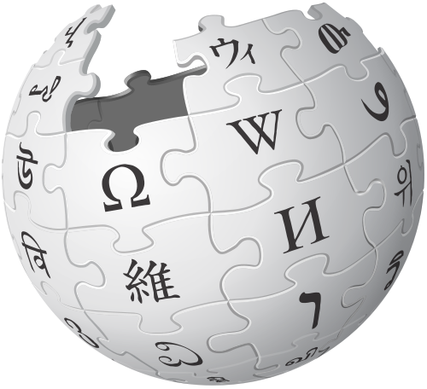
Anything Else?
Potential data applications include:
Military
Corporate
Government
Medical
Consumer
Try for yourself at:
http://coit-ts.uncc.edu/~icho/
Notes:
While the various visualization techniques I learned over the summer were specific to Wikipedia articles, this project has the capacity to handle multiple applications of large data sets such as military, corporate, and even medical data. VARome is currently available for public @ http://coit-ts.uncc.edu/~icho/

Slide 16
Questions?
Notes:
Any questions?

