Slide 1
Dancing with Technology:
Cultivating Presences Through
Distributed Movement Practice
Elizabeth Riddell
Socially Relevant Computing REU at UNC Charlotte - 2014
Human-Computer Interaction Lab
Advisor: Celine Latulipe, PhD
Notes:
Introduce yourself:
Good morning, my name is Elizabeth Riddell and today I would like introduce you all to Dancing with Technology
----------------------
10 seconds
Don’t mention socially relevant computing because everyone will already know that.

Slide 2
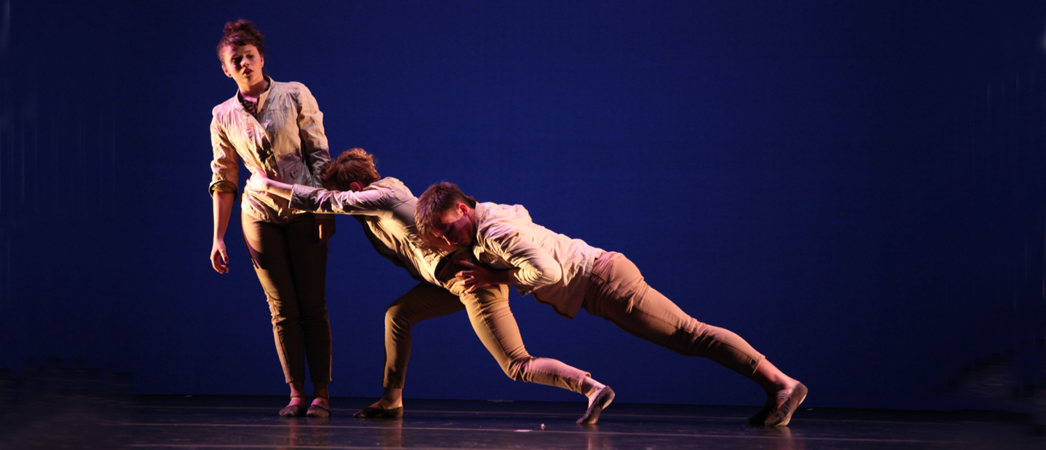
AGA Collaborative ~
Amanda, Gretchen and Alison performing Turtle Crow
Notes:
Introduce AGA Collaborative
AGA includes three dancers professors / choreographers: Amanda, Gretchen, and Alison.
This group collectively collaborated across geographical distances to experiment with different ideas involving intimacy as expressed through dance.
20 seconds

Slide 3
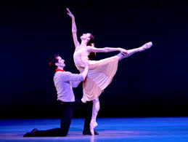
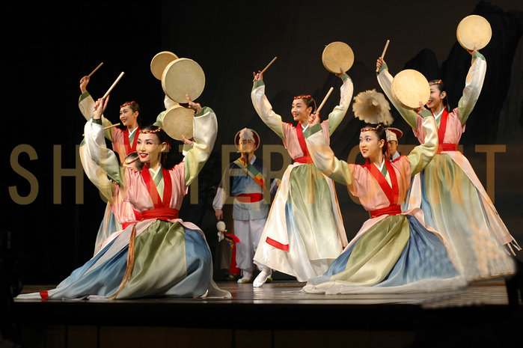
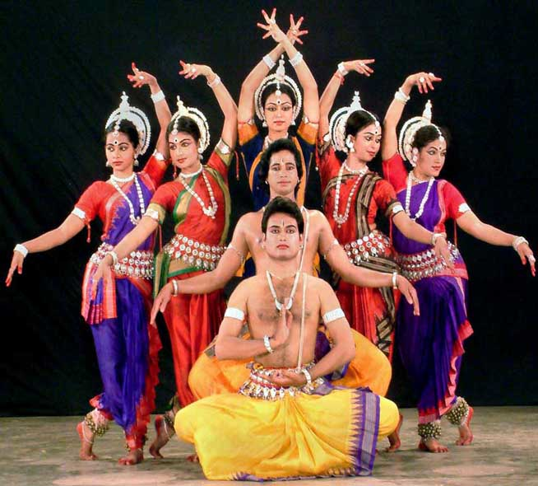
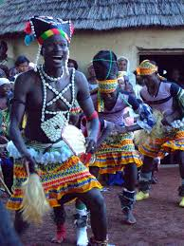
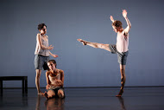
Why Dance Matters?
Notes:
Dance is rooted in cultural tradition and doesn’t really involve technology.
AGA Collaborative branched away from tradition and begin using technology to create a modern dance routine
They needed to use technology to collaborate without having to buy a plane ticket to rehearse with each other.
40 seconds
(this is a maybe to say)
In HCI, we serve a liaisons between the tech designers and the tech users. We take the information we learn and make a bad feature of an application better and a good feature even greater.

Slide 4
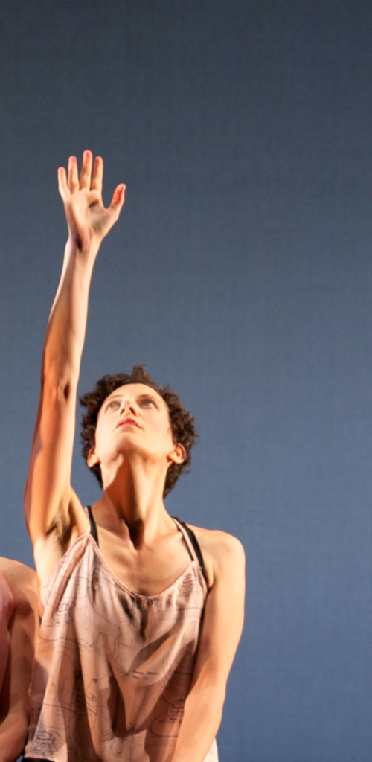
Project Goal ~
To explore the challenges and
opportunities of using technology
in distributed movement practice.
Methodology ~
- Analyze interviews
- Draw conclusions
- Determine social relevance
- Propose possibilities for future design
Notes:
Talk about goal
As a dancer, I bring both my creative dance side and my technical background to the table.
I came on the project after the AGA Collaborate completed their pieces and the interviews were already conducted
My methodology included
analyze these interviews conducted last and year and this year by my advisor
draw conclusions from the qualitative data,
see how this research will effect the use and future design of technology in dance
and to see what possibilities this technology will have in education
From the interviews, I see that the AGA dancers needed a way to use technology to collaborate on a modern dance routine.
They had already held one meeting to stage the choreography and had time to rehearse individually.
At the time Skype would allow three people but only for a price.
So they immediately switched to Google Hangouts which allowed them to all interact for free.
After reflecting upon their interviews regarding the use Google Hangouts, I discovered three main challenges when using Google Hangouts to rehearse.
// Before going on to the next slide, be sure to state that the following slide is the research you did.
--------------
1 minutes 30 seconds
// Talk about compatibility issues with Microsoft and Google doc and excel and Google drive
Include more Timing

Slide 5
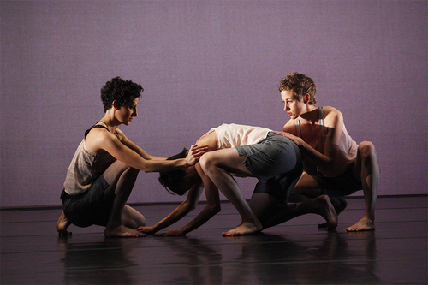
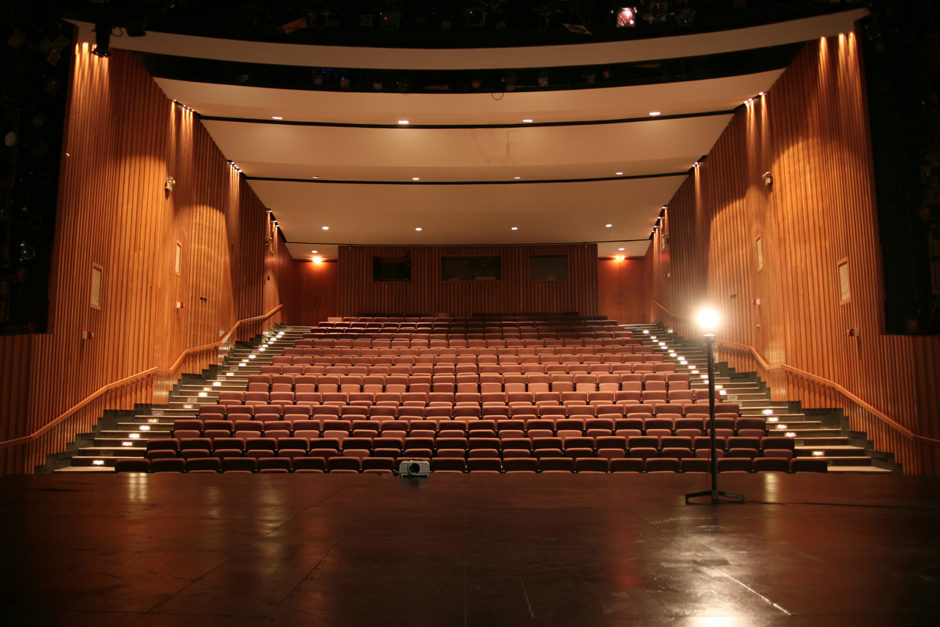
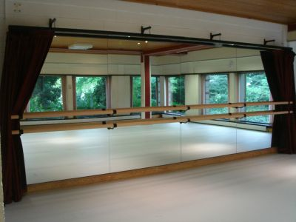
Challenges with Google Hangouts ~
- Spatial relationship
- Depth perception
- Visual orientation
Notes:
Spatial relationship: relationship between the dancers which is distorted by laptop Google Hangouts
Depth perception: relationship between the dancers and the stage. They always had to stay very close to the computer to be seen, they would be constantly running back and forth from the computer to the center of the studio
Visual orientation: The natural front of the studio is the mirror or audience. Since the laptop may not be able to be placed in front of the mirror. Your natural front will be altered towards the laptop’s front.
Additionally, Google Hangouts flips the image. Your right is their left. So often times one of the dancers would have to turn around to show the others her foot.
--------------------
(Spend the most time on this slide) 2 minutes
don’t use the dancers name because the audience may not remember

Slide 6
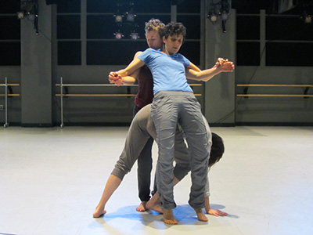
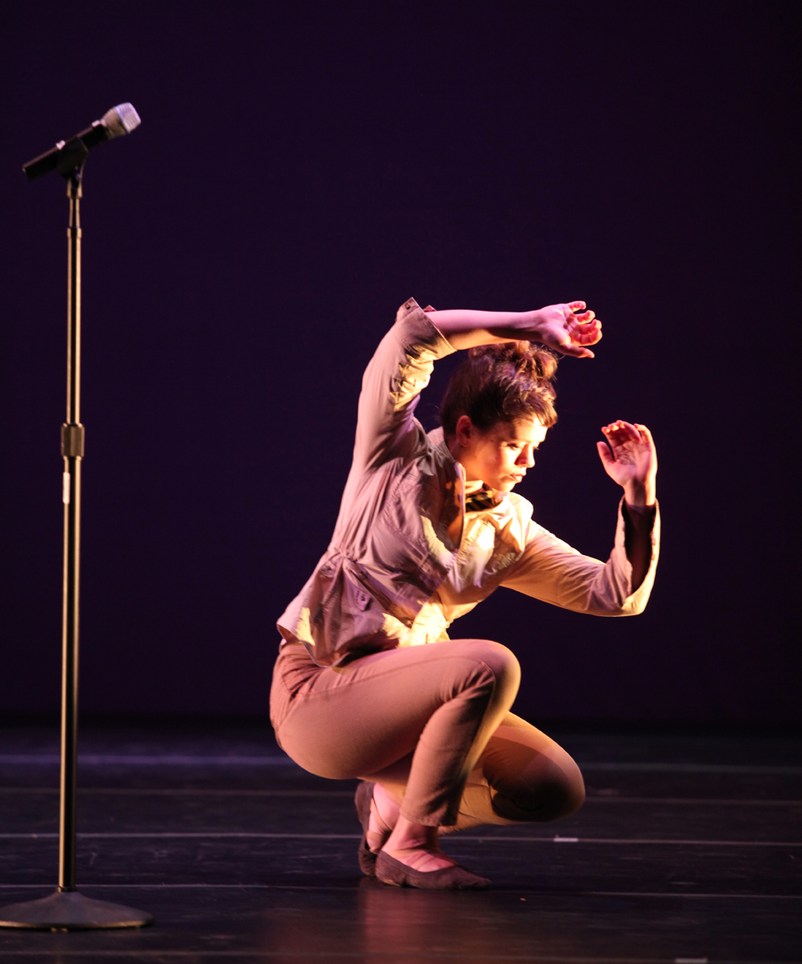
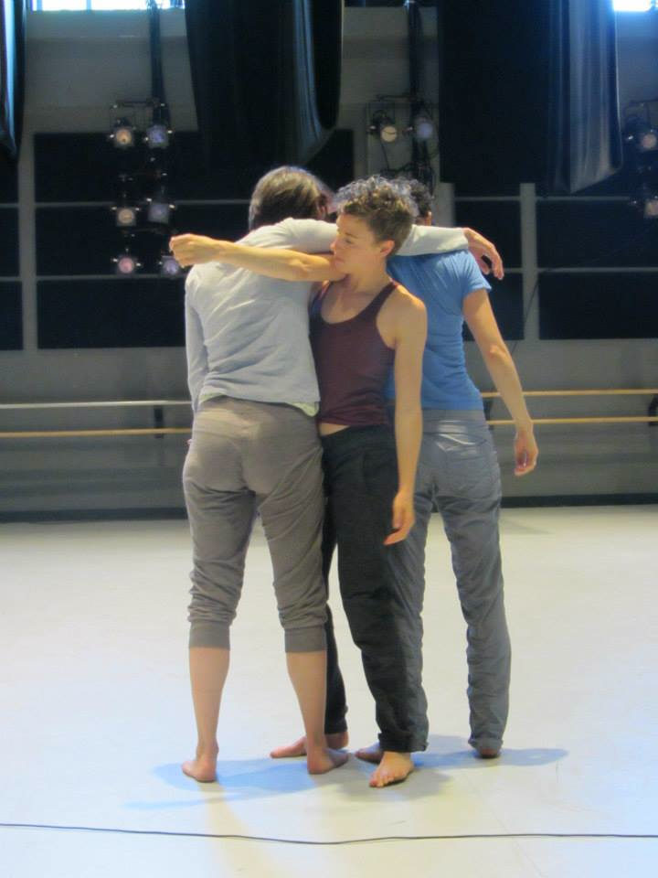
Opportunities ~
Performance level
- Decision making
- Productivity
- Awareness
- Presence
Notes:
Opportunities in using Google Hangouts:
Made them work harder during the dance
Made them more aware of each other’s presence
Made them more open to using technology in dance
Made them aware of being with each other and not being with each other
Made them aware of each other’s presence
------------
1 minute

Slide 7
How can I be in two places at once?
Notes:
20 seconds

Slide 8
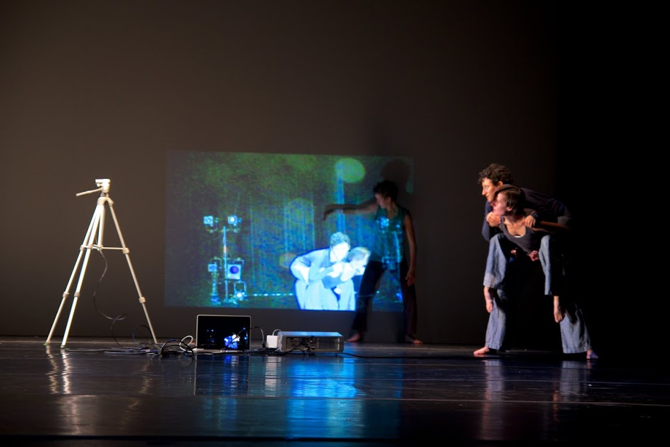
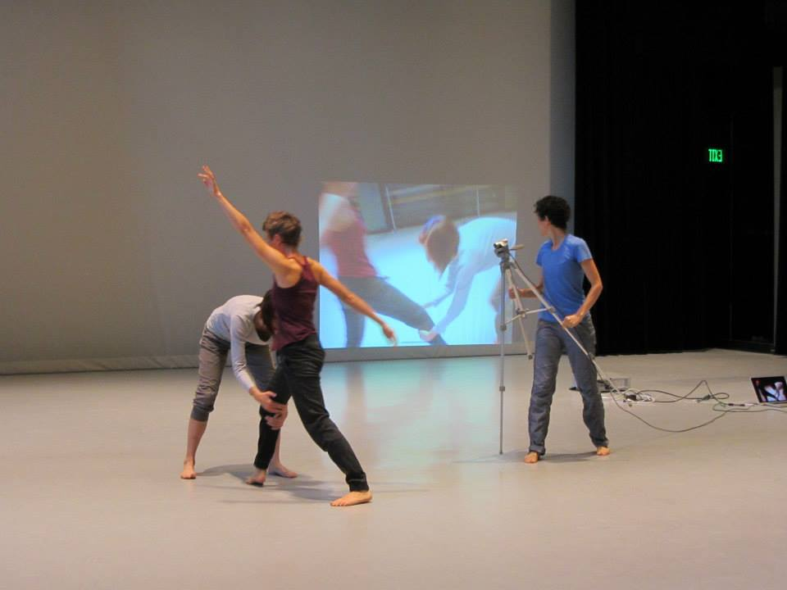
AGA Collaborative presents:
And How to be in Two Places at Once
Notes:
Just like before the set the choreography, rehearsed individually, but unlike the first piece they did not using Google Hangouts to rehearse.
Talk about the tech in the performance (just like flash talk in Charleston)
Just like the first piece they got together right before the performance to physically rehearse together.
---------
1 minute

Slide 9
Challenges and Opportunities ~
- Automatically opening applications
- Ability to connect with the
audience on a new level
Have we created a mixed reality?
The possibilities are endless …
Notes:
Does it matter that of this isn’t real
Does it matter that it’s impossible?
This introduces a whole new area of potential research questions
----------
1 minutes 30 seconds

Slide 10
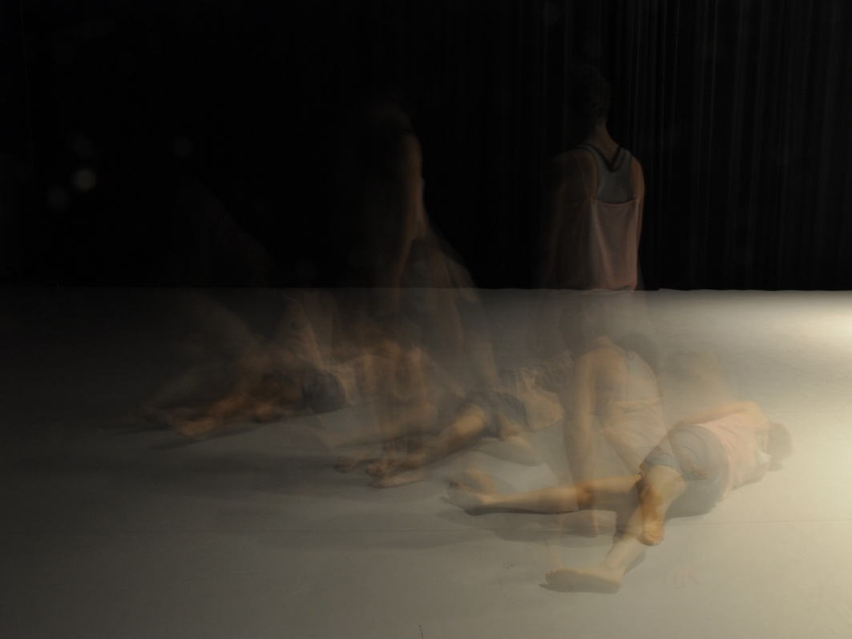
Video Interaction and Dance in Education
Dance Tutorials via
Video Interaction
Dancing Statistics Principles
Break Dance Tutorial
Notes:
Talk about using dance and technology to teach statistics principles.
Talk about online dance classes where via Google Hangouts, one could learn the choreography directly from the choreographer himself. And get on the spot critiques.
Additionally, many of these challenges in using technology in distributed dance would not present themselves in ordinary uses like with video conferences.
Google Hangouts allowed AGA Collaborative to do something in the dance that they wouldn’t be able to do without the technology.
Ultimately, using technology in dance will change the direction of research in computing.
In HCI we use humans to make technology better,
We use technology to make future generations better.
-----------------------
Socially Relevant computing
(dance vs. video conferencing)
Issues that wouldn’t be there unless we brought in dance
Using technology in dance will change the way we research directions in computing
Thank you.

Slide 11
Acknowledgements
- Celine Latulipe, PhD
- Members of AGA Collaborative
Thanks to the REU program and program coordinators.
Questions?
Notes:
2 minutes
When were the dances rehearsed and performed (mention this as applicable throughout the presentation.)

