Slide 1
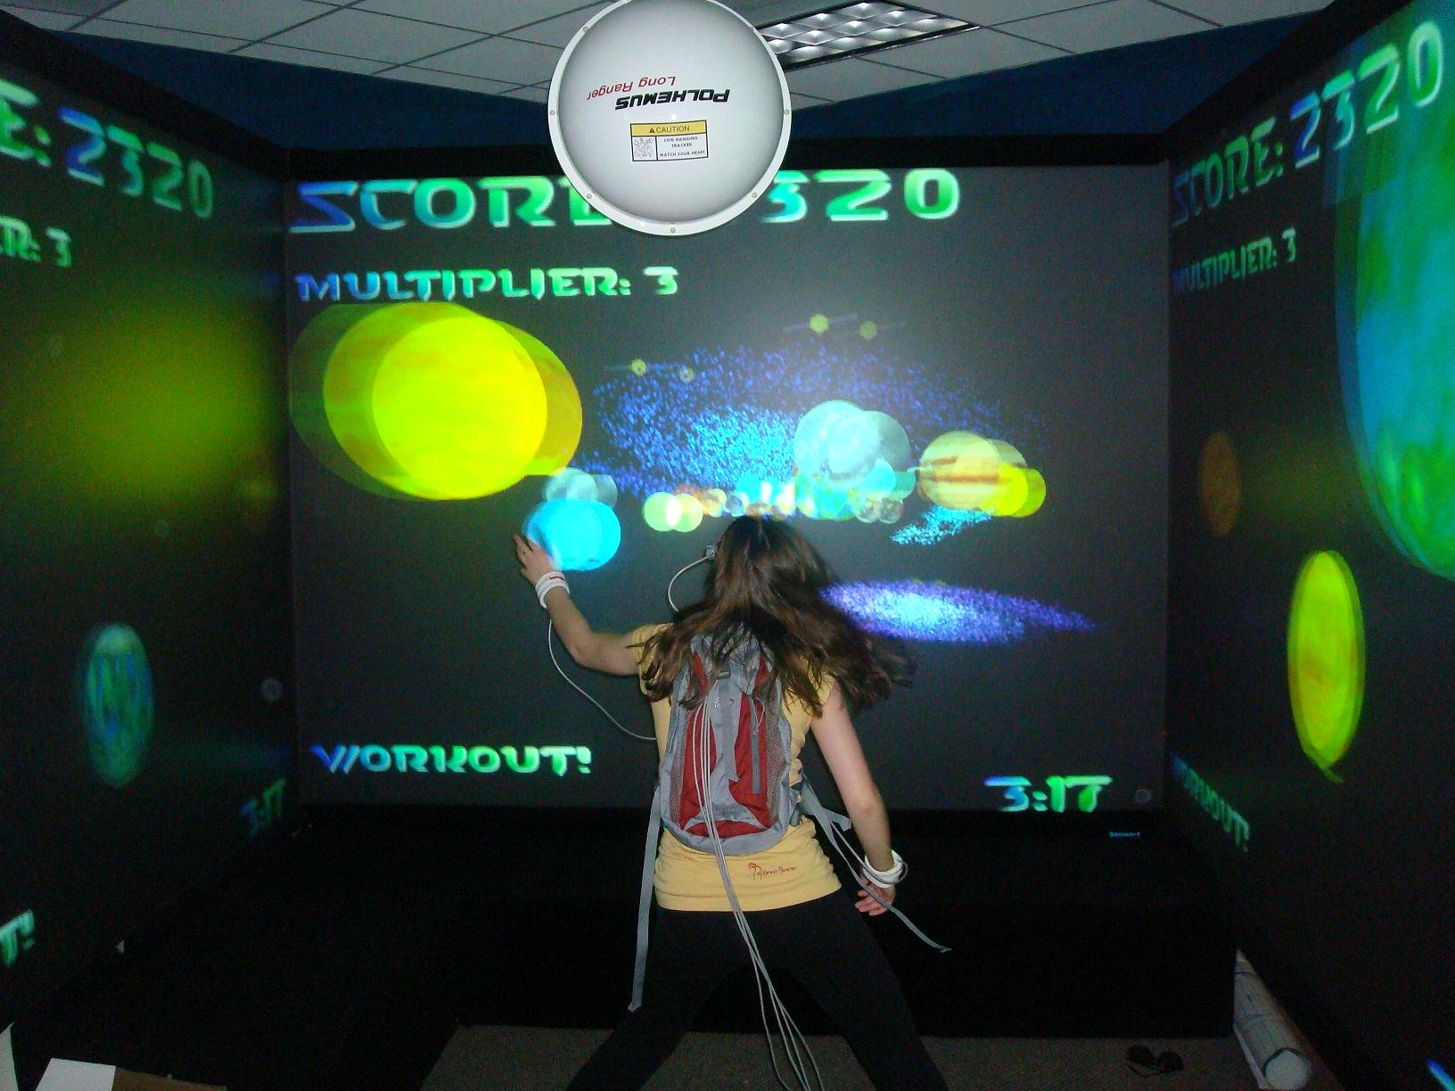
Astrojumper: Effect of First Person versus Third Person Point of View
By: Emily Hudson

Slide 2

A long, long time ago,
in a galaxy far, far away,
there existed a genius
team of scientists.
One day, they put their minds
together to benefit the
galaxy and they created
a video game like no other…

Slide 3
ASTROJUMPER!!!
Exploring the PAST,
PRESENT
And FUTURE!

Slide 4
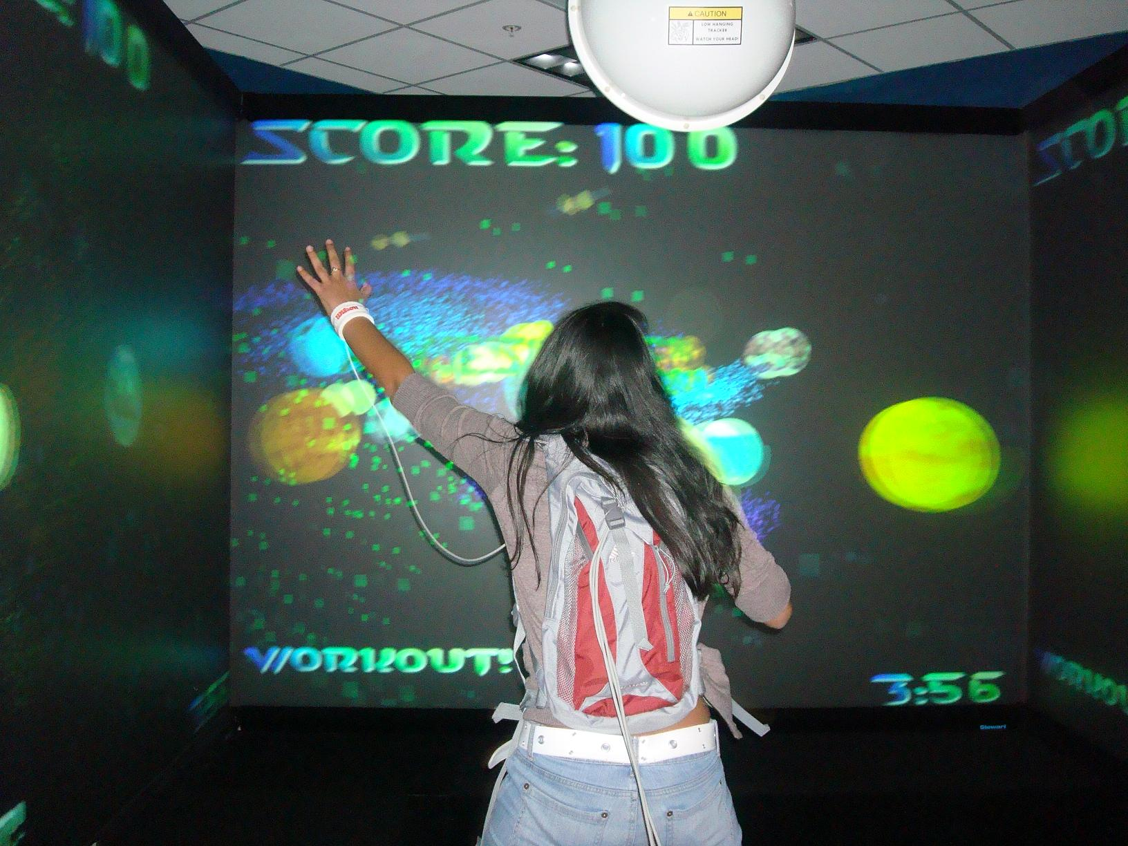
Initial Exploration
Past Present Future
Objective: Immersive and motivational game for children
Focus on children with Autism

Slide 5
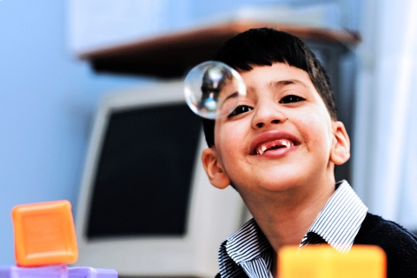
Why children with Autism?
Past Present Future
Lifelong developmental disorder:
  Irregular movement patterns or stereotypical behaviors (can be reduced with exercise)
  Fascination with technology and outer space
  Sedentary lifestyle- Astrojumper is outlet
http://trialx.com/curetalk/2011/03/medical-study-for-autism-disorder-maitland-florida/

Slide 6
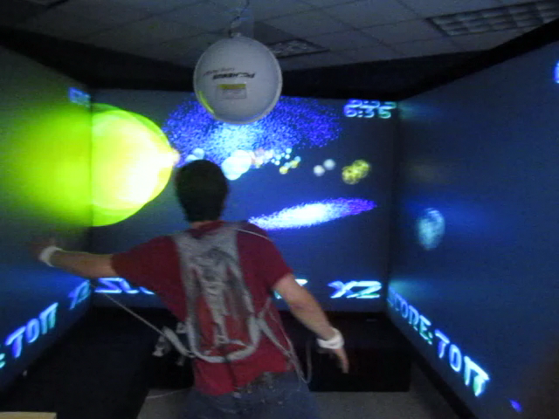
Gaming in Action
Past Present Future
Collide with as many gold planets (suns) as possible
Duck, dodge, and jump to avoid all other planets
Shoot lasers at UFO to make it explode

Slide 7
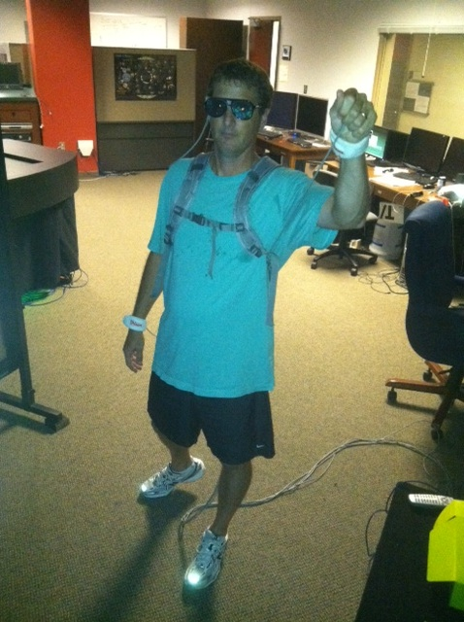
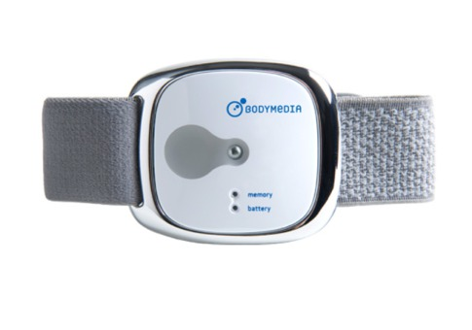
Results of Past Experiment
Past Present Future
Measurements collected:
  Quantitative (METs) and qualitative feedback
  METs recorded by Bodymedia armband
Children with Autism were engaged throughout and motivated to play more
METs | 0-3 | 3-6 | 6+
Intensity | Light | Moderate | Vigorous

Slide 8
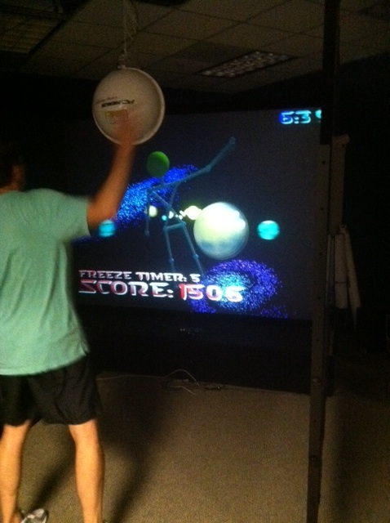
Experimental Design
Past Present Future
Similar objective and measurements, Different conditions
Effect of First Person vs. Third Person Views on Activity and Motivation level
Played in CAVE, 1 screen
Within subject experiment
Autistic and neurotypical (40 total)

Slide 9
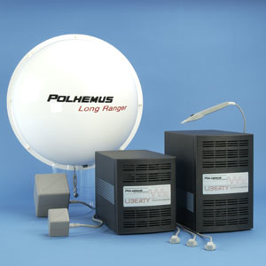
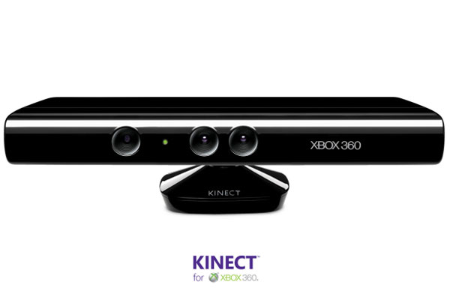
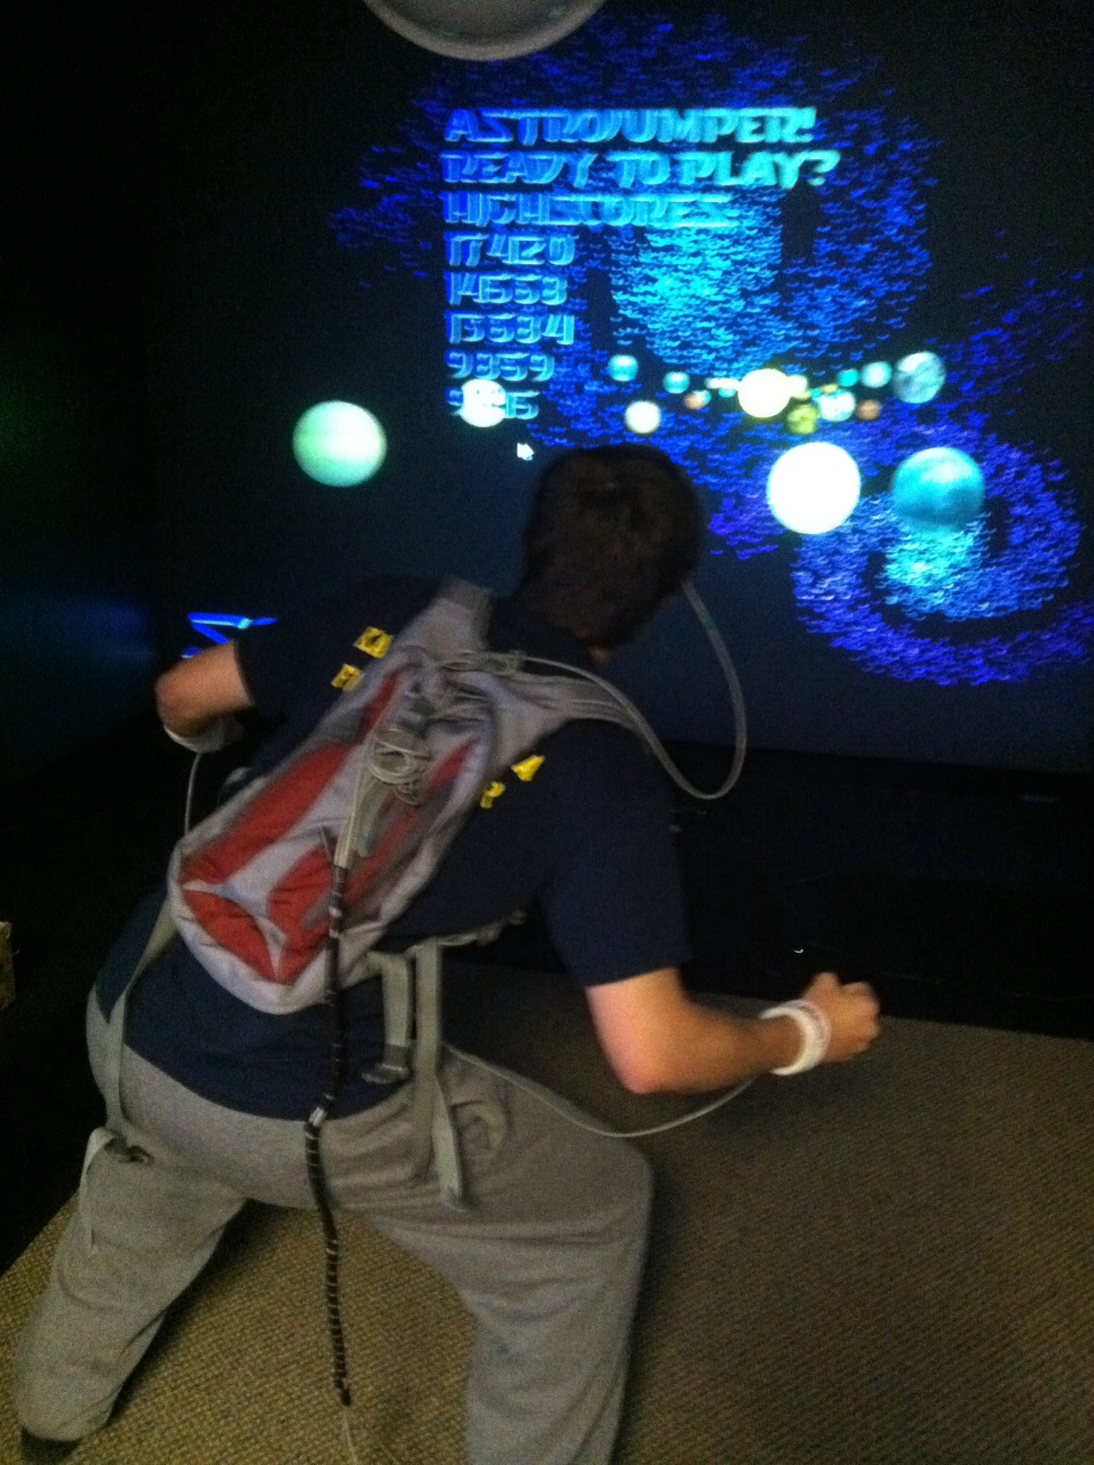
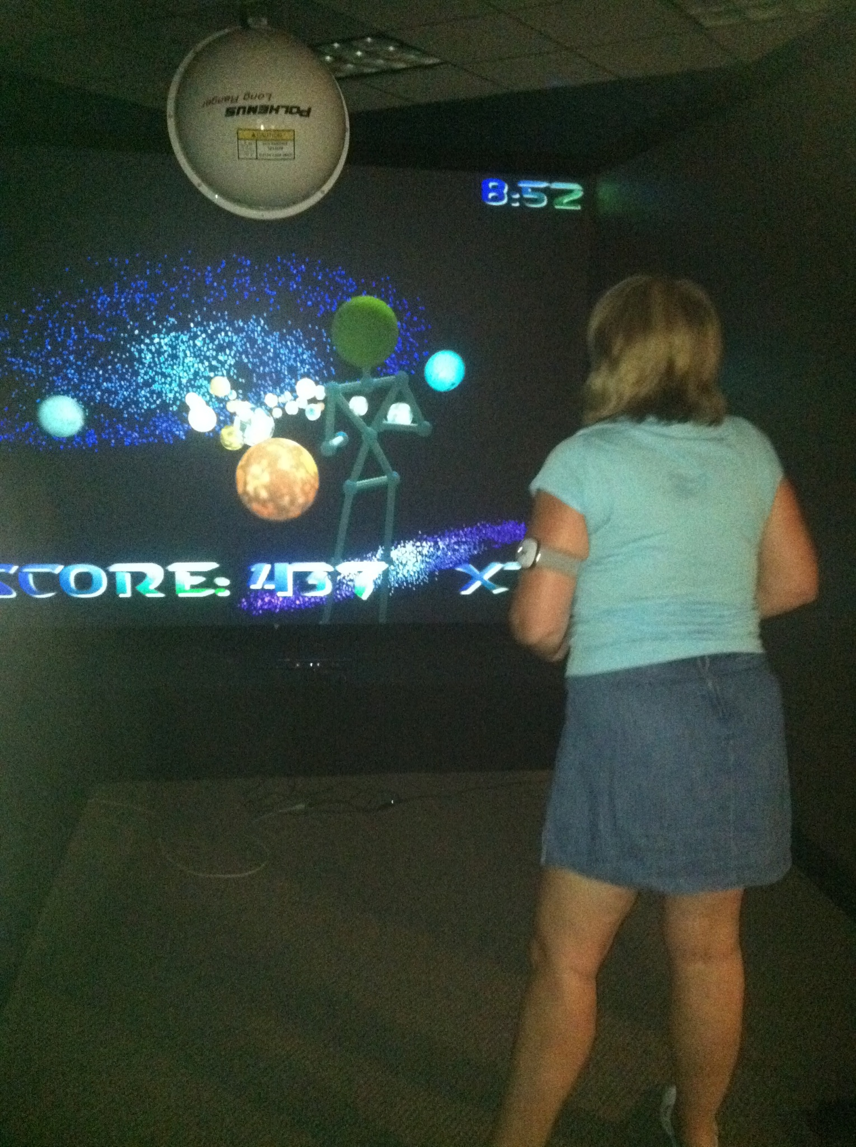
Past Present Future
Microsoft Kinect Version
Polhemus tracking version
Avatar, 3rd person | 1st person
Non-stereoscopic | Stereoscopic
Wireless | Wires/Trackers
2D | 3D
http://software.prokopenko.org/liberty.jpg
http://gigaom2.files.wordpress.com/2010/11/microsoft-kinect-xbox-360.jpg

Slide 10
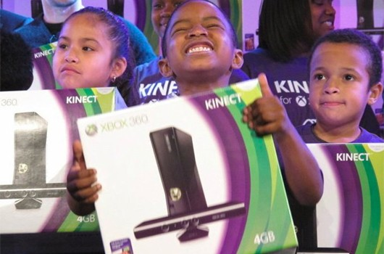
Hypothesis
Past Present Future
First-person play- more immersive
Exercise and enjoyment the same 1st and 3rd
http://xboxkinecthub.com/wp-content/uploads/2011/02/boysandgirlskinect.jpg

Slide 11
Observations of
Differences between versions
Past Present Future
3rd person (Kinect) | 1st person (Polhemus)
Can’t grab planets on sides as well | Can grab planets within CAVE area
Can’t get as close to screen | Can get very close to screen
More parts of body shown- more collide | Only torso, hands, and head tracked
Easier to jump- not tethered | Don’t have to jump as high to avoid planets
Focus on planets and avatar | Only focus on planets
Be aware and adjust when starts tracking poorly | Tracks more accurately

Slide 12
Results of Preliminary Experiment
Past Present Future
 | 3rd person (Kinect) | 1st person (Polhemus tracking)
Average METs | 4.4 | 4.6
Average calories burned | 41.75 | 41.42
5 minutes of jogging a 10 min mile= 40 calories
Motivational addition
-modified Kinect- Ave. game from 4790 to 8819
- METs from 3.7 to 4.7

Slide 13
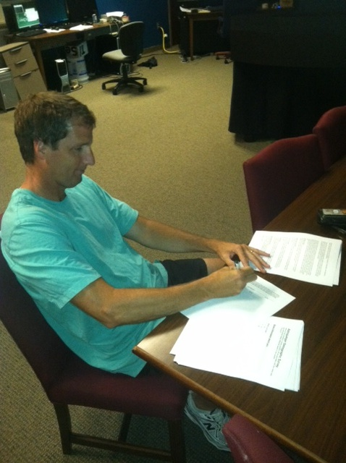
Results of Preliminary Experiment
Past Present Future
3D version more appealing, quantitative results similar
Kinect is more difficult, participants frustrated

Slide 14
Conclusions
Past Present Future
Designed and carried out a pilot study that compared two different versions of Astrojumper (1st person vs. 3rd person)
Learned about IRB, research, application
Learned basics of programming

Slide 15
Future Goals for Astrojumper
Past Present Future
Astrojumper is in its early stages, continue to make changes based on user feedback
Better response= further research
Kinect- more accessible for wider audience ($20,000 versus $150), possibly sold for at home play
Notes:
Make their house a gaming environment

Slide 16

Acknowledgement
UNC Charlotte
Visualization Center
Dr. William Ribarsky
Dr. Zachary Wartell
Dr. Xiaoyu Wang
Dr. Tiffany Barnes
Andrea Nickel
Aubrae Collins
REU Program

Slide 17

Questions?

Slide 18
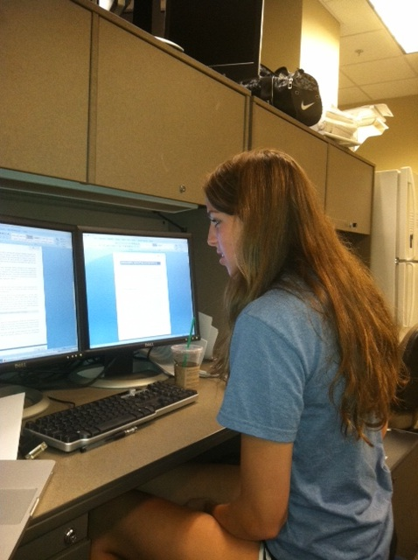
The Four R’s
Past Present Future
Research
Review
Recruitment
Reality! (virtual that is…)

Slide 19
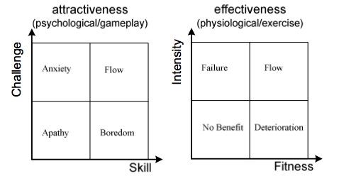
Astrojumper 2010
Past Present Future
“Motivating Autism with Virtual Reality”
Used dual-flow model for skill/challenge balance in both psychological and physiological game factors
http://delivery.acm.org/10.1145/1750000/1746061/a11-sinclair.pdf?ip=152.15.200.209&CFID=34352657&CFTOKEN=41537872&__acm__=1311693419_824f6ed09596f6f1900ee1c64729b88f

Slide 20
