Slide 1
BeadLoom Game
by Jonathan Curry
Acey Boyce David Brickler
Derek Mayfield Dr. Tiffany Barnes

Slide 2
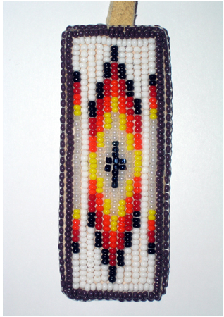
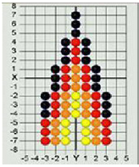
Virtual Bead Loom
Designed to teach Cartesian Coordinates, symmetry, geometry, and iteration through the creation of Native American bead art
Students use six functions that place virtual beads on a grid
Notes:
Doesn’t teach iteration and layering -> BLG

Slide 3
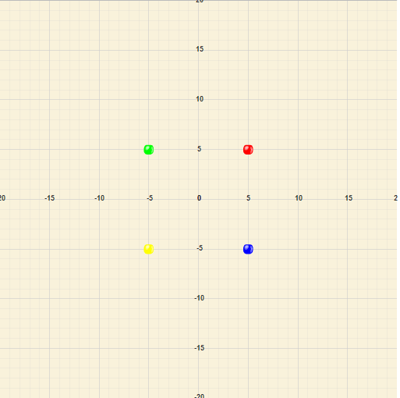
Point Function
Places a singles bead
X
Y
2 values

Slide 4
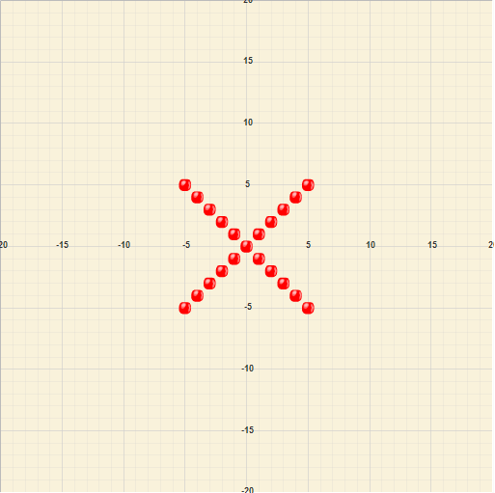
Line Function
Places a line of beads
X1
Y1
X2
Y2
4 values
(X1,Y1)
(X2,Y2)
Notes:
Point out x1,y1 x2,y2

Slide 5
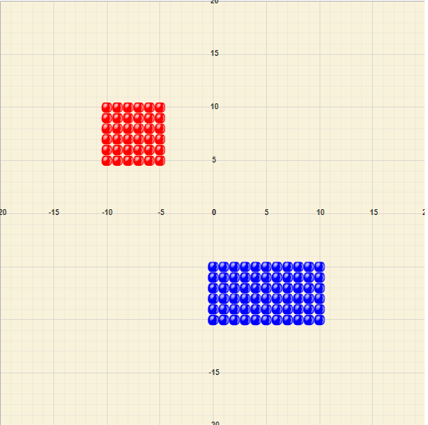
Rectangle Function
Places a rectangle of beads between two points
X1
Y1
X2
Y2
4 values
(X1,Y1)
(X2,Y2)
(X2,Y2)
(X1,Y1)

Slide 6
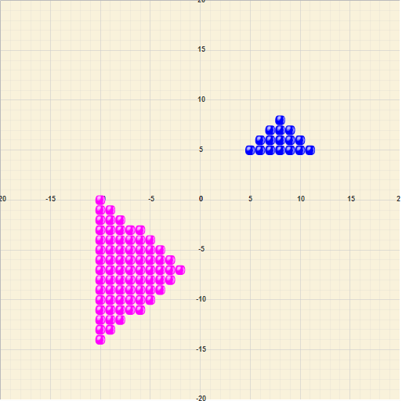
Triangle Function
Places a triangle of beads between three points
X1
Y1
X2
Y2
X3
Y3
6 values
(X1,Y1)
(X2,Y2)
(X3,Y3)

Slide 7
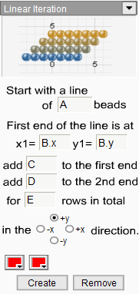
Linear Iteration
Draws a line of beads then iteratively redraws that line
A Beads
Starting at point B (B.x, B.y)
Add C to one end
Add D to the other end
For E rows in total
In a Certain Direction
7 values

Slide 8
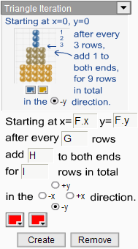
Triangle Iteration
Draws a single bead then iteratively creates a triangle
Starting at a point F (F.x, F.y)
Every G rows
Add H beads to both sides
For I rows in total
In a Certain Direction
6 values

Slide 9
BeadLoom Game
Added Custom Puzzle Mode
Competition
BeadLoom Game is more effective than Virtual Bead Loom

Slide 10
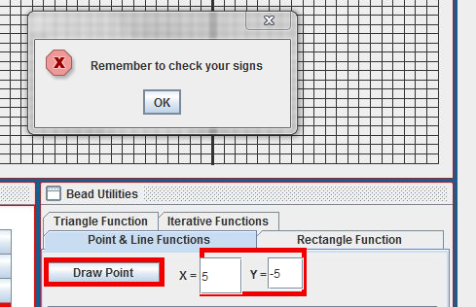
Need for Tutorial
Physical instruction
Catch common errors associated with BLG

Slide 11
Tutorial Hardships
Reengineering BLG code
Visual approximation
Time constraints

Slide 12
Tutorial
Notes:
Live Demo

Slide 13
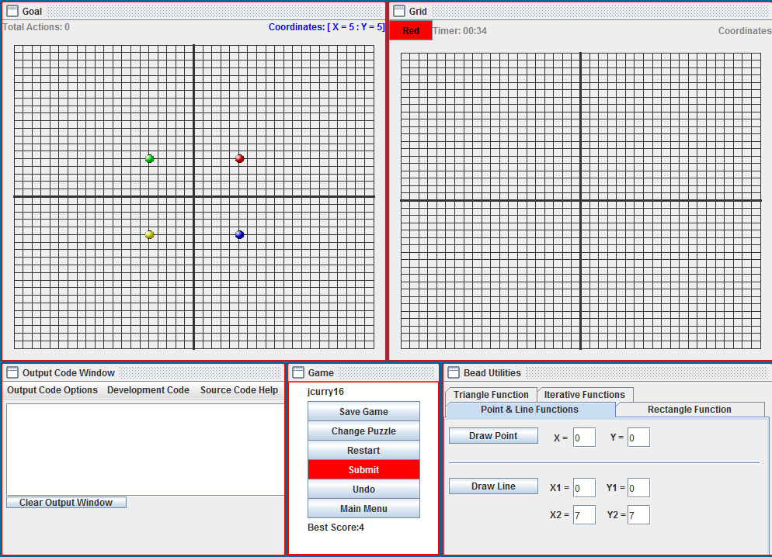

Slide 14
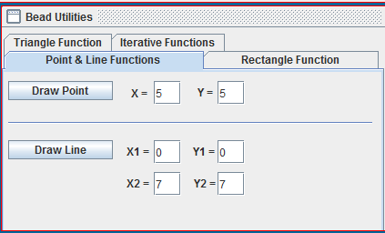

Slide 15
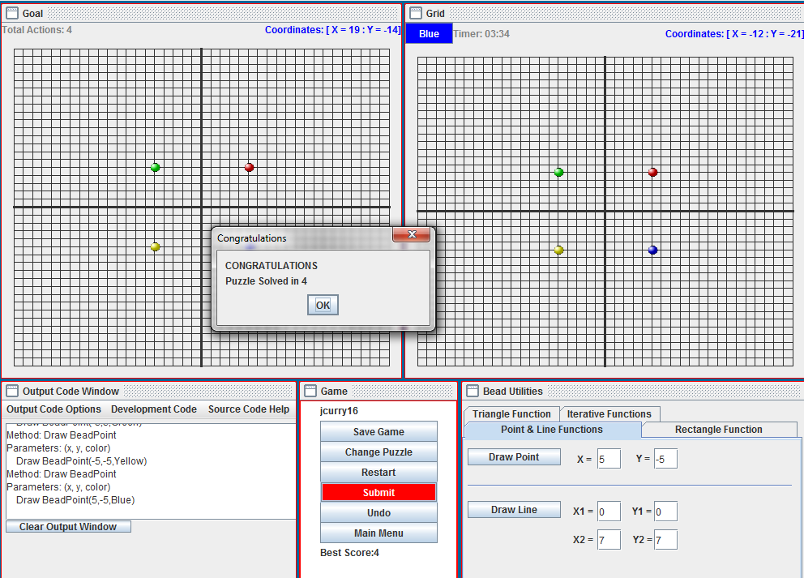
`

Slide 16
Research Studies
1 Camp
1- Middle School Gamemaker
13 participants
Data Collection
Observations
User Feedback
Notes:
Opinion survey on tutorials

Slide 17
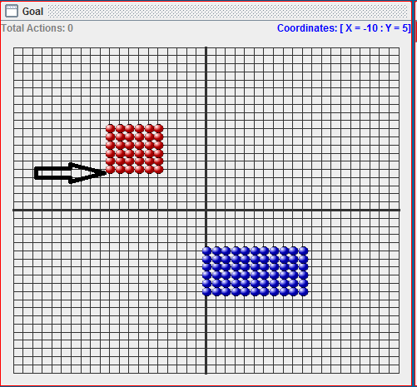
Results
Strong need for Tutorial Mode
Visual cues

Slide 18
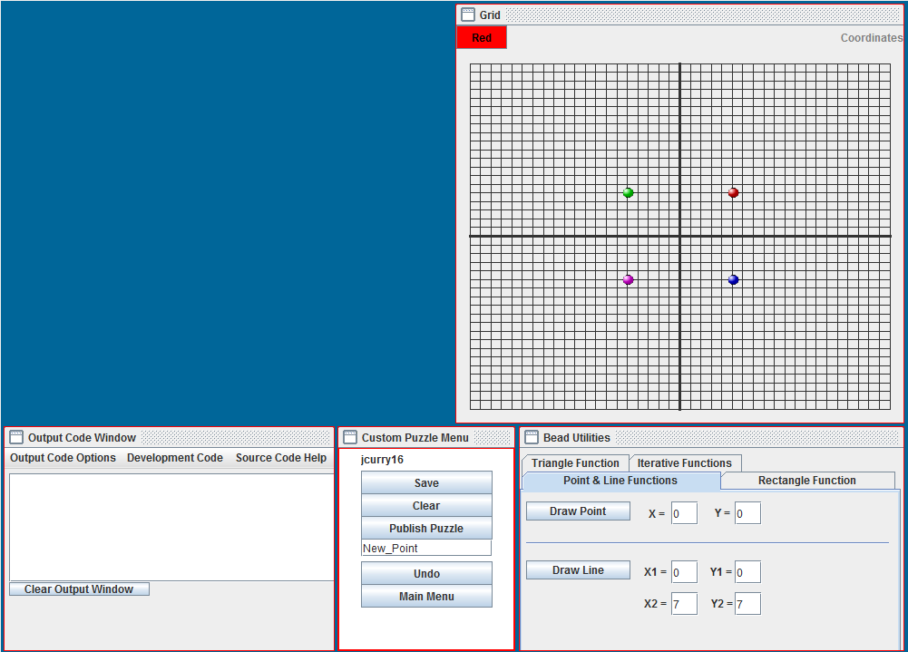
Creation Challenge
Need for Custom Puzzles Challenge
Simplicity of puzzle creation
Function Mastery
Iteration on all puzzles

Slide 19
Creation Challenge
Function Used | Point Value
Point | 5 points
Line | 4 points
Rectangle | 3 points
Triangle | 2 points
Triangle Iteration | 1 point
Linear Iteration | 1 point

Slide 20
Research Methods
Pencil and Paper Trial
Participants
36 completed
18 on going

Slide 21
Creation Challenge Results
Advanced motivation
Preferred 100 point
challenge
High complexity
using 25 and 50 pts.
69%
31%
Notes:
Add % on bar graph

Slide 22
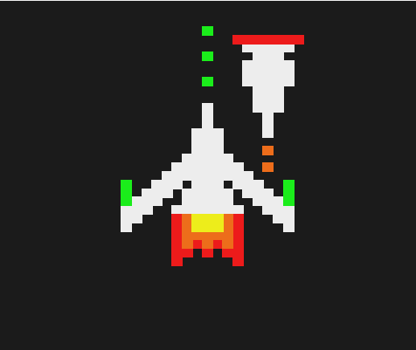
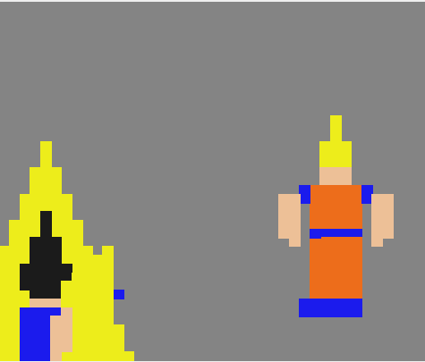
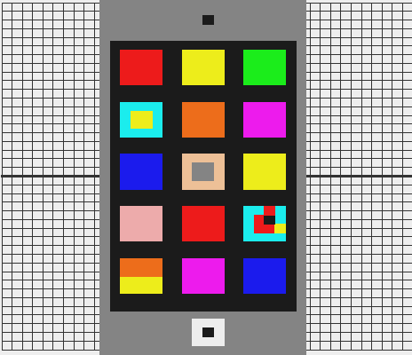
Creation Challenge
100 Challenge
50 Challenge
25Challenge
Notes:
Retro bead

Slide 23
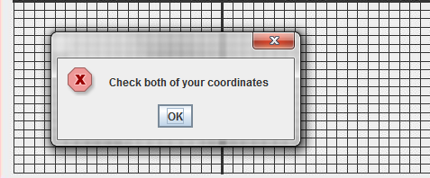
Future Work
Tutorial Mode
Full integration
Creation Challenge
Unlocking Points vs. Set Point Limits
Full integration
Study on full impact

Slide 24
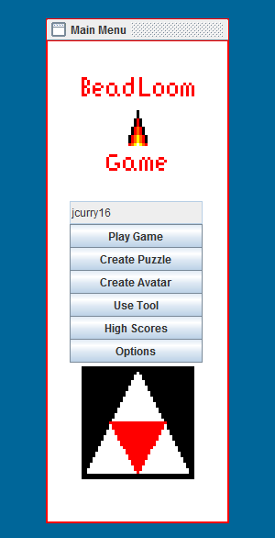
STARS Artifact
Audience: 6-12
Purpose:
to teach middle
school students iteration

Slide 25
Questions?

Slide 26
Thank You!
Jonathan Curry
jcurry16@uncc.edu
Acey Boyce Dr. Tiffany Barnes
akboyce@uncc.edu tiffany.barnes@uncc.edu
UNC Charlotte

