Slide 1
Creation of A New Culturally Situated Design Tool
Shaun G. Pickford
Dream Team
Antoine Campbell
acampbel@uncc.edu
Dustin Culler
daculler@uncc.edu
Advisor
Dr. Tiffany Barnes
Tiffany.Barnes@gmail.com
Graduate Advisors
Acey Boyce
akboyce@uncc.edu
Drew Hicks
ahicks37@uncc.edu

Slide 2
Problem
Shaun Pickford – Creation of a new CSDT

Slide 3
Fostering interest in computer science with K-12 students.
How is this done?
Teach them CS concepts but don’t let them know they’re learning!
Show them what they are capable of creating.
Make it fun!
Shaun Pickford – Creation of a new CSDT

Slide 4
The $1,000,000 question…
Q) How can we show that computer science can be fun while teaching programming concepts?
A) Games and Design Tools!
Shaun Pickford – Creation of a new CSDT

Slide 5
Background Research
A Tale of Two Online Communities: Fostering Collaboration and Creativity in Scientists and Children
Cecilia R. Aragon, Sarah S. Poon, Andres Monroy-Hernandez, Diana Aragon
Making University Education more like Middle School Computer Club: Facilitating the Flow of Inspiration
Alexander Repenning, Ashok Basawapatna, Kyu Han Koh
Designing Games for Learning: Insights from Conversation with Designers
Katherine Isbister, Mary Flanagan, Chelsea Hash
Culturally Situated Design Tools: Ethnocomputing from Field Site to Classroom
Ron Eglash, Audrey Bennett, Casey O’Donnell, Sybillyn Jennings, Margaret Cintorino
Shaun Pickford – Creation of a new CSDT

Slide 6
Background Research
Shaun Pickford – Creation of a new CSDT

Slide 7
Motivation
Shaun Pickford – Creation of a new CSDT

Slide 8
Shaun Pickford – Creation of a new CSDT

Slide 9
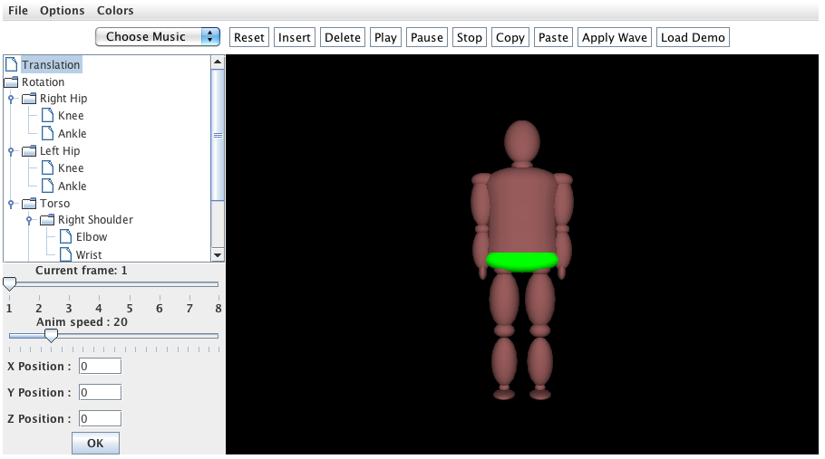
BreakDancer
Shaun Pickford – Creation of a new CSDT

Slide 10
Solution
Shaun Pickford – Creation of a new CSDT

Slide 11
3 Step Process
Shaun Pickford – Creation of a new CSDT

Slide 12
Solution
Shaun Pickford – Creation of a new CSDT

Slide 13
Dance Tool
Shaun Pickford – Creation of a new CSDT

Slide 14
Hypotheses
Utilize the cultural aspects of the BreakDancer CSDT and make it into a Design Tool.
Create an intuitive and simple interface for the Design Tool to allow players to easily program dancers and fully execute a custom dance.
Shaun Pickford – Creation of a new CSDT

Slide 15
Enter Dance Tool
Shaun Pickford – Creation of a new CSDT

Slide 16
Tools of the Trade
Shaun Pickford – Creation of a new CSDT

Slide 17
Extreme Makeover Dance Tool Edition
Shaun Pickford – Creation of a new CSDT

Slide 18
Dance Tool GUI
Shaun Pickford – Creation of a new CSDT

Slide 19
Extreme Makeover Dance Tool Edition
Shaun Pickford – Creation of a new CSDT

Slide 20
Unruly Dancers
Shaun Pickford – Creation of a new CSDT

Slide 21
Extreme Makeover Dance Tool Edition
Shaun Pickford – Creation of a new CSDT

Slide 22
Massive Multi-Level Tiered Data Structure

Slide 23
MMLT Data Structure Key Points
Shaun Pickford – Creation of a new CSDT

Slide 24
Demo Video
Shaun Pickford – Creation of a new CSDT

Slide 25
Initial Play-Testing / Feedback
Shaun Pickford – Creation of a new CSDT

Slide 26
Initial Play-Testing / Feedback
Comments:
“Its cool!”
“I loved it!”
“Pretty fun!”
Suggestions for improvement:
“Add way more moves and songs”
“song database and customizable outfits. get rid of max. oh yea.. volume control would be nice. the comp master volume is on its lowest and the game is still loud.”
“instructions on the side of the page”
Shaun Pickford – Creation of a new CSDT

Slide 27
What I Learned
Shaun Pickford – Creation of a new CSDT

Slide 28
Future Work
Improved Animations.
Tutorials.
Challenges and Game Aspects.
Larger song selection.
Teach looping and functions.
Dance sharing and collaboration.
Formal Testing and Analysis.
Shaun Pickford – Creation of a new CSDT

Slide 29
Questions/Comments?
Shaun Pickford – Creation of a new CSDT

Slide 30
Thank You!
Shaun G. Pickford
sgpickfo@uncc.edu
Advisor
Dr. Tiffany Barnes
tbarnes2@uncc.edu
Graduate Advisors
Acey Boyce
akboyce@uncc.edu
Drew Hicks
ahicks37@uncc.edu
Dream Team
Antoine Campbell
acampbel@uncc.edu
Dustin Culler
daculler@uncc.edu

Slide 31
Sample Dance

