Slide 1
Visualization of Storm Surge Time-Varying Data
Rye Yauilla
Visualization Lab

Slide 2
Introduction
Hurricane Isabel: Outer Banks of North Carolina.
The dataset:
ADCIRC storm surge model
has been approved by FEMA
792 time steps
520,000 triangles
260,000 vertices.

Slide 3
Objectives
simulate a combination of time steps in a way that makes their relationships easier to understand
contribute something new to the existing temporal data display methods.

Slide 4
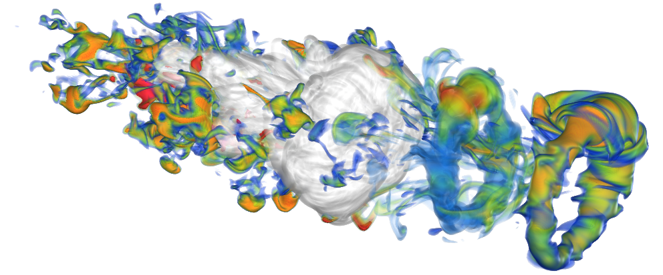
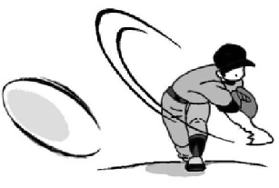
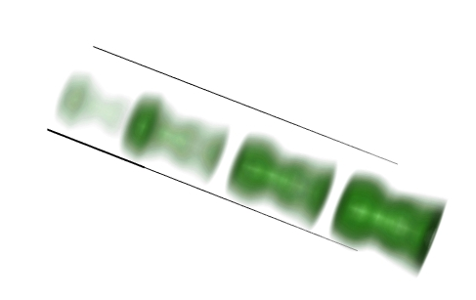
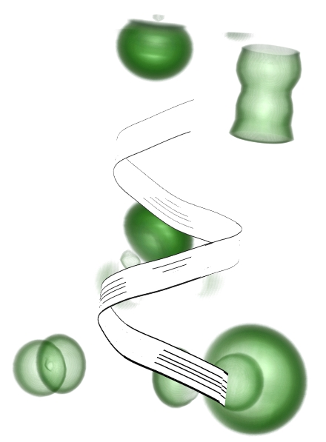
Previous Research
non-photorealistic rendering
Speed lines
Illustration-inspired techniques for visualizing time-varying data Alark Joshi and Penny Rheingans
Chronovolumes: A Direct Rendering Technique for Visualizing Time- Varying Data Jonathan Woodring and Han-Wei Shen
Depicting Time Evolving Flow with Illustrative Visualization Techniques Wei-Hsien Hsu, Jianqiang Mei, Carlos D. Correa, and Kwan-Liu Ma
Strobe silhouettes
flow ribbons

Slide 5
Part I: Aesthetics
Original image

Slide 6
New Colors: Inspiration
Three perceptual dimensions of color:
Saturation
Hue
Luminosity
Color Family: difference in hue, with similar low saturation and dark luminosity
ColorBrewer.org: An Online Tool for Selecting Colour Schemes for Maps Mark Harrowerand Cynthia A. Brewer The Cartographic Journal

Slide 7
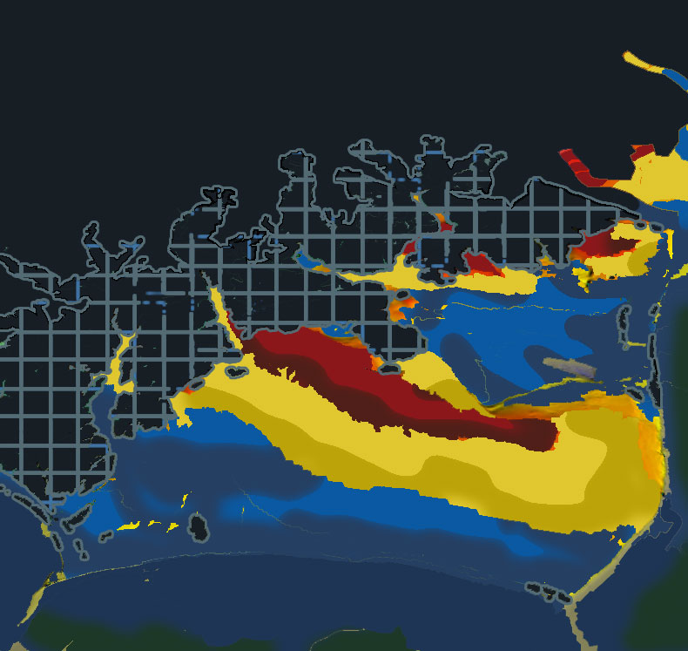
Plans
Screenshot
Photoshop Rendering

Slide 8
New Colors

Slide 9
Color
Same colors: different order and value
New Color Order: based on Homeland Security Advisory System
It uses threat levels Green, Blue, Yellow, Orange and Red, to show increasing danger
shows increasing water level
not only an aesthetic aspect, but can also be used to show information based on a scale.
Colors in same color family

Slide 10
Lighting
Lighter
Darker

Slide 11
Lighting
visualization became darker after color change
Changed properties of light and materials
Light: light position and light ambiance
Materials: emission, ambiance, specular and shininess
brightened visualization
GLfloat light_position[] = { 0.0, 1.0, 1.0, 0.0 };
GLfloat LightAmbient[]= { 0.0, 0.0, 0.0, 1.0 };

Slide 12
Lighting
Original Lighting
New Lighting

Slide 13
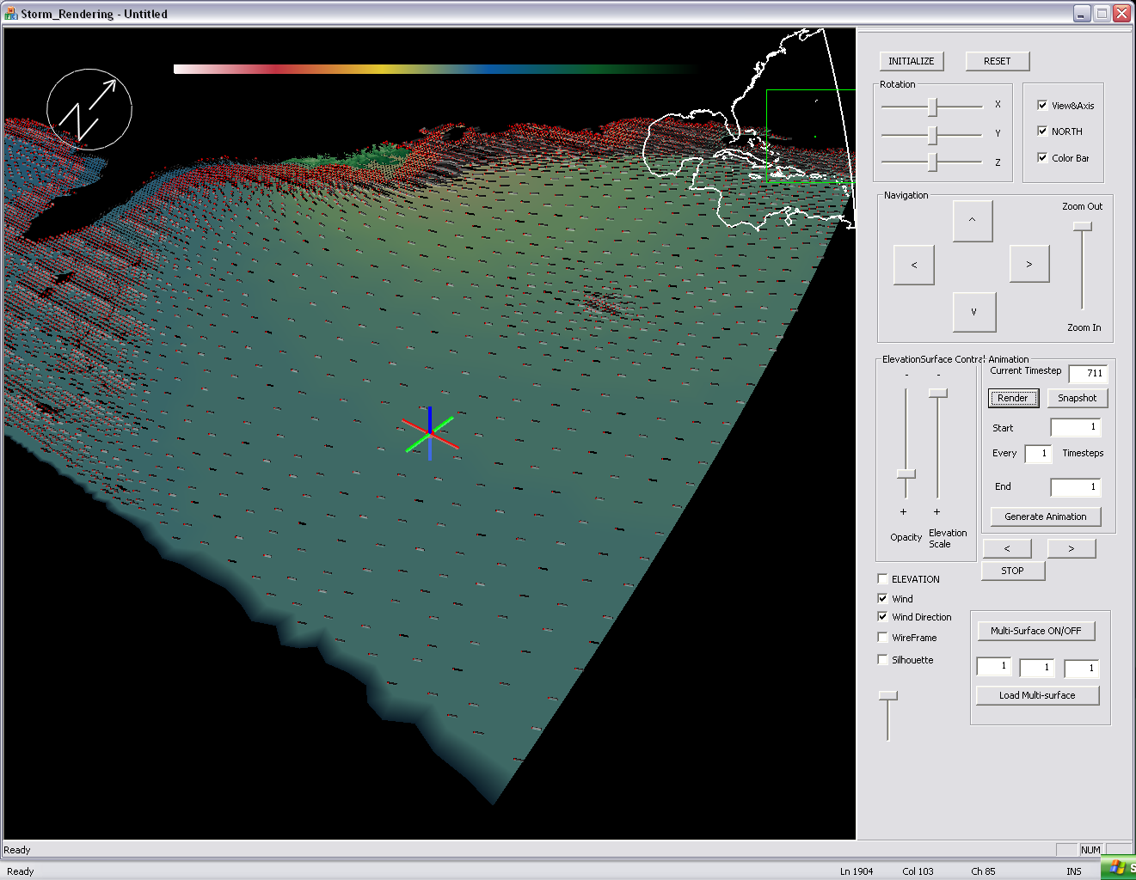
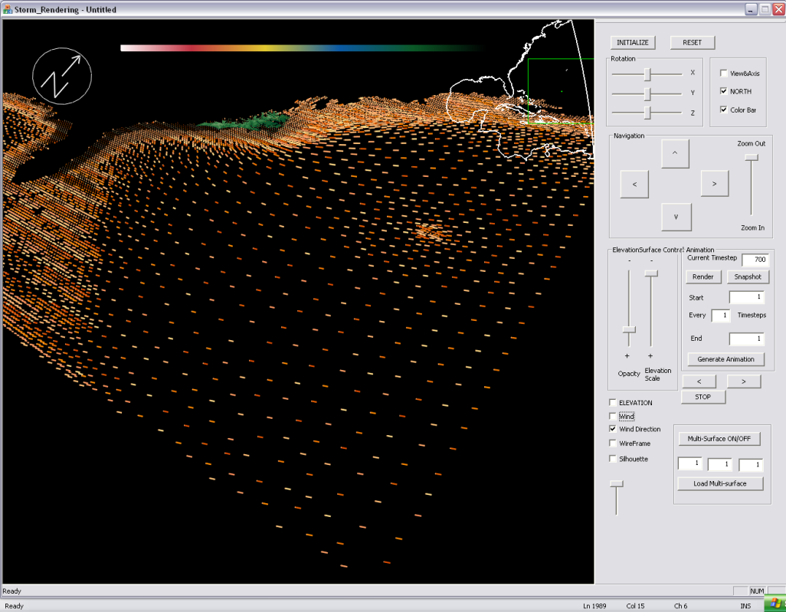
Part II: Visualization

Slide 14
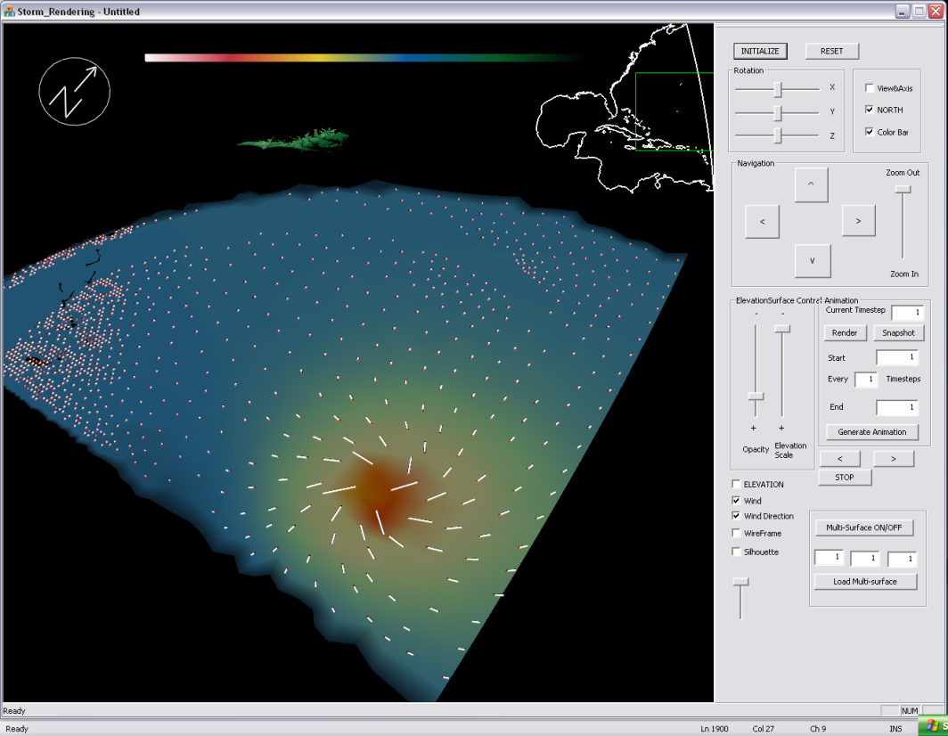
Wind Direction
Original white lines

Slide 15
Wind Direction
added color to lines to also show wind speed
different information is more effectively presented in single visualization
because they are lines, you can show other things in the background such as water elevation

Slide 16
Shades of Red
Used different values of a single color to show wind speed

Slide 17
Elevation Color Scale
Uses the color scale for water elevation to show wind speed
Uses an array to project multiple colors from the scale onto the lines
Hard to see patterns with this visualization/ too much information

Slide 18
Solution
Created a new color scale
Four closely related colors: white, yellow, orange, and red
Used values from original color bar to stay in same family
Sequential Color Scheme: luminosity scale
Visualization and patterns more clear

Slide 19
Time Steps
program can display three different time steps
experimented with blend functions and transparency
transparency used to suggest older time steps in sequence

Slide 20
Implementation
used Open GL
creates 3D applications, hardware independent interfaces, and uses C++
Background in web design and graphic design
Learning to work in the program was my biggest personal challenge

Slide 21
Impact
Helps scientists to visualize temporal datasets
Time in two and three dimensions
Transparency and illustration techniques
Improves comparative visualization
time steps are shown simultaneously
More details
Introduces more aesthetics and design into scientific visualization.
Smart color relationships can emphasize data patterns

Slide 22
Conclusions
Our method of showing multiple time steps within the three dimensional framework is a much more effective technique than using the original animation scheme.
Because of the movement of the hurricane, it is easy to compare time steps side by side

Slide 23
Future Work
Future work will add other methods besides transparency.
It is hoped that this project will add something new to the existing temporal data display methods.

Slide 24
Thank you! Questions?

