Slide 1
Twitterpedia
Visualization Lab
By: Thomas Kraft

Slide 2
Problem
Overview
Current State
Future
What is being talked
about and where?
Twitter has massive amounts of data
Tweets are unstructured
Goal: Quickly identify current events / topics on a large scale

Slide 3
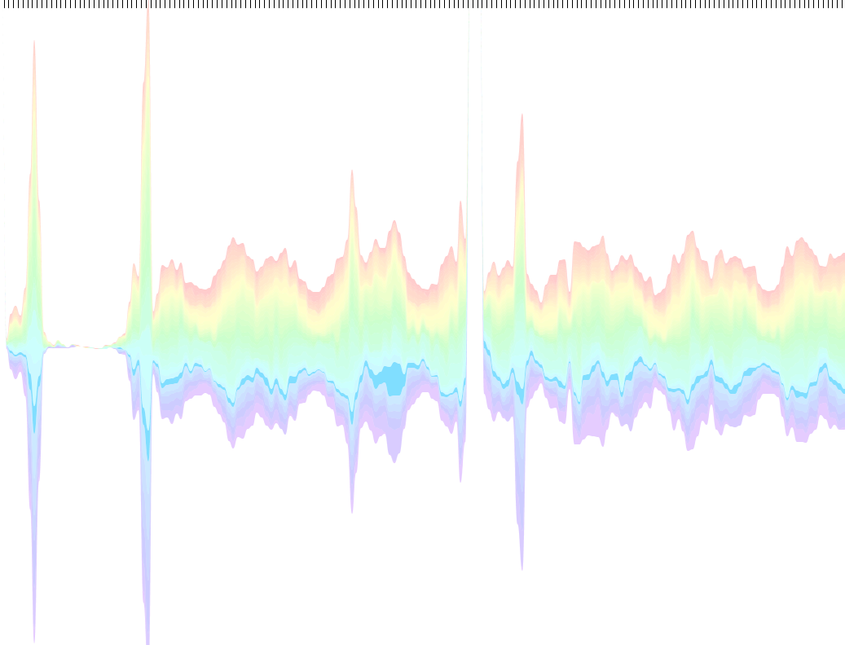
What Needs To Be Done
Overview
Current State
Future
Data Collection
Database
Web Crawler
Analyze Data
Topic Modeling
Get Trends and topics!

Slide 4
Hadoop
Overview
Current State
Future
Processes large datasets
Splits data into chunks
Data processed on multiple machines
Very Scalable
Add/remove computers easily
As dataset grows so can # of machines

Slide 5
Computer Cluster
Overview
Current State
Future

Slide 6
Topic Modeling
Overview
Current State
Future
Latent Dirichlet Allocation (LDA)
Correlations between words in topics
Topics composed of keyword groups
Tweets topic can effectively be inferred

Slide 7
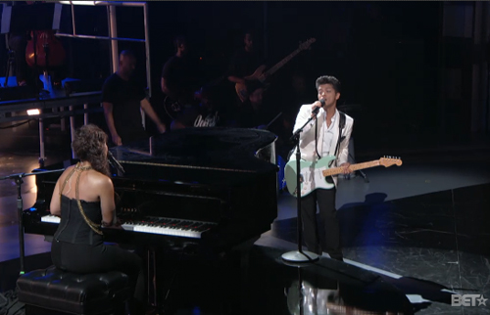
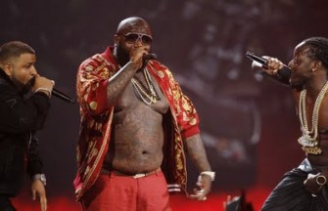
Overview
Current State
Future
June 26, 2011
“Bruno & alicia! I love it!”
“Can Rick Ross Please put his clothes on?”

Slide 8
Challenge
Overview
Current State
Future
Topic Modeling Resource Intensive
Iterates over data
Single Computer can’t
handle large dataset
Solution: Parallelize
the process

Slide 9
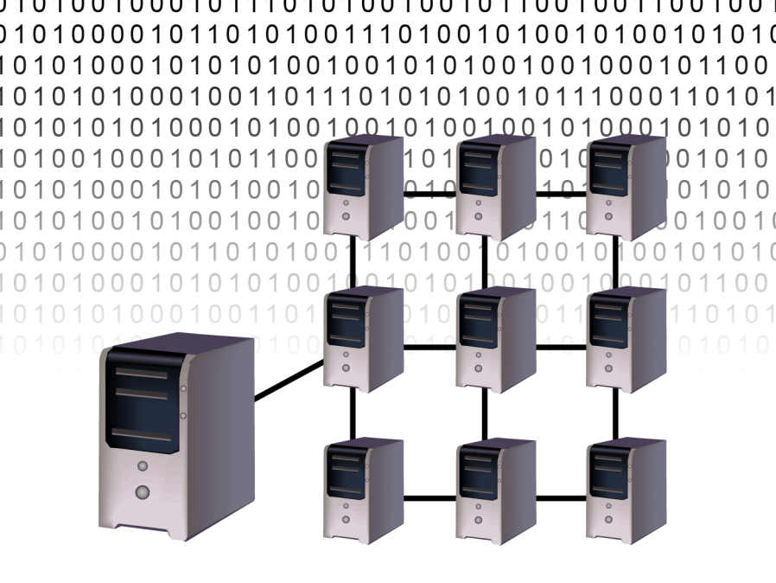
Parallel - LDA
Overview
Current State
Future
Write algorithm to split up tweets and join output
Improves scalability for LDA
Shows near linear improvements
PLDA will take twitterpedia to next level
Larger datasets with quicker processing

Slide 10
Future
Overview
Current State
Future
Write algorithm to parallelize tweet distribution and aggregation
Create website implementing topics

Slide 11
Conclusion
Overview
Current State
Future
Working on this project has been a great learning experience
Designed and managed a large database
Efficiency high priority
Learned cool tricks along the way…

Slide 12
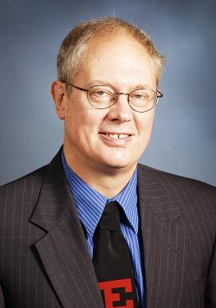
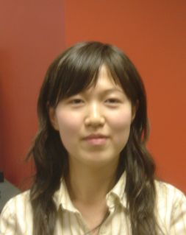
Thanks
Overview
Current State
Future
A Special thanks to my advisor Xiaoyu Wang, Wenwen Dou, and to the Visualization Center
Thomas Kraft : tbkraf08@stlawu.edu

Slide 13
Questions?

