Slide 1
BeadLoom Game: Effective Practices in Game Tutorial Systems
Amy Shannon
Games + learning lab
With Chitra Gadwal, Acey Boyce, and Dr. tiffany Barnes

Slide 2
The Problem:
How to design an effective game tutorial?
The Problem
Evolution of BLG
Method
Results
Conclusion
Notes:
Two “great debates” in tutorial design that we had to consider.
First: strategy in providing feedback
Second: learning strategy

Slide 3
The First Great Debate: Feedback
Cognitive
Affective
Notes:
Struggle between 2 competing strategies for providing feedback and correction.
Cognitive = knowledge based “right, wrong”
Affective = emotional “good, bad”

Slide 4
The First Great Debate
Cognitive Feedback
More effective for learning improvement
Does not address self-efficacy
Affective Feedback
Increases confidence and motivation
“Right”
“Do this instead”
“Wrong”
“Good Job”
“You can do it!”
“Try again”
Notes:
Major Issue: these strategies conflict, so it is not possible to have a single strategy that is both cognitive and affective.

Slide 5
The First Debate: RESOLVED
Positive Cognitive Feedback
“Correct!”
“Right, but…”
Even if
the student is wrong!
Notes:
Why? Based on literature and research in this area, best possible learning gains by using cognitive strategy.
Focus on the positive provides motivation and confidence.

Slide 6
The Second Great Debate: Learning Strategy
Guided
Free Play
Notes:
Struggle between 2 competing learning strategies:
Guided = traditional lecture, teacher or program strictly limits activity
Free Play = exploratory learning, no limits to activity

Slide 7
The Second Great Debate
Guided Learning
On-task
Free-Play Learning
Set individual pace
Exploratory
Notes:
Constant Balancing Act
Same struggle teachers face in a normal classroom when there are students with different strengths and abilities that need to reach a common goal.

Slide 8
The Second Debate: RESOLVED?
Extended Process of Trial and Error
Using the BeadLoom Game
Notes:
Resolving this debate became the focus of our research.
Through evolution of tutorial using BLG, we explored both these strategies and arrived at an effective solution for tutorial design.

Slide 9
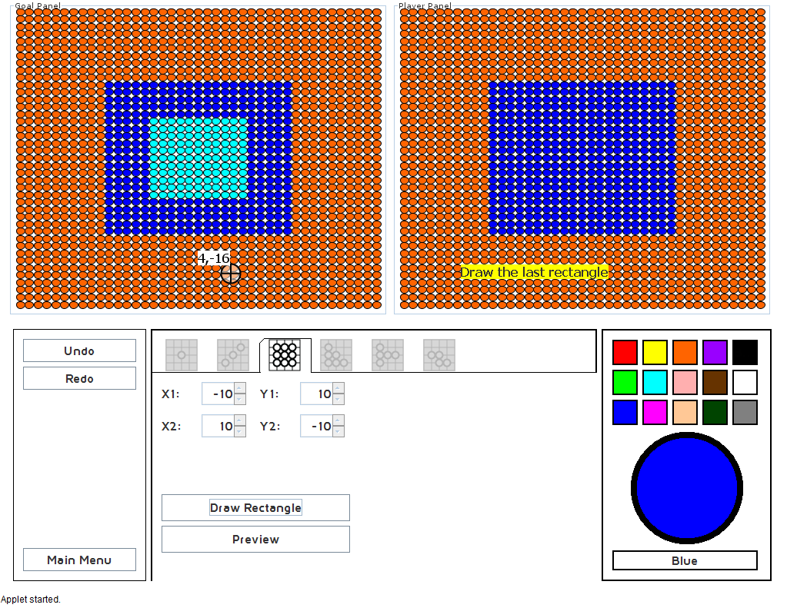
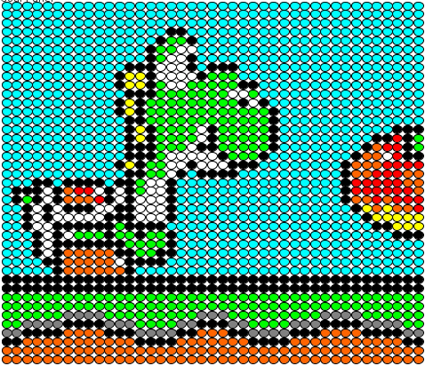
What is BeadLoom Game (BLG)?
Designed to teach:
Cartesian coordinates
Graphing
Layering
Iteration
Goal:
recreate puzzle
fewest number of moves
use graphing tools
Custom Puzzle Mode
Based on Native American culture
Notes:
Before we jump in to the research, here is some background on the BeadLoom Game.

Slide 10
Evolution of BLG Tutorial
resolving the debate
The Problem
Evolution of BLG
Method
Results
Conclusion
Notes:
Process of resolving the debate between guided learning and free-play learning
Our main goal was to develop a tutorial that would actually teach students without boring them.

Slide 11
Evolution of BLG Tutorial
Free-Play Only
How to Play
Guided Only
New Tutorial System
Positive cognitive feedback
Guided learning THEN free-play for each tutorial
Short bursts of information
Notes:
Our first iteration of the BLG Tutorial consisted of easy puzzles that students were told to play on their own.

Slide 12
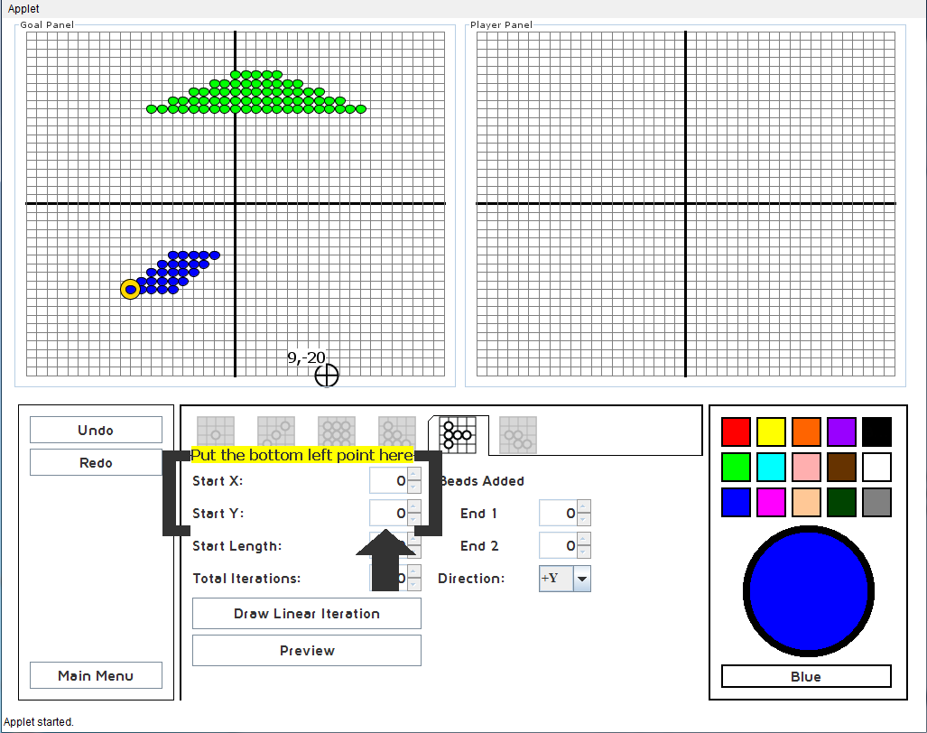
BLG Tutorial System
Notes:
Guided to create blue shape. Limited behavior. Minimal text.
Free to create green shape. Hints immediately provided if mistake is made.

Slide 13
Method
Tested tutorials at our
middle school summer camp
The Problem
Evolution of BLG
Method
Results
Conclusion
Notes:
After we implemented the new tutorial system for BLG, we put it to the Ultimate Test: middle schoolers!

Slide 14
Method
Pre-test
Play tutorials
Play full game and custom puzzle mode
Post-test
All moves and scores logged during game play
Sample test questions? image
Notes:
Questions include: how many rectangles to draw flag including the white stripes (8)? Fill in step to create this iteration?

Slide 15
Results
How effective was our
tutorial system?
The Problem
Evolution of BLG
Method
Results
Conclusion

Slide 16
Results
Students performed significantly better!
t(15) = 7.92, p < .001, d = .87, on the post test (M = 7.02, SD = 2.95) than on the pretest (M =4.60, SD = 2.60).
Notes:
Cohen's d indicates that students improved from pretest to post test by .87 of a standard deviation.
Important things to note: every student improved.
Time to complete the tutorials was significantly less.
Higher percentage of tutorial completion

Slide 17
Conclusion
What did we learn from our design choices?
Future work
Why it mattered
The Problem
Evolution of BLG
Method
Results
Conclusion

Slide 18
Conclusions
Transfer of Information:
Short bursts of information
Use visual cues rather than text
Avoid Pop-Ups
Provision of Feedback:
Individualized for students
Immediately provided
Positive cognitive feedback
Learning Strategy:
Guided THEN Free-Play for each tutorial level
Notes:
Why did we conclude that pop-ups should be avoided? Everyone just closes them without reading.

Slide 19
Future Work
1. Implement study to determine effectiveness of pop-ups.
2. Require ideal solution for tutorial completion.
?
Notes:
We designed a study where ALL tutorial instructions are given via pop up windows.

Slide 20
References and Acknowledgements
For Full References, Visit
reusummer2012.weebly.com
Acey Boyce and Tiffany Barnes. 2010. BeadLoom Game: using game elements to increase motivation and learning.
Boyer, Phillips, Wallis, Vouk, Lester. 2008. Balancing Cognitive and Motivational Scaffolding in Tutorial Dialogue.
Gratitude is expressed to:
Games + Learning Lab,
University of North Carolina at Charlotte
www.game2learn.com

Slide 21
Questions?

